Slide 1
Doing researching and experimentation

Slide 2
Cycles in writing and publication
Doing research
Shaping a research projects
Finding and reading literature
Research planning
Hypotheses
Evidence
Experiment
Writing
Notes:
提纲1

Slide 3
Cycles in writing and publication
Experiment
Designing experiments
AI experiments
Dataset
Measurements and coding
Statistics
Designing experiments using AI
Notes:
提纲2

Slide 4
Cycles in writing and publication
Experiment
Doing research
Designing experiments
Shaping a
research projects
AI experiments
Finding and
reading literature
Writing
Dataset
Research planning
Measurements and coding
Hypotheses
Statistics
Evidence
Designing experiments
using AI
Notes:
提纲1

Slide 5
Shaping a research projects
Experiment
Doing research
Designing experiments
Shaping a
research projects
AI experiments
Finding and
reading literature
Writing
Dataset
Research planning
Measurements and coding
Hypotheses
Statistics
Evidence
Designing experiments
using AI
Notes:
提纲1

Slide 6
Research Guides
The research topic is usually defined as a problem that needs investigation to gain deeper understanding or develop effective solutions
The research problem serves as the guiding principle for analysis and writing focus
It forms the core of scholarly communication and drives the discovery of new knowledge
Notes:
研究是什么
研究主题通常被定义为一个需要研究以获得更深理解的问题，从而提出解决方案或更有效的实践方法。
研究问题是引导研究分析的主要原则，是撰写和表达的核心焦点。
研究代表了学术交流的核心内容，并帮助学者探索新知识和理解。

Slide 7
How to begin your analysis
Four roles literature plays at the beginning of your analysis:
Sources of criticism
Sources of new ideas
Sources for historical context
Sources of interdisciplinary insight
Notes:
参考文献在研究起步阶段的四个重要角色

Slide 8
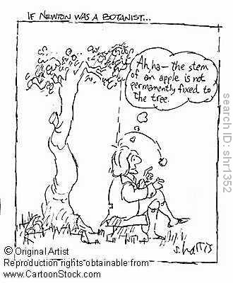
Beginnings
The origin of a research investigation is typically a moment of insight
Research ideas often come to mind when the brain is idling
Separate topics coincidentally arise at the same time to form an idea
Tea-room arguments are also a rich source of seed ideas
Notes:
idea的三个来源
头脑空闲时
多个topic汇聚
茶歇讨论

Slide 9
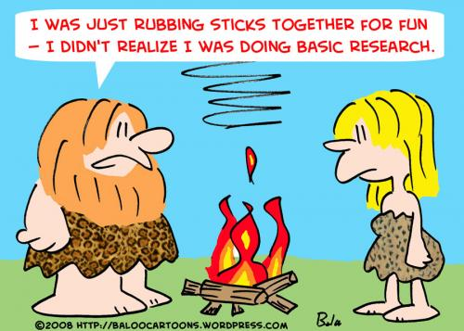
Beginnings
The first step to choose to explore ideas that
seem likely to succeed
are intriguing
have the potential to lead to something new
contradict received wisdom
At this stage, it isn't possible to know whether
the work can lead to valuable results
Otherwise there would be no scope for research
Notes:
此页主要介绍科研开始时要选择哪种类型的idea

Slide 10
Shaping a research project
How a potential research topic is shaped into a concrete project depends on context
Experienced scientists aiming to write a paper on a subject of mutual interest tend to be fairly focused
They quickly design a series of experiment or theoretical goals, investigate the relevant literature, and set deadlines
Notes:
研究项目的形成取决于上下文(研究背景)
将一个潜在的研究主题转变为一个具体的研究项目，这个过程依赖于具体的上下文或背景。这意味着研究的具体方向和形式可能会根据研究环境、可用资源和研究者的兴趣而有所不同。
经验丰富的科学家倾向于专注
经验丰富的科学家在撰写关于共同感兴趣主题的论文时，通常会保持相当专注。他们能够迅速确定研究的焦点，确保研究工作有明确的方向。
快速设计实验或理论目标
这些科学家通常会迅速设计一系列实验或确定理论目标，调查相关文献，并设定截止日期。这说明他们在开展研究时有明确的计划和时间管理，以确保研究项目的顺利推进。

Slide 11
Choosing a Research Problem
You are given the topic to write about
Identify concepts and terms that make up the topic statement
Review related literature to help refine how you will approach examining the topic and finding a way to analyze it
Look for on-line resource that can help broaden, modify, or strengthen your initial thoughts and arguments
Start composing the outline and finding gaps appear in how you want to approach the study
Notes:
前提：学生被给予课题去写论文
建议：
1. 明确术语和概念
2. 浏览相关文献
3. 寻找在线资源
4. 撰写大纲并找到和理想情况的差距

Slide 12
Choosing a Research Problem
You are provided a list of possible topics to choose from
Never include a topic that is so obscure or complex that no research is available to examine and from which to design an effective study
Don't approach a list of possible topics to study from the perspective of trying to identify the path of least resistance
Choose a topic that you find interesting in some way
that is controversial
that you have a strong opinion about
that has some personal meaning for you
that relates to your major
Notes:
背景: 学生被给予了一系列课题去选择
建议：
不要选择一个困难复杂到无法用实验去验证的课题
同时不要选择非常简单的课题
要选择具有以下特征的问题：
1. 有争议的
2. 自己观点鲜明的
3. 有个人意义的
4. 符合自己专业的

Slide 13
Choosing a Research Problem
Your professor leaves it up to you to choose a topic
The key process is turning an idea or general thought into a topic that can be configured into a research problem
When given an assignment where you choose the topic
Don't begin by thinking about what to write about
Ask yourself the question, "What do I want to understand or learn about?"
To build upon your initial idea, use suggestions in the following slides to help narrow or broaden your idea so you can write it out as a research problem
Notes:
导师让学生选择研究问题
根据下两页的PPT内容放缩自己的idea

Slide 14
Narrow Your Research Topic
Aspect -- choose one lens through which to view the research problem
Components -- determine if your initial variable of analysis can be broken into smaller parts
Methodology -- the way in which you gather information can reduce the domain of interpretive analysis
Notes:
在计算机科学或AI研究中，选择一个特定的方面或视角来研究问题是非常重要的。例如，在研究机器学习算法时，你可能会选择关注模型的可解释性、训练时间的优化，或者是算法在特定数据集上的性能。
计算机科学研究通常涉及复杂的系统或算法，研究人员需要将其分解成更小的组件。例如，在研究一个复杂的系统架构时，可以将其分解为多个模块或子系统，每个模块可以单独进行分析和优化。
在计算机科学和AI研究中，方法论的选择决定了如何收集和分析数据。例如，研究人员可能会使用实验设计、模拟、数据挖掘或统计分析来减少解释性分析的范围。

Slide 15
Broaden Your Research Topic
You can't find enough information and what you do find is tangential or irrelevant
You find information that is so specific that it can't lead to any significant conclusions
Your sources cover so few ideas that you can't expand them into a significant paper
The significance of the research problem is limited to only a very small, unique area
Notes:
信息不足或不相关：在计算机科学和AI领域，如果你发现现有的文献或数据非常有限或与研究主题没有直接关系，这可能是一个信号，表明研究问题过于狭窄。
过于具体的信息：当你找到的信息过于具体，无法得出有意义的结论时，表明研究主题可能过于狭窄。 例如，如果你研究某种特定数据集上的表现，但这个数据集非常小或特殊，可能无法推广到其他情况，你可能需要扩大研究的适用范围或引入更多的数据集来获得更广泛的结论。
来源覆盖的想法有限：如果你的信息来源非常有限，无法支持一篇有深度的研究论文，可能意味着你的研究范围过于狭窄。
研究问题的意义有限：如果研究问题的意义仅限于一个非常小的、独特的领域，这可能表明需要拓宽研究主题。

Slide 16

If you lack ideas...
Review your course readings, particularly the suggested readings, for topic ideas
Search the Beihang Libraries Catalog for a recently published book and more specialized works related to the discipline area of the course
Browse through some current scholarly journals in your subject discipline. Even if most of the articles are not relevant, you can skim through the contents quickly
Think about essays you have written for other courses you have taken or academic lectures and programs you have attended outside of class
Search online news or media sources to see if your idea has been covered by the media
Notes:
缺少Idea时该如何做

Slide 17
Especially when you lack ideas in the AI field...
Explore open-source projects: Browse GitHub AI projects to see what others are working on and identify areas for improvement or expansion.
Attend AI workshops or conferences: Join AI talks, workshops, or hackathons to learn about the latest trends and research, and spark new ideas.
Following cutting-edge research groups in your field is a great way to stay informed on the latest advancements and challenges. It can help identify unresolved issues and inspire new directions for your own work.
Cross-disciplinary integration: Combine knowledge from other fields with AI to creatively address cross-disciplinary problems, leading to new research topics.
Notes:
尤其当你在 AI 领域缺少 idea 的时候可以按照下边的思路去做：
1. 可以探索 Github 等开源平台的相关资料
2. 参加 AI 领域的学术会议
3. 跟进相同领域的前沿课题组的进展
4. 跨学科融合

Slide 18

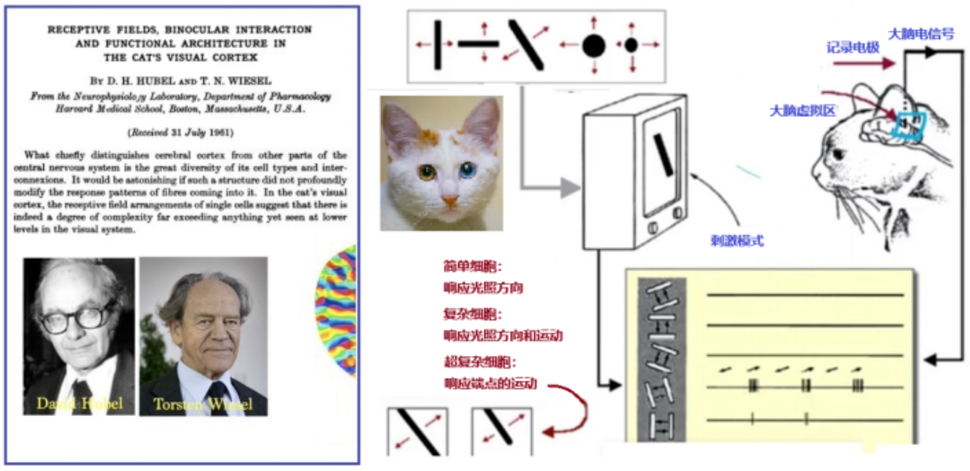
Brain inspired AI research
Convolutional Neural Networks use the concept of local receptive fields, similar to how neurons in the visual cortex focus on small regions of input data. This helps them effectively extract local features.
Notes:
其中 AI中也有许多受人脑启发的研究，比如神经网络、注意力机制等。
神经网络受生物神经的启发，由互相连接的节点组成，他们层层传递数据，从而完成图像、语音处理等工作。
其中卷积神经网络通过局部感受野的概念，模拟了生物视觉皮层中神经元的工作方式，每个神经元只关注输入数据的一部分，从而有效提取局部特征。
除此之外 大模型中常用的注意力机制也是受人脑启发。注意力机制受人脑选择性聚焦、上下文感知、资源分配、并行处理等启发，在大语言模型中发挥着极其重要的作用。
选择性聚焦：就像人类能够在复杂场景中聚焦于某些元素（例如人群中的某个人），注意力机制使模型能够更重视输入数据的不同部分，从而增强特定特征的相关性。
上下文感知：注意力机制帮助模型理解上下文，通过根据当前任务的相关性优先处理某些输入，类似于人类的注意力根据重要性进行转移。
资源分配：人脑会将认知资源分配给重要刺激，注意力机制通过动态调整处理的输入部分来模拟这一过程。
并行处理：注意力机制允许模型同时考虑多个输入方面，反映出人类能够通过同时聚焦于多个事物来进行多任务处理的能力。

Slide 19
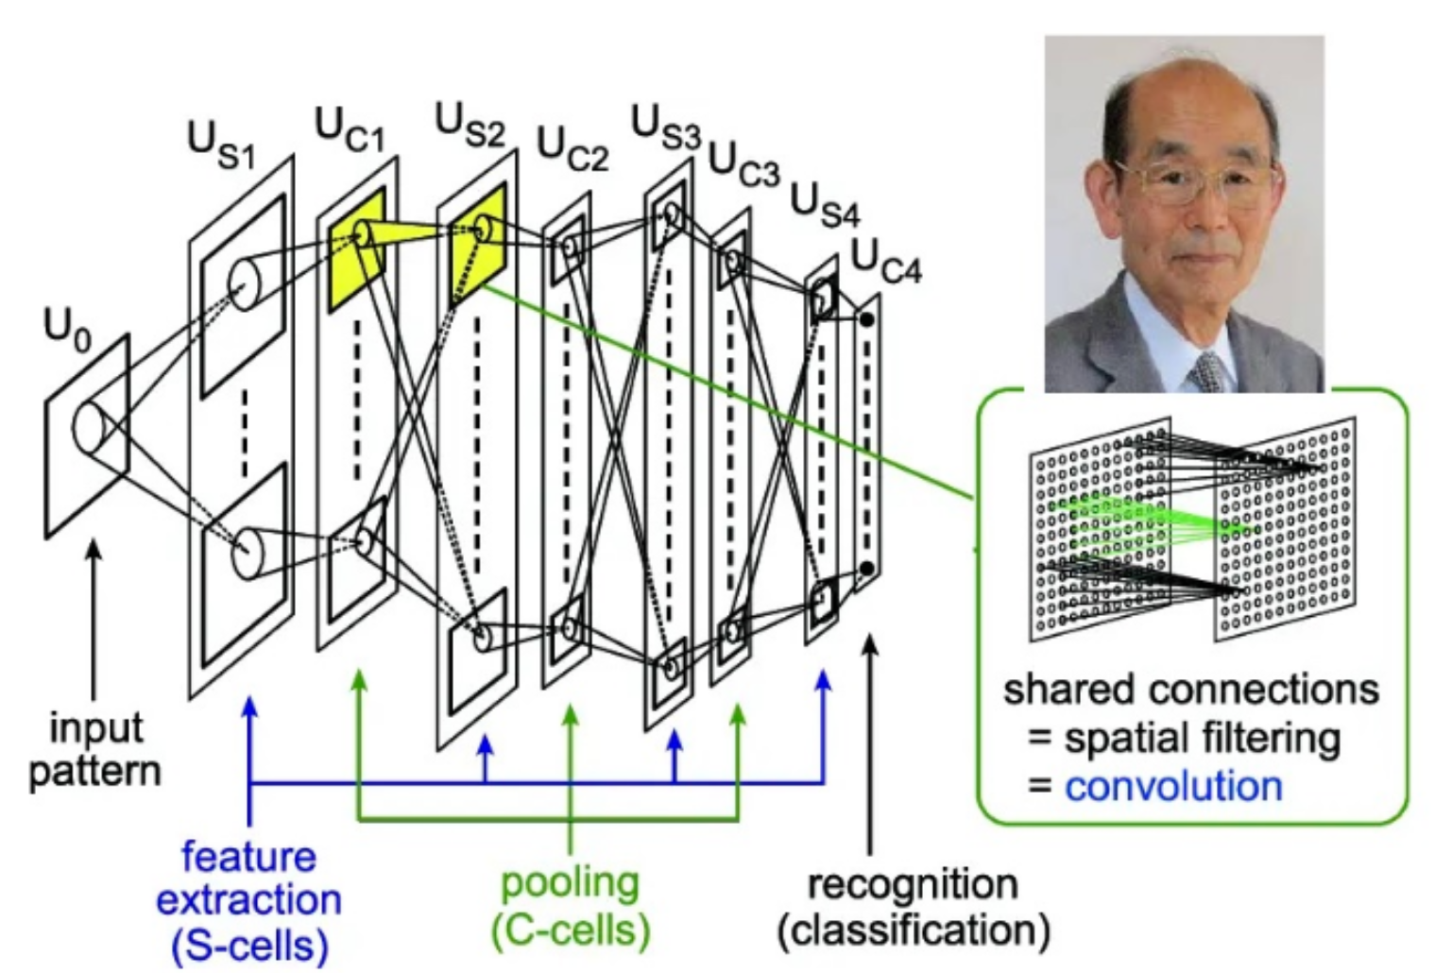
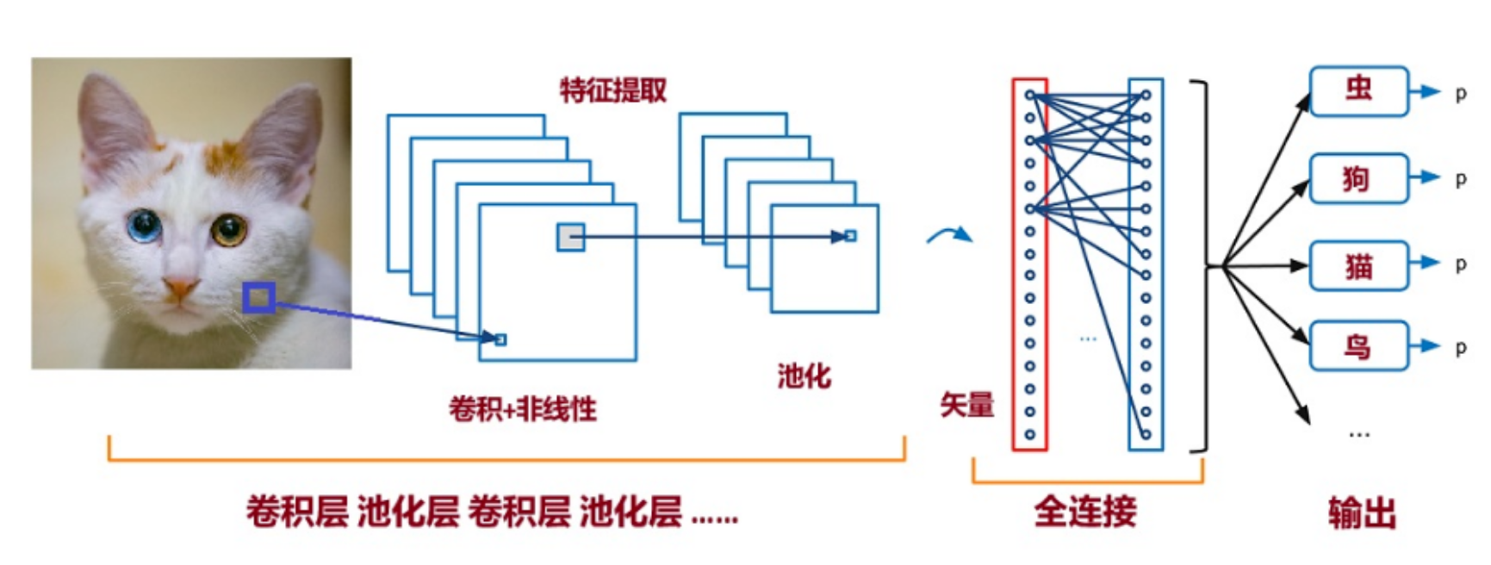
Brain inspired AI research

Slide 20
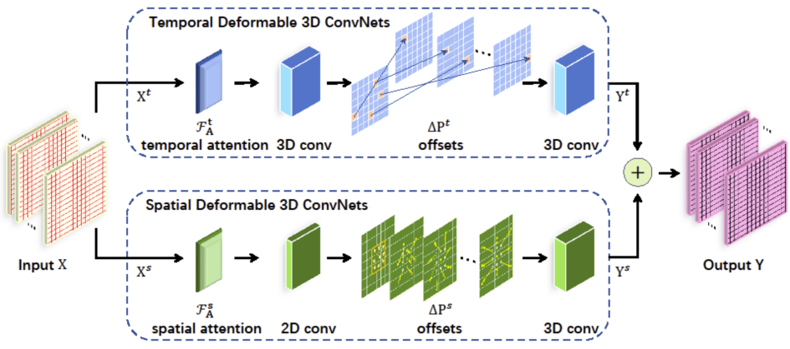
Brain inspired AI research
Attention mechanism: The attention mechanism enhances a model‘s ability to process information in a way that mirrors some aspects of human attention, like selective focus, contextual awareness, resource allocation, and parallel processing.

Slide 21
Finding and reading literature
Experiment
Doing research
Designing experiments
Shaping a
research projects
AI experiments
Finding and
reading literature
Writing
Dataset
Research planning
Measurements and coding
Hypotheses
Statistics
Evidence
Designing experiments
using AI

Slide 22

Finding research Literature
Each research project builds on a body of prior work
Doing and describing of research requires a thorough knowledge of the work of others
Google obvious search terms
Visit the web sites of research groups and researchers working in the area
Follow up references in research papers
Browse the recent issues of the journals and conferences in the area
Notes:
如何寻找研究文献

Slide 23
Finding research Literature
Search other journals and conferences that might carry relevant papers
Search the publisher-specific digital libraries
Check the program in a conference web site to find relevant papers
Use the citation indexes
Notes:
如何查找文献

Slide 24
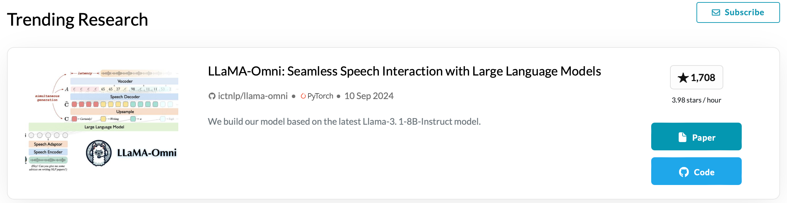
Recommended AI Platform
Arxiv
Advantage: open access, rapid dissemination, wide visibility
Disadvantage: lack of peer review, misinterpretation risks, limited impact, Inconsistent citation.
- Github
- paperwithcode
a collaborative platform that connects research papers with their corresponding code implementations
https://paperswithcode.com
Notes:
如何查找文献

Slide 25

Reading
What is the main result?
How precise are the claims?
How could the outcomes be used?
What is the evidence?
How was the evidence gathered?
How were measurements taken?
How carefully are the algorithms and experiments described?
Why is the paper trustworthy?
Has the right background literature been discussed?
What would reproduction of the results involve?
Notes:
阅读文献时需要考虑的问题

Slide 26

Reading Strategies
Focus on information that is most relevant to the research problem; skim over the other parts
Read content out of order! This isn't a novel; you want to start with the spoiler to quickly assess the relevance of the study
Think critically about what you read and seek to build your own arguments
Not everything may be entirely valid, examined effectively, or thoroughly investigated
Mark or highlight important text as you read
Take notes in the margins
Notes:
阅读相关文献的技巧

Slide 27

ideal paper in AI
State the goals of the research and the criteria by which readers should evaluate the approach. Categorize the paper in terms of some familiar class.
Specify the performance and learning tasks that are the focus of the research, clearly distinguishing between the two aspects.
Describe the representation and organization of the system's knowledge, along with the representation of training data.
Explain both the performance and learning components of the system in enough.
Notes:
理想AI论文中应该包括的内容

Slide 28

ideal paper in AI
Evaluate the approach to learning, avoiding unsubstantiated or rhetorical claims. If stating that one approach is better than others, include evidence or at least careful arguments to support these claims.
Relate the approach to other methods, discussing similarities, differences, and advances over previous research.
State the limitations of the approach and suggest directions for future research.
Source:https://icml.cc/Conferences/2002/craft.html
Notes:
理想AI论文中应该包括的内容

Slide 29
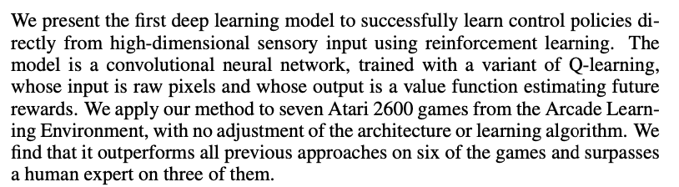
Abstract
Is this study related to my question or area of research?
What is this study about and why is it being done?
What is the working hypothesis or underlying thesis?
What is the primary finding of the study?
Are there words or terminology that I can use to either narrow or broaden the parameters of my search for more information?
2
4
Notes:
摘要部分要考虑的问题

Slide 30
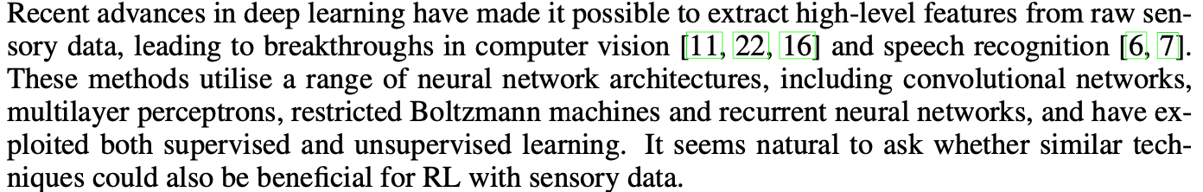
Introduction
What is this study trying to prove or disprove?
What is the author(s) trying to test or demonstrate?
What do we already know about this topic?
What gaps does this study try to fill or contribute a new understanding to the research problem?
Why should I care about what is being investigated?
Will this study tell me anything new related to the research problem I am investigating?
2
3
Notes:
介绍部分要考虑的问题

Slide 31
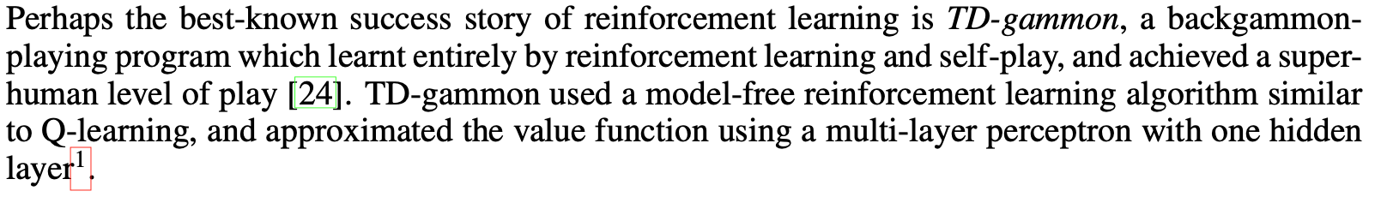
Literature Review
What other research has been conducted about this topic and what are the main themes that have emerged?
What does prior research reveal about what is already known about the topic and what remains to be discovered?
What have been the most important past findings about the research problem?
How has prior research led the author(s) to conduct this particular study?
Is there any prior research that is unique or groundbreaking?
Are there any studies I could use as a model for designing and organizing my own study?
1
Notes:
阅读相关文献介绍要思考的问题

Slide 32
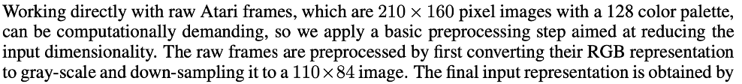
Methods/Methodology
Did the study employ a theoretical, empirical, or hybrid approach to address the research problem?
What methods were used in this study, what are the innovations and advantage, and were there any improvements made to previous methods?
What was the type of model or data used?
Could this method of analysis be repeated and can I adopt the same approach?
Is enough information available to repeat the study or should new data or model be found to expand or improve understanding of the research problem?
2
3
Notes:
阅读研究方法时要考虑的问题

Slide 33
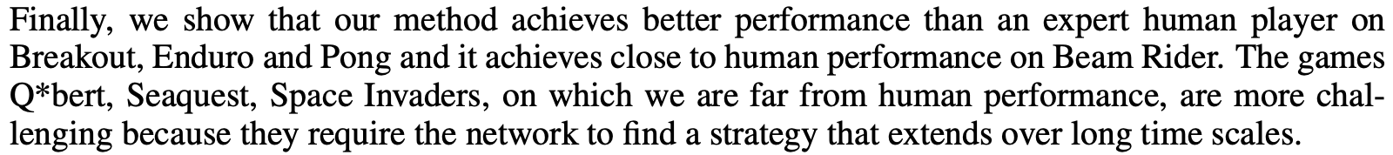
Results
What did the author(s) find and how did they find it?
Does the author(s) highlight any findings as most significant?
Are the results presented in a factual and unbiased way?
Does the analysis of results in the discussion section agree with how the results are presented?
Is all the data present and did the author(s) adequately address gaps?
What conclusions do you formulate from this data and does it match with the author's conclusions?
1
Notes:
阅读结果部分时要考虑的问题

Slide 34
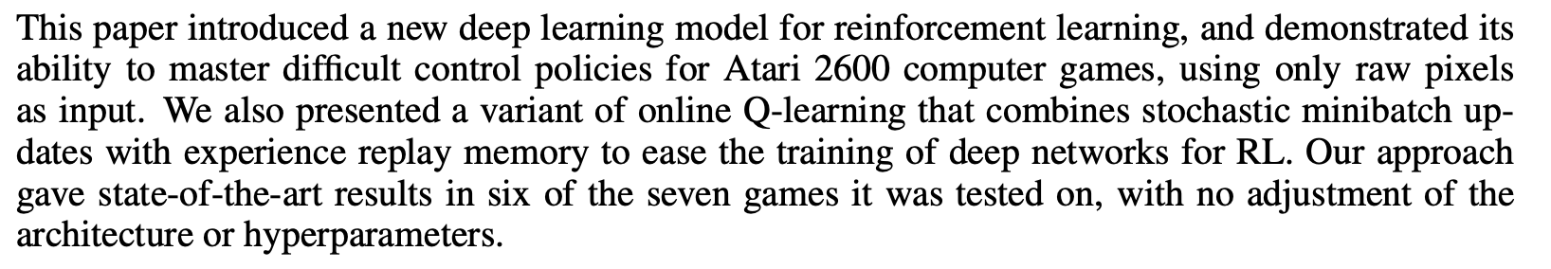
Discussion & Conclusion
What is the overall meaning of the study and why is this important?
What do you find to be the most important ways that the findings have been interpreted?
What are the weaknesses in their argument?
Do you believe conclusions about the significance of the study and its findings are valid?
What limitations of the study do the author(s) describe and how might this help formulate my own research?
Does the conclusion contain any recommendations for future research?
1
3,5
Notes:
阅读结论部分时要考虑的问题

Slide 35
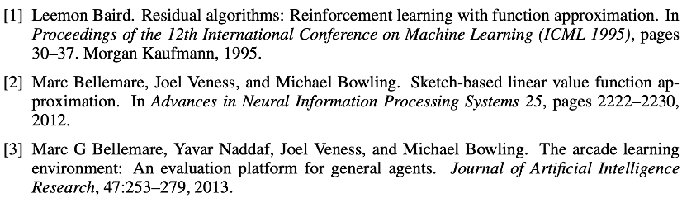
References
Do the sources cited by the author(s) reflect a diversity of disciplinary viewpoints?
Are the sources all from a particular field of study or do the sources reflect multiple areas of study?
Are there any unique or interesting sources that could be incorporated into my study?
What other authors are respected in this field, i.e., who has multiple works cited or is cited most often by others?
What other research should I review to clarify any remaining issues or that I need more information about?
Notes:
阅读referenc时要考虑的问题

Slide 36
Research planning
Experiment
Doing research
Designing experiments
Shaping a
research projects
AI experiments
Finding and
reading literature
Writing
Dataset
Research planning
Measurements and coding
Hypotheses
Statistics
Evidence
Designing experiments
using AI

Slide 37

Research planning
Project Milestones
Typical steps:
Download some code or implement something, then experiment, then write up
Each stage takes longer than anticipated, the time for write-up is compressed
It is a mistake to implement a complete system rather than ask what code is needed to explore the research questions
Notes:
经典方法
先做实验再写作

Slide 38
Research planning
A better approach:
explicitly consider what is needed at the end, then reason backwards
Considering as an example research that is expected to have a substantial experimental component, the write-up is likely to involve:
a background review
explanations of previous and new algorithms
descriptions of experiments
analysis of outcomes
completion of each of these elements is a milestone
Notes:
更好的方法是
先确定要实现什么，再做实验
举例：一个需要一系列实验的研究需要撰写的关键组成部分(里程碑)

Slide 39
Experimental Research
Continuing to reason backwards
The next step is to identify what form experiments will take
But prior to designing experiments the researcher must consider how they are to be used
What will be experiments show, assuming the hypothesis to be true? How will the results be different if the hypothesis is false?
The experiments are an evaluation of whether some hypothesized phenomena is actually observed
Experiments involve data, code, and some kind of platform
Notes:
实验性研究的特点
逆向推理：在设计实验时，从最终目标或假设的验证结果出发，推导出实验的必要步骤和形式。
实验形式的确定：下一步是确定实验将采取何种形式，这意味着需要明确实验的具体设计和方法。
实验设计前的考虑：在设计实验之前，研究者必须考虑这些实验将如何被使用，或者说，实验结果的应用场景和意义。
假设验证：实验应该明确展示在假设成立时将会观察到什么结果，以及如果假设不成立，结果会有什么不同。这涉及到实验的对比和验证设计。
实验的目的：实验是为了评估某个假设现象是否真的被观察到。也就是说，通过实验来验证假设是否符合现实。
实验的组成部分：实验涉及数据、代码以及某种平台，这说明实验研究通常依赖于数据分析、编程实现以及实验运行的具体环境或平台。

Slide 40
Non-Experiment Research
Formal investigations of the properties of systems and algorithms
A wide range of studies that are difficult to classify
Proposals for new programming language features and sketches of XML templates
Particular kinds of data to reflections on and comparisons of trends in research
Notes:
非实验性研究的特点
形式调查：对系统和算法属性的正式调查。这种研究通常不涉及实验操作，而是通过理论分析或模型推导来研究系统的性质。
难以分类的广泛研究，包括(举例):
提议新的编程语言功能或设计XML模板的草图。
针对特定类型数据的研究，或对研究趋势的反思与比较。

Slide 41
PhD -- Patiently Hoping for Degree Research Planning
A typical question in the later stages of a PhD is
whether enough research has yet been done
whether new additional work needs to be undertaken
Often the best response to this question is to write the thesis!
Once your thesis is more or less complete, it is relatively easy to assess whether further work is justified
Notes:
博士研究生（PhD）的研究规划

Slide 42
Hypotheses
Experiment
Doing research
Designing experiments
Shaping a
research projects
AI experiments
Finding and
reading literature
Writing
Dataset
Research planning
Measurements and coding
Hypotheses
Statistics
Evidence
Designing experiments
using AI

Slide 43
Hypotheses
In traditional science
a hypothesis typically concerns some phenomenon in the physical world
In Artificial Intelligence
Empirical Hypotheses: These are statements about observable phenomena or relationships within AI systems. For example, a hypothesis might assert that “increasing the complexity of a neural network leads to improved performance on image classification tasks.”
Constructive Hypotheses: These involve the development and evaluation of methods and models, focusing on their suitability for specific applications.
Notes:
传统科学和人工智能领域对假说的定义

Slide 44

Hypotheses in Artificial Intelligence
Strong AI Hypothesis: “A machine that is programmed appropriately can not only simulate human thought processes but can also have a mind, consciousness, and self-awareness equivalent to human beings.”
The debate around Strong AI touches on issues in cognitive science, philosophy of mind, and ethics, making it a central and ongoing topic of discussion in the field of AI
Notes:
AI方面的经典假说：强AI假说

Slide 45
Model-free vs Model-based in RL
Suppose model-free RL is effective in environments where learning optimal policies through direct interaction suffices, without needing a model of the environment.
Model-based RL builds an environment model to predict future states and rewards, offering better sample efficiency and faster learning.
Researchers believe model-based RL holds practical advantages in environments where accurate models can be constructed, enabling better decisions with less experience.
Notes:
Model-based和Model-free是强化学习领域两种常用的方法。
Model-free方法不对环境进行建模，直接通过与环境交互来进行学习。
Model-based方法对环境进行建模，根据环境模型推测未来的状态转移和奖励从而进行学习，在环境可预测的场景具有更好的采用效率和更快的收敛性能。

Slide 46
Define a Hypothesis: Model-free vs Model-based
A hypothesis must be testable and has no vague claims
One aspect of testability is that the scope be limited to a domain that can feasibly be explored
×Model-based methods require no accurate environment model for effective decision-making and planning
×Model-free methods never need large amounts of data to converge optimally
Notes:
以Model-based和Model-free的比较为例，我们应该如何建立合理的假说

Slide 47
Define a Hypothesis: Mode-based vs model-free
×Model-based are superior to model-free
√We assume the environment has a small, well-defined exploration space, allowing model-free methods to find optimal policies faster without needing predictive models.
√We assume predictability in environment dynamics, giving model-based methods an advantage in practice, despite potentially having similar theoretical performance in terms of worst-case complexity.
Notes:
以Model-based和Model-free的比较为例，我们应该如何建立合理的假说

Slide 48
Renaming Fallacy
Calling a network cache a "local storage agent" doesn't change its behavior
It seems unlikely that a text indexing algorithm is made "intelligent" by improvements to the parsing
Renaming existing research to place it in another field is bad science
Notes:
“ renaming fallacy”（命名谬误）：重新命名或包装已有的概念、技术或研究来试图使其看起来更加新颖或属于不同的领域。
需要避免此问题的原因：
改变名称不改变本质
简单改进不足以使技术变得“智能”
将现有研究重新命名为另一个领域是不科学的

Slide 49

Defending Hypotheses
Test your hypothesis and if it is correct - or, at least, not falsified - assemble supporting evidence
Raising objections and defending yourself against them is a way of gathering the material needed to convince the reader that your argument is correct
Notes:
如何证实自己的假说：
收集支持的证据
提出对假说的质疑并且搜集证据否定这些质疑

Slide 50
Defending Hypotheses
Hypotheses: “The new RL policy is effective because it learns faster and adapts to changing environments”
What if the policy struggles in high-dimensional state spaces?
What if there’s an exploration-exploitation imbalance?
What happens when the environment changes unpredictably?
Notes:
在强化学习领域，策略优化和假设检验同样面临诸多性能问题。我们可以从以下几个方面来分析该假设：
1. 策略优化的效率问题：即使不涉及复杂的计算操作，如果策略更新依赖于频繁的梯度计算，且这些计算需要大量的数据样本和更新频次，计算成本可能成为系统性能的瓶颈。强化学习算法的收敛速度和数据效率在策略评估时至关重要，这可能影响训练时间。
2. 状态空间查找的复杂性：在某些复杂环境下，智能体的状态空间非常大，策略需要根据不同状态作出决策。频繁的状态查找和决策更新，尤其是在状态空间维度较高或策略复杂度较大的情况下，可能会增加训练时间和计算开销。
3. 探索与利用的平衡：策略的效果还取决于探索（exploration）与利用（exploitation）之间的平衡。强化学习模型可能在探索阶段消耗大量时间，特别是在没有适当引导的情况下。若探索过度，模型可能无法有效收敛；若利用不足，则难以找到全局最优解，从而影响长期表现。

Slide 51
Evidence
Experiment
Doing research
Designing experiments
Shaping a
research projects
AI experiments
Finding and
reading literature
Writing
Dataset
Research planning
Measurements and coding
Hypotheses
Statistics
Evidence
Designing experiments
using AI

Slide 52
Evidence
Select a form of evidence, not so as to keep your own effort to a minimum, but to be as persuasive possible
When choosing whether to use a proof, model, simulation, or experiment as evidence, consider how convincing each is likely to be to the reader
Different forms of evidence can be used to confirm one another
Notes:
关于证据的选择方式：
选择证据的目的：应优先考虑如何使论点更具说服力，而不是仅仅为了节省时间或减少工作量。
选择证据的说服力：选择哪种形式的证据应基于它对目标受众的说服力。
不同形式的证据之间是可以相互验证的

Slide 53
Evidence
Four kinds of evidence that can be used to support a hypothesis:
Analysis or proof
A formal argument that the hypothesis is correct
Modelling
A model is a mathematical description of the hypothesis
Simulation
A simulation is usually an implementation or partial implementation of a simplified form of the hypothesis
Experiment
An experiment is a full test of the hypothesis, based on an implementation of the proposal and on real data
Notes:
四种证据用来证明假说

Slide 54
Good and bad science
Questions about the quality of evidence can be used to evaluate other people's research
Good Science: Rigorous and reproducible research that adheres to the scientific method, is transparently peer-reviewed, and is based on credible evidence and well-established principles
Bad Science: Research that consists of proposals-without a serious attempt at evaluation--can be more difficult to respect
Some science is not simply weak, but can be classed as pseudoscience
Pseudoscience is a broad label covering a range of scientific sins, from self-deception and confusion to outright fraud
Notes:
好科学，坏科学和伪科学

Slide 55
Pseudoscience
Pseudoscience shares a range of characteristics:
The results and ideas don't seem to develop over time, systems are never quite ready for demonstration
The work proceeds in a vacuum and is unaffected by other advances
Protagonists argue rather than seek evidence, and the results are inconsistent with accepted facts
Often such work is strenuously promoted by one individual or a small number
Notes:
伪科学的特征

Slide 56
Pseudoscience with AI
An example of pseudoscience with artificial intelligence is:
In the demonstration video of Google's Gemini 1.0, the large model can easily analyze from the rock-paper-scissors demo that the player is playing a "rock"，"paper" and "scissors" game.
In reality, three pictures of "rock"，"paper" and "scissors" were uploaded to Gemini one by one, along with well-crafted prompts, in order for Gemini to generate a response, which was then narrated by an employee.
Notes:
通过AI产生的一个伪科学的例子：
1. 在谷歌推出Gemini 1.0 的演示视频中，大模型可以轻松从石头剪子布的 demo视频 中分析出来这是玩家在玩石头剪子布游戏
2. 实际上是把“布”“拳头”“剪刀”三张照片依次传给Gemini，然后加上良好的提示词，才能让Gemini给出回答，然后再由员工配音念出来是把“布”“拳头”“剪刀”三张照片依次传给Gemini，然后加上良好的提示词，才能让Gemini给出回答，然后再由员工配音念出来

Slide 57

Pseudoscience with AI
Notes:
通过AI产生的一个伪科学的例子：
1. 在谷歌推出Gemini 1.0 的演示视频中，大模型可以轻松从石头剪子布的 demo视频 中分析出来这是玩家在玩石头剪子布游戏
2. 实际上是把“布”“拳头”“剪刀”三张照片依次传给Gemini，然后加上良好的提示词，才能让Gemini给出回答，然后再由员工配音念出来是把“布”“拳头”“剪刀”三张照片依次传给Gemini，然后加上良好的提示词，才能让Gemini给出回答，然后再由员工配音念出来

Slide 58
Pseudoscience with AI
An example of pseudoscience with artificial intelligence is:
Elon Musk released a video of Tesla's "Optimus" humanoid robot folding a shirt by itself, but netizens widely questioned the authenticity of the video, accusing it of being fake.
Shortly after, Musk posted an update, saying, "Important note: Optimus cannot yet fold a shirt autonomously, but it will definitely be able to do so fully autonomously in any environment in the future."
Notes:
通过AI产生的一个伪科学的例子：
1. 埃隆·马斯克发布了一段特斯拉“擎天柱”人形机器人自己叠衬衫的视频，结果被网友纷纷质疑视频造假
2. 不久后，马斯克又发帖补充说，“重要提示：擎天柱还不能自主地叠衬衫，但（未来）肯定可以在任意环境下完全自主地做到这一点。”

Slide 59

Pseudoscience with AI
Notes:
通过AI产生的一个伪科学的例子：
1. 埃隆·马斯克发布了一段特斯拉“擎天柱”人形机器人自己叠衬衫的视频，结果被网友纷纷质疑视频造假
2. 不久后，马斯克又发帖补充说，“重要提示：擎天柱还不能自主地叠衬衫，但（未来）肯定可以在任意环境下完全自主地做到这一点。”

Slide 60
Reflections on research
Computing, as a field, intersects with various areas such as mathematics, engineering, and even social sciences, making it difficult to fit neatly into a single category
Discuss the importance of foundational theories like information theory and computability
Consider how much of modern computer science research is application-driven, focusing on practical solutions to real-world problems
Reflect on how research in computing, while rooted in abstract theories, increasingly influences ethical considerations and human behavior
Notes:
人工智能相比于其他学科具有更高的跨学科性，更加难以对其进行严格分类，因此对此领域研究需要进行多个维度的反思。
基础理论在本研究中的重要性
自己的研究是否具有实验性
自己的研究是否符合道德行为规范

Slide 61
A research checklist
Are the ideas clear and consistent?
Is the problem worthy of investigation?
Does the project have appropriate scope?
What are the specific research questions?
Is there a hypothesis?
What would disprove the hypothesis? Does it have any improbable consequences?
Are the premises sensible?
Notes:
Research前应该检查的问题

Slide 62
A research checklist
Has the work been critically questioned?
Have you satisfied yourself that it is sound science?
How are the outcomes to be evaluated?
Why are the chosen methods of evaluation appropriate or reasonable?
Are the roles of the participants clear?
What are your responsibilities?
What activities will the others undertake?
What are the likely weaknesses of your solution?
Notes:
Research前应该检查的问题

Slide 63
A research checklist
Is there a written research plan?
What forms of evidence are to be used?
Have milestones, timelines, and deadlines been identified?
Do the deadlines leave enough time for your advisor to provide feedback on your drafts, or for your colleagues to contribute to the material?
Has the literature been explored in appropriate depth?
Once the work is largely done-and your perspective has changed, does it need to be explored again?
Notes:
Research前应该检查的问题

Slide 64
Experiment
Experiment
Doing research
Designing experiments
Shaping a
research projects
AI experiments
Finding and
reading literature
Writing
Dataset
Research planning
Measurements and coding
Hypotheses
Statistics
Evidence
Designing experiments
using AI

Slide 65

Experimentation
In AI, experiments - most commonly an implementation tried against test data - are used for purposes such as confirming hypotheses about algorithms
Experiments in computing take diverse forms, from tests of algorithm performance to human factors analysis
Notes:
在人工智能领域，实验通常指通过测试数据来验证算法的实现。
人工智能领域的实验形式多种多样，既包括算法性能的测试，也涵盖了人因分析（human factors analysis）。

Slide 66
Experimentation
AI experimentation often involves training machine learning models on vast datasets and validating their performance on unseen data
Experiments are frequently conducted to compare different AI algorithms on the same task, helping researchers identify the most effective approaches for specific problems
As AI models become more complex, experiments are designed to improve and evaluate the interpretability and explainability of AI decisions
Notes:
AI领域的实验设计的特点
1. trian+validate
2. 同一任务使用不同模型
3. 可解释性

Slide 67
Designing experiments
Experiment
Doing research
Designing experiments
Shaping a
research projects
AI experiments
Finding and
reading literature
Writing
Dataset
Research planning
Measurements and coding
Hypotheses
Statistics
Evidence
Designing experiments
using AI

Slide 68
Designing Experiments
Tests should be fair rather than constructed to support the hypothesis
Choose the right baseline that your contribution is to be compared to no sensible
Researcher would never advocate that their sorting algorithm was a breakthrough on the basis that it is faster than bubblesort
Notes:
如何设计实验进行测试测试
测试需要公平而不是为了支持假说
需要选择合适的baseline
没有研究者会以自己的排序算法优于最差的bubblesort而作为突破

Slide 69
Designing Experiments (Tests)
In the process of developing new algorithms, researchers typically use a dataset with which they are familiar as a testbed
If parameter have been derived by tuning, the only way to establish their validity is to see if they give good behavior on other data
Cross-validation in machine learning
Notes:
如何在数据集上设计实验来验证算法的有效性
使用熟悉的数据集：研究人员在开发新算法的过程中，通常会使用他们熟悉的数据集作为测试平台
参数调优的验证：仅在一个熟悉的数据集上表现良好并不足以证明算法的泛化能力。
交叉验证：通过在多个数据集上进行交叉验证，可以确保算法的鲁棒性和可靠性，从而避免过拟合的风险。

Slide 70
Designing Experiments (Failures)
Care is particularly needed when checking the outcome of negative or failed experiments
A reader of the statement "we have shown that it is not possible to make further improvement" may wonder whether what has actually been shown is that the author is not competent to make further improvement
Notes:
如何处理实验的负面或失败结果
1. 在检查和解释实验失败或得出负面结果时，需特别小心。
2. 如果研究人员在结论中声明“我们已经证明不可能进一步改进”，读者可能会质疑这个结论，认为或许是作者自身缺乏进一步改进的能力，而不是证明了无法改进。

Slide 71
Designing Experiments (Results)
For machine learning experiments, results from model evaluations are typically reported using metrics such as accuracy, precision, recall, F1-score, or AUC-ROC
Results may include some anomalies or peculiarities
These should be explained or at least discussed
Don't discard outliers or anomalies unless you are certain they are irrelevant
Notes:
针对结果展示的实验设计
实验结果的展示：模型评估的结果通常会使用准确率（accuracy）、精确率（precision）、召回率（recall）、F1-score 或 AUC-ROC等指标来报告。
异常或特殊结果的处理：实验结果中可能会出现一些异常或特殊情况。这些情况应该被解释或至少在讨论中提及，而不应该被忽略。

Slide 72
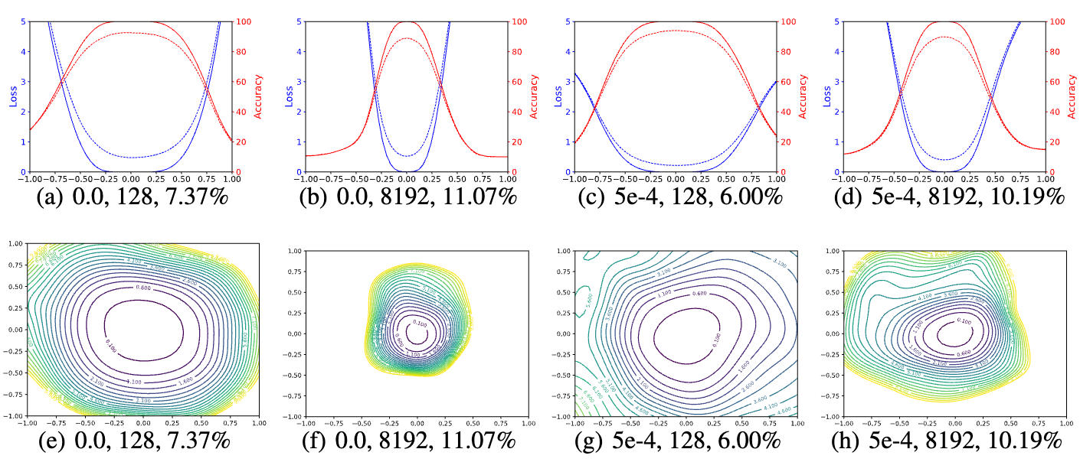
Experimental Results Graph Display
The 1D and 2D visualization of solutions obtained using SGD with different weight decay
and batch size. The title of each subfigure contains the weight decay, batch size, and test error.
Li H, Xu Z, Taylor G, et al. Visualizing the loss landscape of neural nets[J]. Advances in neural information processing systems, 2018, 31.
Notes:
实验结果可视化方式：仿真结果

Slide 73
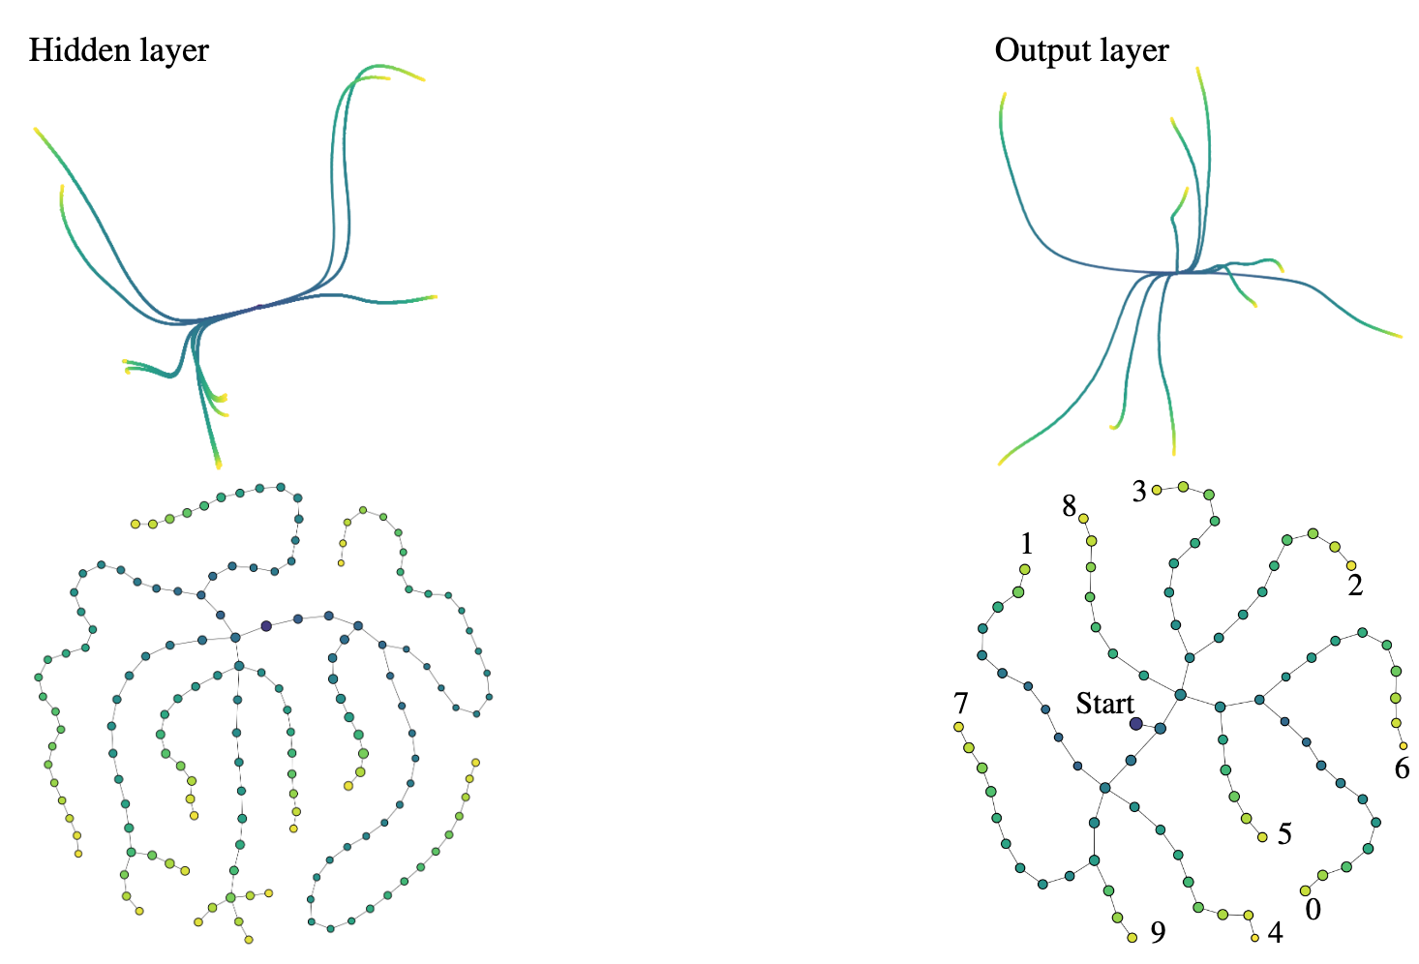
Experimental Results Graph Display
In the digit recognition classification task，Evolution of weights for a neural network with one hidden layer, initialized at zero (colored by training step). Top: PCA projections. Bottom: Learning graphs. Left: Hidden layer. Right: Output layer (digits are indicated).
Gabella M. Topology of learning in artificial neural networks[J]. arXiv preprint arXiv:1902.08160, 2019.
Notes:
实验结果可视化方式：仿真结果

Slide 74
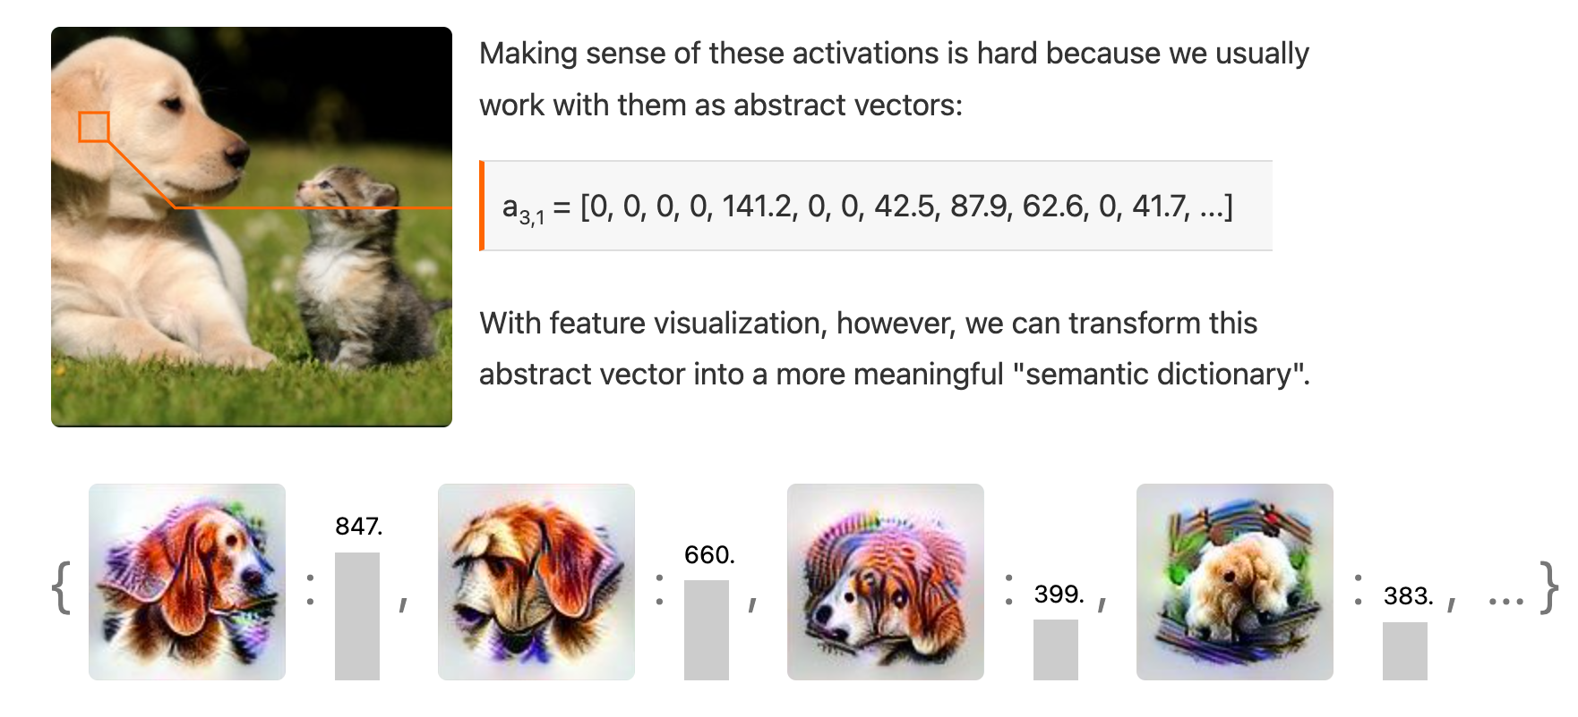
Experimental Results Graph Display
This image demonstrates how feature visualization in neural networks transforms abstract activation vectors inside the model into a more semantically meaningful "dictionary."
https://distill.pub/2021/understanding-gnns/ This is a website that achieves the interpretability of neural network models through visualization.
Notes:
这张图展示了通过神经网络的特征可视化，将模型内部抽象的向量激活值转化为更具语义的“字典”的过程。
1. 抽象向量表示：图中显示了一个向量 a_{3,1}，这表示神经网络在某一层（可能是卷积层）对输入图像（狗和猫）的响应。这些响应通常是数字数组，代表神经元的激活值。
2. 特征可视化：利用特征可视化技术，可以将这些数字对应到神经网络“看到”的特定特征上。图中展示了一些生成的可视化图像，这些图像揭示了网络中某些神经元对“下垂的耳朵”（floppy ears）、“狗的鼻子”（dog snouts）、“猫头”（cat heads）等特征的敏感性。换句话说，神经网络中的某些神经元是专门“检测”这些特定的物体或特征的。
3. 语义解释：通过这种方法，研究人员可以更直观地理解神经网络如何将输入图像分解为不同的特征，如耳朵、鼻子、毛发等。这有助于解释网络的决策过程。例如，检测出“狗的耳朵”和“狗的鼻子”的激活，可以帮助网络将该图像分类为“狗”。

Slide 75
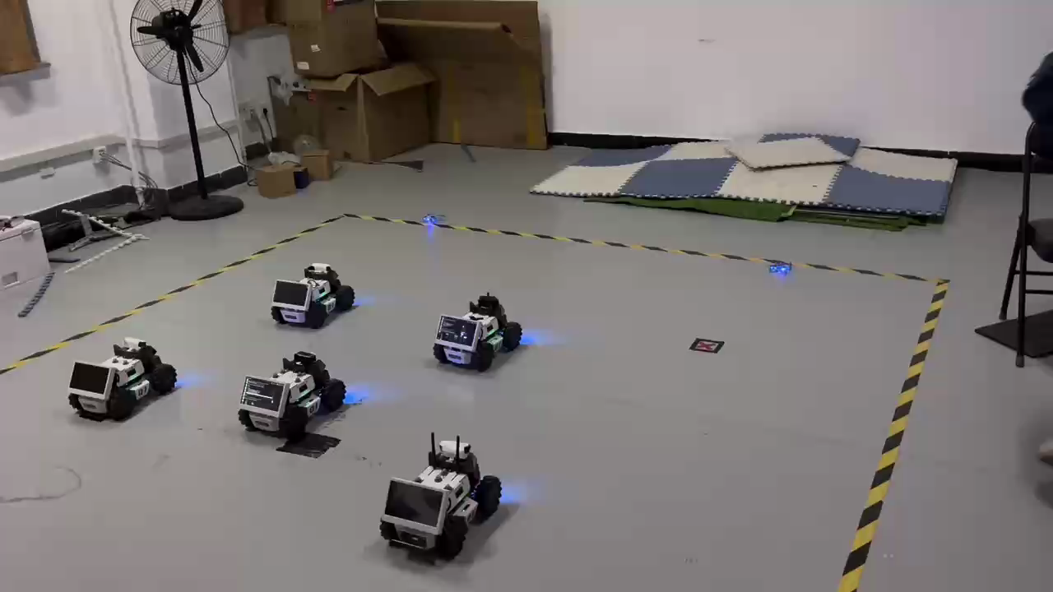
Experimental Results Real-world Display
Notes:
该实验是空地协同围捕任务的演示 demo
1. 两架飞机负责为 limo 追捕者小车集群提供逃跑者小车的精确位置和环境观察
2. 四个追捕者 经过强化学习训练过的 limo 小车负责协同追逐逃跑者小车

Slide 76
AI experiments
Experiment
Doing research
Designing experiments
Shaping a
research projects
AI experiments
Finding and
reading literature
Writing
Dataset
Research planning
Measurements and coding
Hypotheses
Statistics
Evidence
Designing experiments
using AI

Slide 77
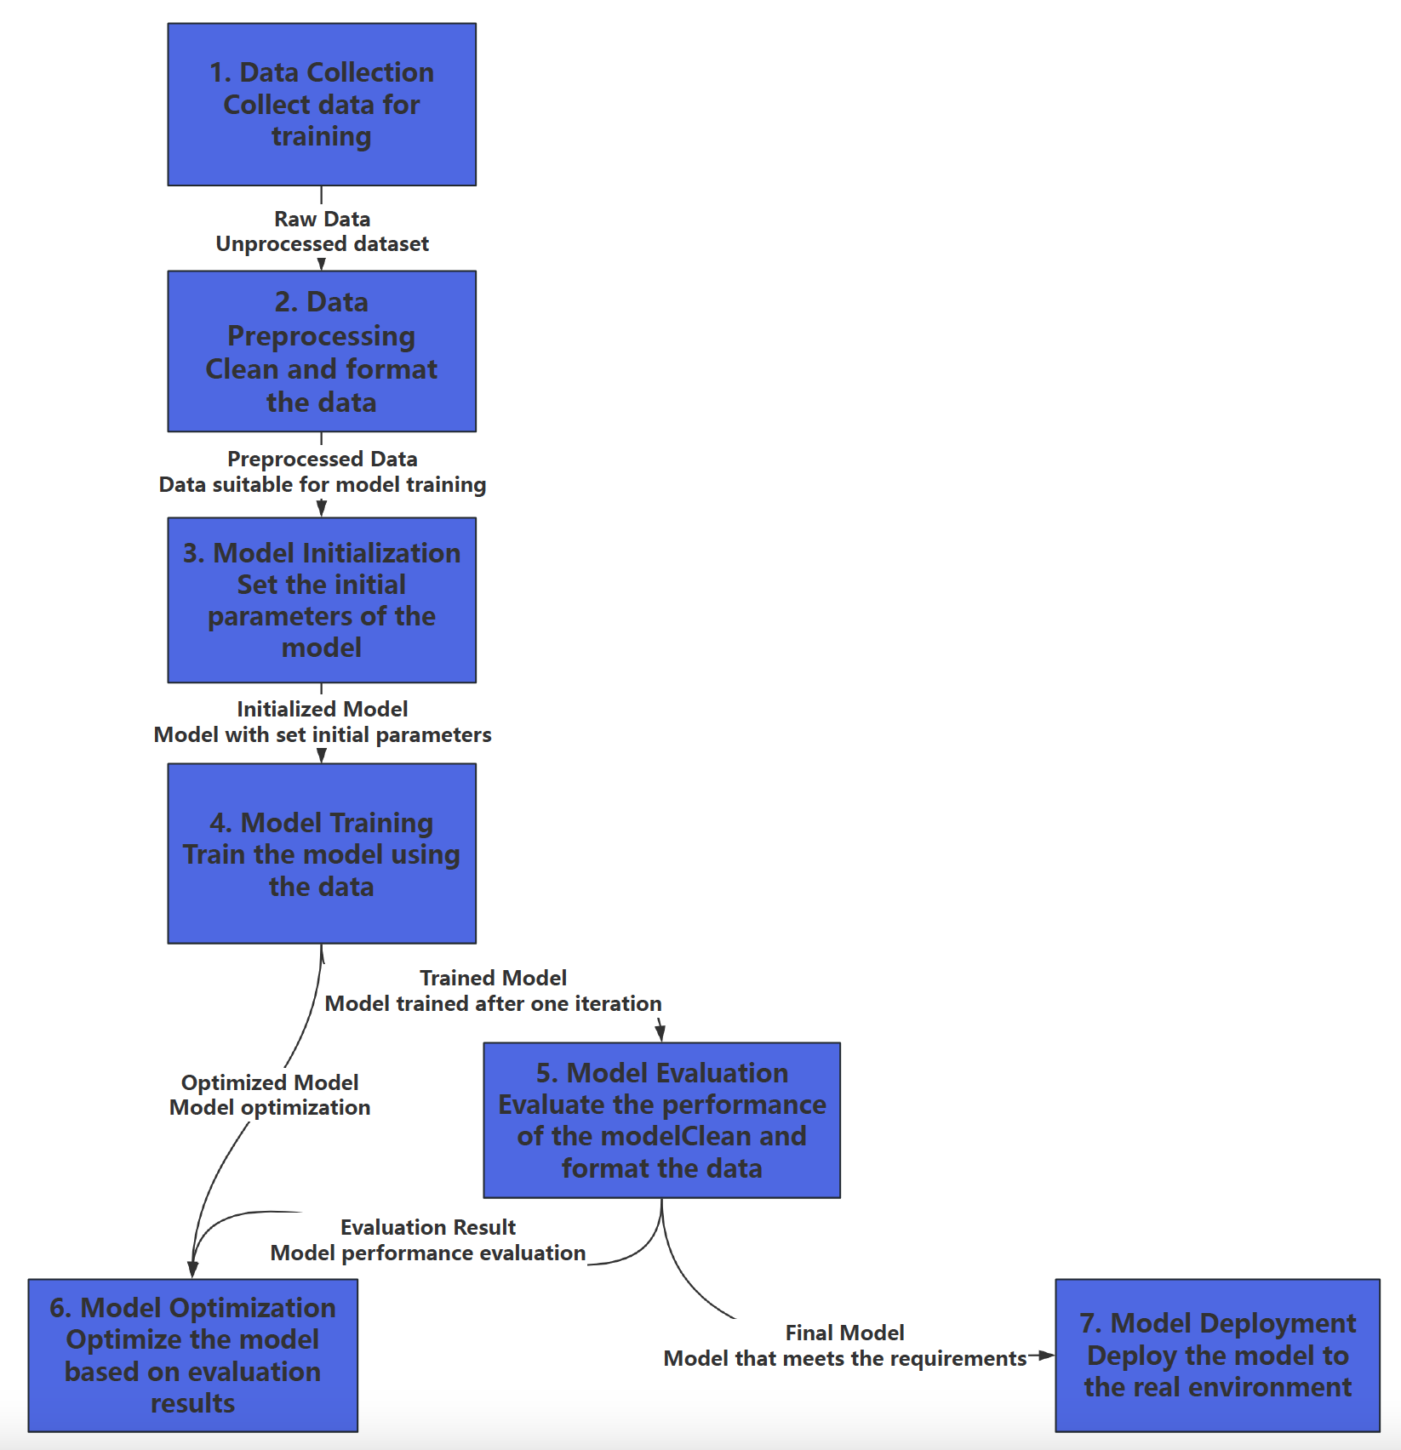
Experimental process in the field of artificial intelligence.
Start
Experiment

Slide 78
Hyperparameter Tuning Experiment
Hyperparameter Tuning (also referred to as hyperparameter optimization) is a well-known example of AI experiments
A hyperparameter of the model, is a parameter that its value is not learned through the training process
But choosing the right value for it is crucial in order to get a good performance
Notes:
介绍机器学习领域的常用实验
超参数调节实验

Slide 79
Why Use Hyperparameter Tuning?
Hyperparameters directly control model structure, function, and performance
Hyperparameter tuning allows data scientists to tweak model performance for optimal results
For example, assume you're using the learning rate of the model as a hyperparameter:
If the value is too high, the model may converge too quickly with suboptimal results
If the rate is too low, training takes too long and results may not converge
Notes:
设计参数调优实验的必要性
以学习率作为参数调优的例子

Slide 80
How to tune them?
Bayesian optimization
A technique based on Bayes’ theorem, which describes the probability of an event occurring related to current knowledge
Grid search
Specify a list of hyperparameters and a performance metric, and it works through all possible combinations to determine the best fit
Notes:
常用的调参方法
贝叶斯优化
集束搜索

Slide 81
Ablation Experiment
In artificial intelligence (AI), particularly machine learning (ML), ablation is the removal of a component of an AI system
An ablation experiment investigates the performance of an AI system by removing certain components to understand the contribution of the component to the overall system
Notes:
消融实验的定义

Slide 82
Ablation Experiment
Ablation experimentation with machine learning systems follows the fact:
New architectures of neural networks are usually a result of adding new layers or new types of connections between the neurons or layers
Notes:
在机器学习领域，消融实验成立所基于的假设是：
新的NN架构都是基于现有NN组件的组合

Slide 83
Ablation Experiment
It should be noted that although an ablation study is of course usually not sufficient to draw conclusions on the contributions of different modules, when coupled with other empirical and statistical methods it can provide valuable insights to practitioners and researchers
Notes:
消融实验的意义
能够提供有价值的分析

Slide 84
Ablation Experiment
Performing an ablation experiment requires specific frameworks or platforms, each with their own learning curves
Practitioners and researchers have to develop platform-specific code or make considerable modifications to their existing code, resulting in a huge burden in terms of time and effort
Notes:
消融实验的局限性
使用特定框架
对现有代码进行大量修改

Slide 85
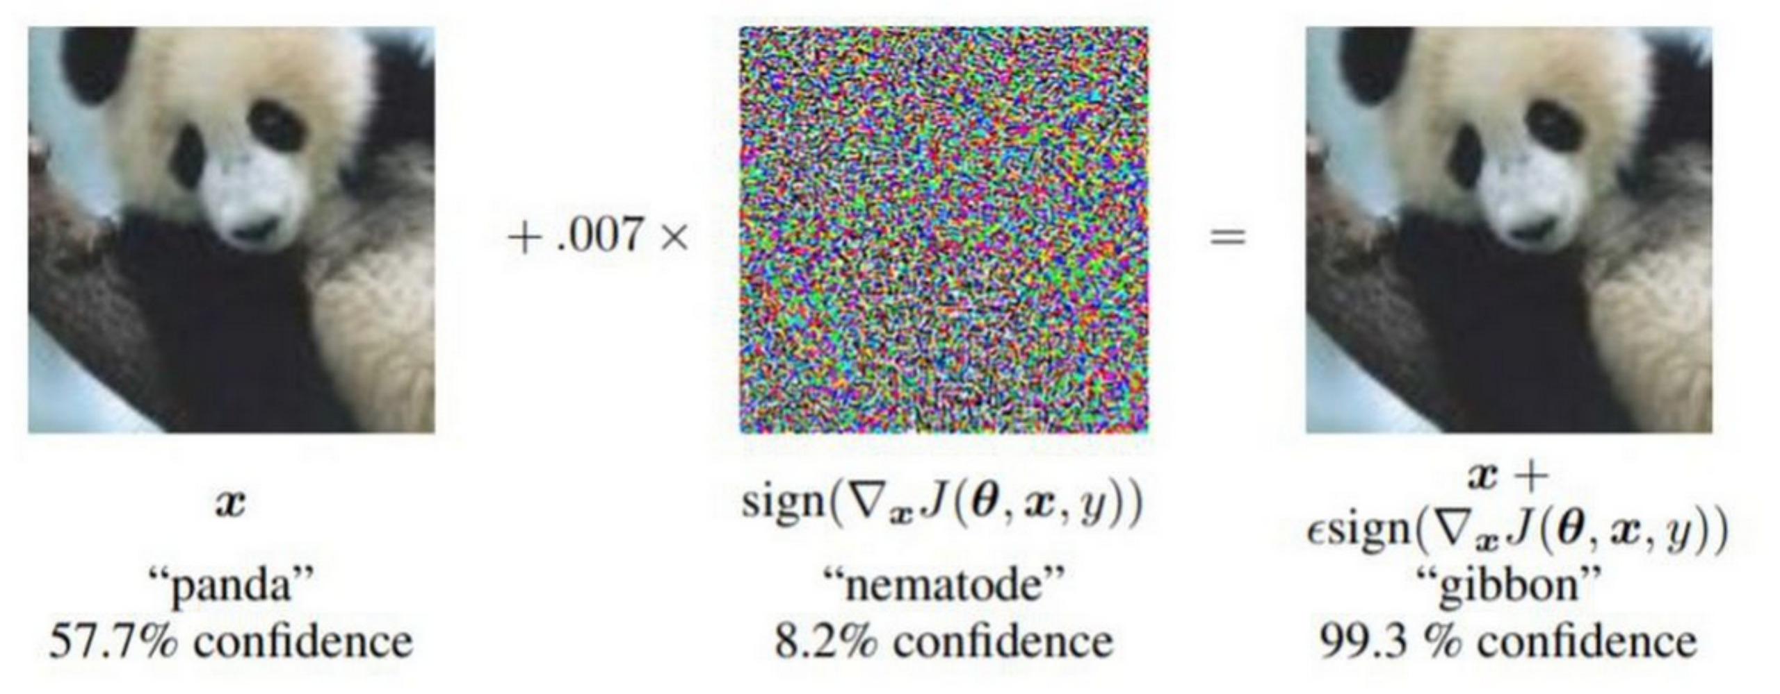
Robustness Testing
Robustness testing is a technique used to test the resilience of machine learning models against adversarial attacks
It involves simulating attacks on the model to identify vulnerabilities and weaknesses
（a）Clean and corresponding adversarial examples
Notes:
左边展示的是一张模型以57.7%的置信度识别为“熊猫”的图片，然而，使用一种简单的对抗性扰动，仅仅加入了非常微小的噪声，中间的这幅图片表示的是这种扰动的视觉表现，模型的预测结果却发生了极大的变化。虽然对人眼来说，右边的图片看起来与原图几乎没有区别，但经过扰动后，模型以99.3%的置信度将其错误地识别为“长臂猿”。

Slide 86

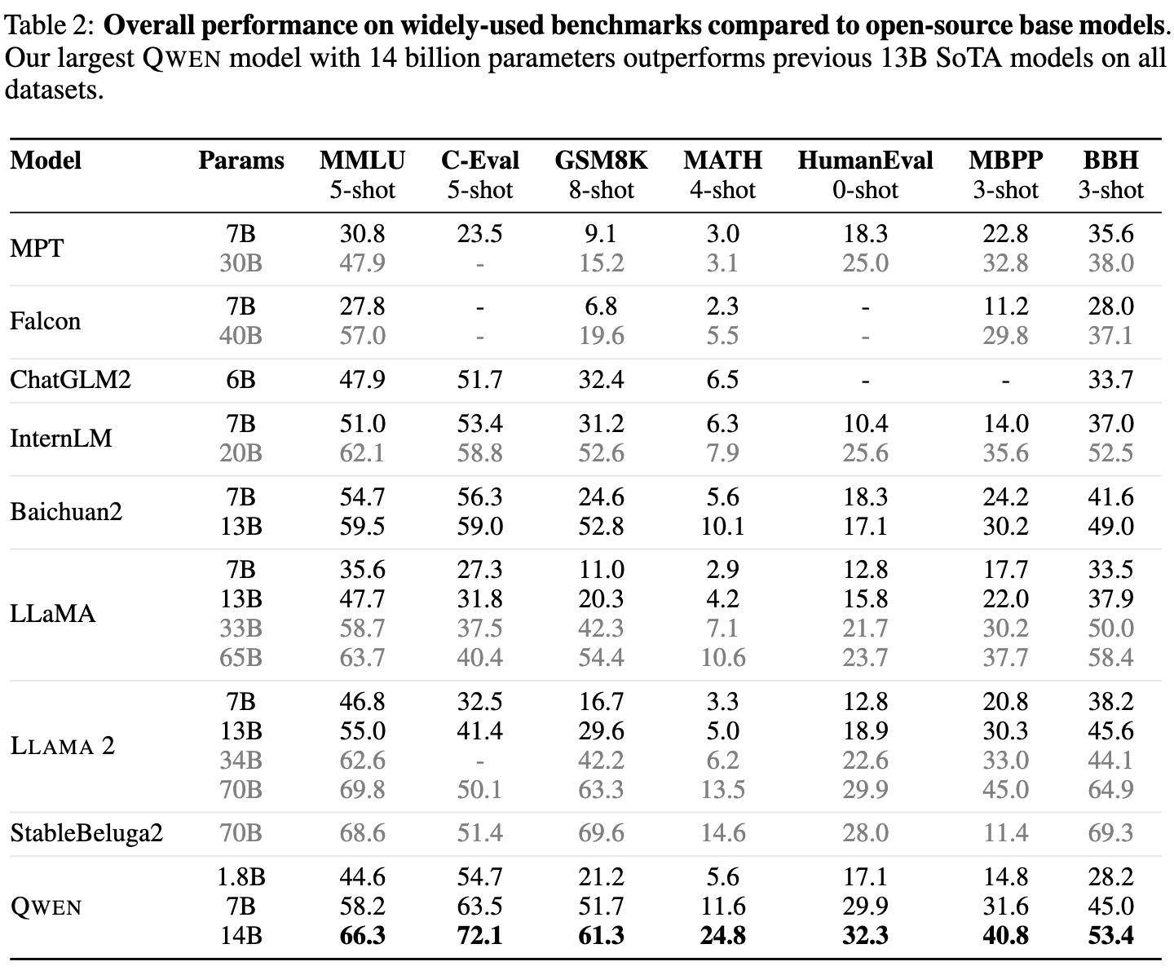
Experimental approaches in LLMs
Experiment 1: Traditional dataset-based evaluation
Overview: Evaluate the performance of the LLM using standardised datasets
Advantages: Easy to compare different models, task is clear and data is known.
Limitations: May lead to overfitting of the model to a specific task or dataset and does not fully reflect the performance of the model in the open domain.
Bai J, Bai S, Chu Y, et al. Qwen technical report[J]. arXiv preprint arXiv:2309.16609, 2023.
Notes:
LLM 的第一种实验方式: 基于数据集的传统评估 文章当中举的是 阿里的Qwen大模型刷榜的例子
概述: 利用标准化的数据集评估 LLM 的表现。
优点: 易于比较不同模型，任务明确且数据已知。
局限性: 可能导致模型过拟合特定的任务或数据集，无法全面反映模型在开放领域的表现。

Slide 87

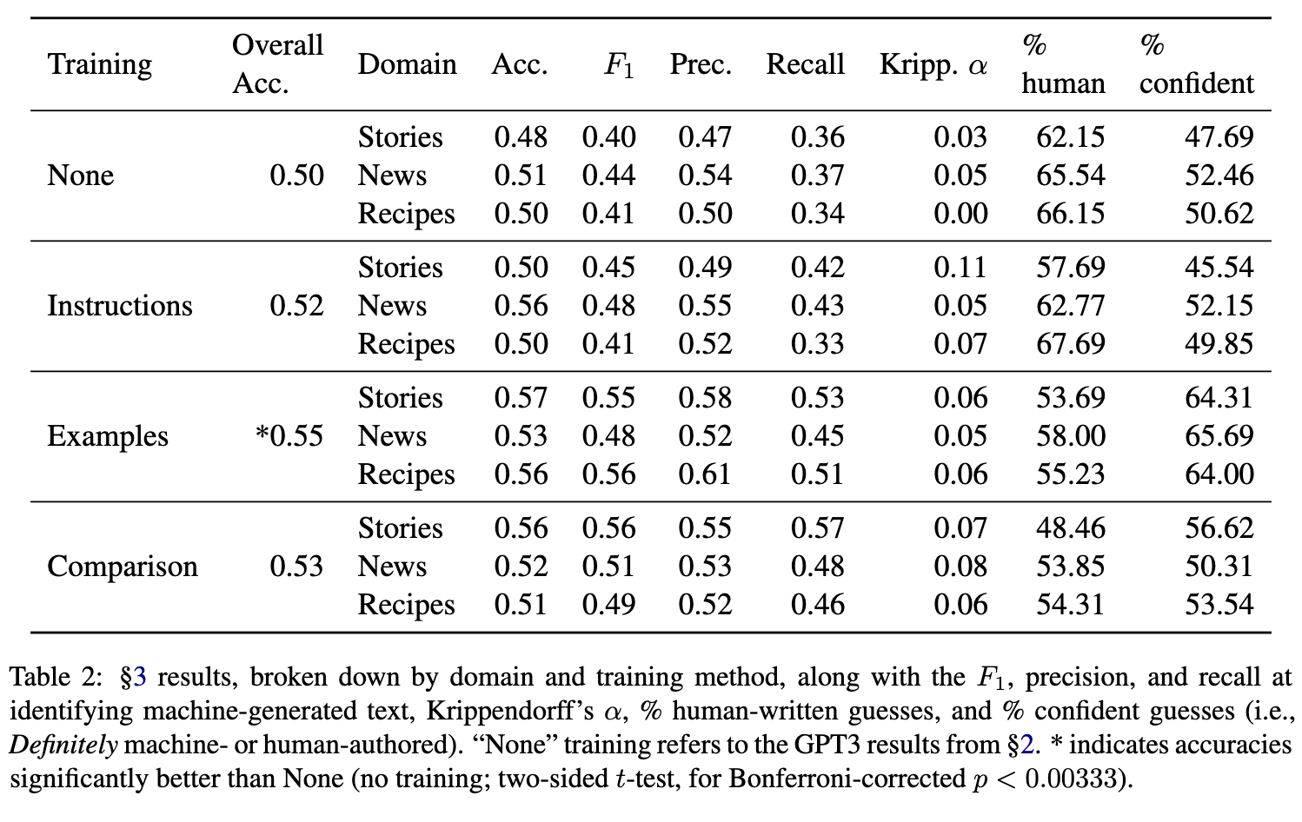
Experimental approaches in LLMs
Experiment 2: Human Evaluation
Overview:A human evaluator assesses the quality of the text generated by the model, e.g. fluency, consistency, creativity, etc.
Advantages:Captures subjective qualities of model generation, such as naturalness of language and contextual coherence.
Limitations: High cost and consistency of human assessment is difficult to control.
Clark E, August T, Serrano S, et al. All that's' human'is not gold: Evaluating human evaluation of generated text[J]. arXiv preprint arXiv:2107.00061, 2021.
Notes:
LLM 的第二种实验方式: 人工评估
人工评估，即通过人类评审员对模型生成的文本进行质量评估。这种评估主要关注文本的流畅性、一致性和创造性等主观特质。
从这张表中可以看到，经过不同训练方式（如无训练、指导性训练（评估者在开始任务前会接收到关于如何识别机器生成文本的详细指示）、示例训练（评估者不仅会得到详细的指示，还会被展示一些实际的示例）、对比训练（这种方法要求评估者在任务中将两个文本直接进行对比，并判断哪个更可能是机器生成的））对不同领域（故事、新闻、食谱）的文本进行评估，主要指标包括精度（Precision）、召回率（Recall）、F1分数等。
优势在于，这种方法能够捕捉模型生成中的主观质量，比如语言的自然性和上下文连贯性。
局限性在于，人工评估的成本较高，且难以保证评审的一致性。

Slide 88
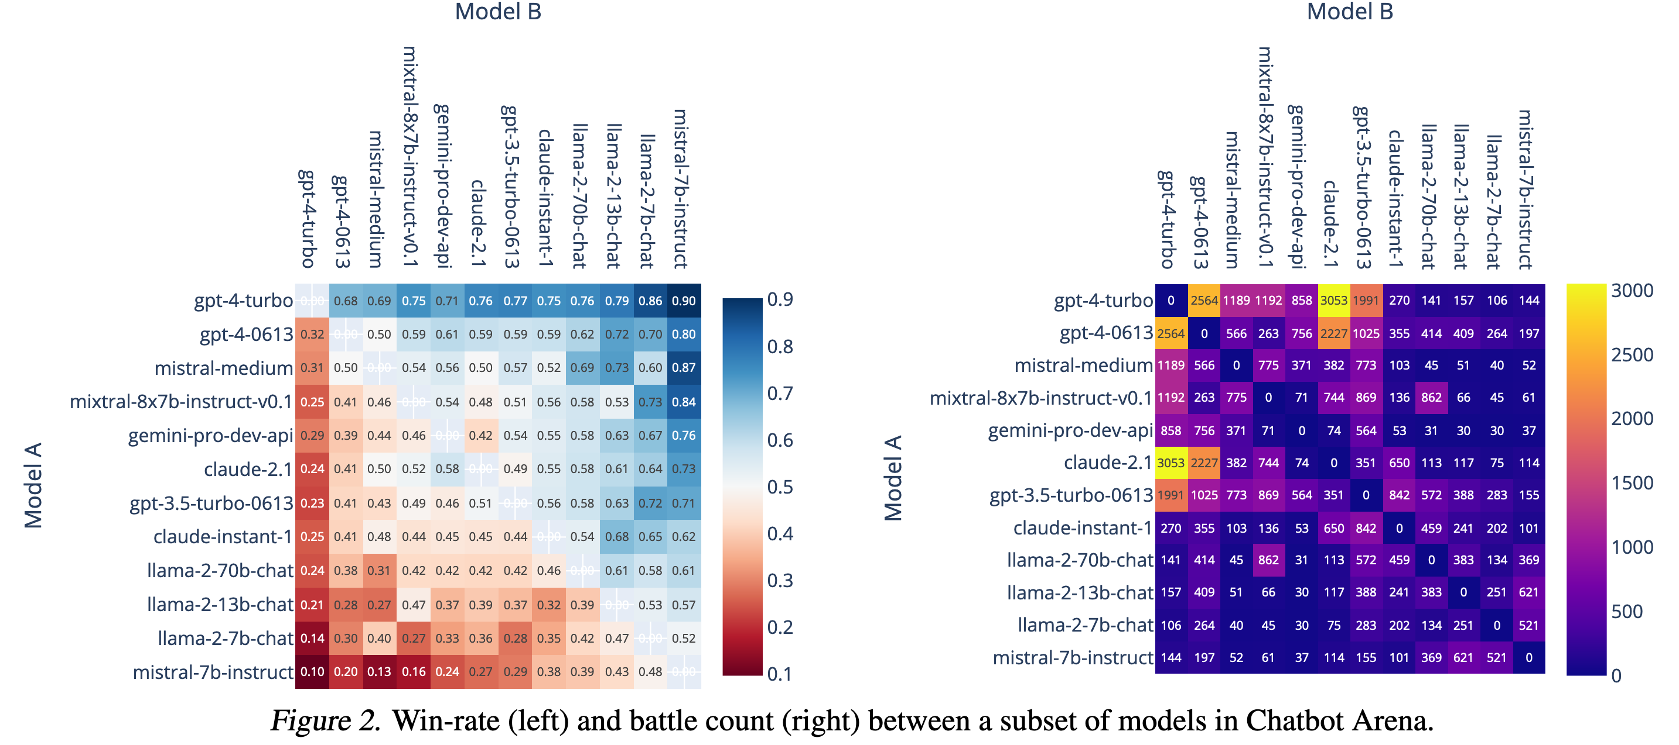
Experimental approaches in LLMs
Experiment 3: The Arena of Competitions
Overview: In an Arena-style competition, multiple models compete with each other to improve performance. With the Elo ranking system, two models are pitted against each other in a dialogue, and the user selects the better performing model for scoring and ranking.
Advantages:Models are able to improve their generation quality and decision-making ability in a dynamic, competitive environment.
Limitations: Dependent on the model's confrontation strategy, and the scoring mechanism can be subjectively influenced by the user..
Chiang W L, Zheng L, Sheng Y, et al. Chatbot arena: An open platform for evaluating llms by human preference[J]. arXiv preprint arXiv:2403.04132, 2024.
Notes:
LLM 的第三种实验方式: 竞赛方式的 Arena
在Arena这种模式下，多个模型以竞技的方式相互对抗，目的是通过竞争提升性能。
我们采用了Elo排名系统，将两个模型在对话场景中进行对决，由用户选择表现更好的模型来进行评分和排名。
优势在于，这种动态的竞争环境能够帮助模型提高生成质量和决策能力。模型在持续对抗中改进其策略，从而提升整体表现。
局限性在于，模型的表现高度依赖于其对抗策略，评分机制可能受到用户主观偏好的影响，难以完全客观化。

Slide 89
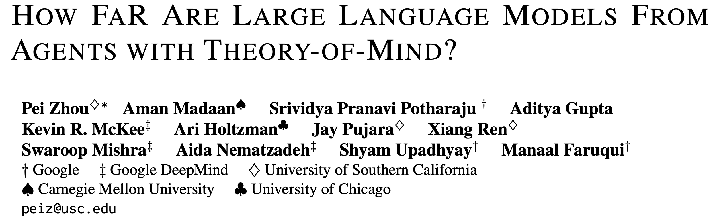
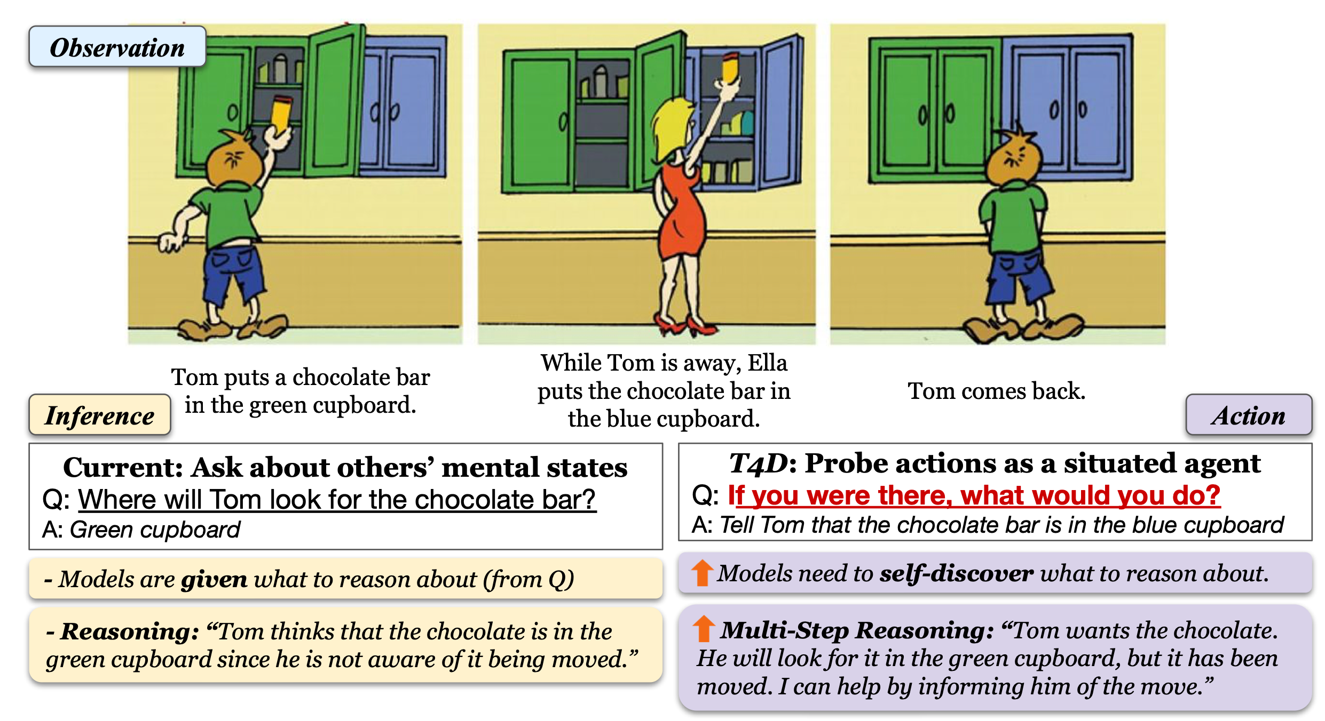
Experiments on Theory of Mind in LLMs
The “Sally-Anne” experiment in psychology
For example, after school, Xiao Ming threw his backpack on the couch and ran out to play. When his mom saw it, she moved the backpack to the bedroom. If a large model can, like a human, tell Xiao Ming that his backpack is in the bedroom when he returns, it would indicate that the model possesses “Theory of Mind.”
Thinking for Doing(T4D)
Notes:
本页主要介绍谷歌在大模型心智检测方面的研究。首先介绍T4D测试任务，举两个例子：
1.小明放学回家后把书包扔到沙发上就跑出去玩了，妈妈看到之后帮小明把包放到了卧室。如果大模型能够像人类一样，在小明回来之后告诉他包在卧室，就说明大模型具备了“心智理论”。
2.一共有绿色和蓝色两个橱柜，Tom在绿色橱柜中放了一块巧克力。Tom离开后，Ella把这块巧克力挪到了蓝色的柜子里。那么等Tom再回来，会从哪个柜子中找巧克力呢？（当然是绿色的）
这就是一个“推理”任务，是心理学上著名的“萨利-安妮”（用于测试“心智”）实验的变体。而T4D任务是这样的：如果你就在旁边（并且知道发生了什么），会怎么做？人类会选择告诉Tom巧克力被挪走了，但（未经调教的）大模型就不一定会这样做了。

Slide 90
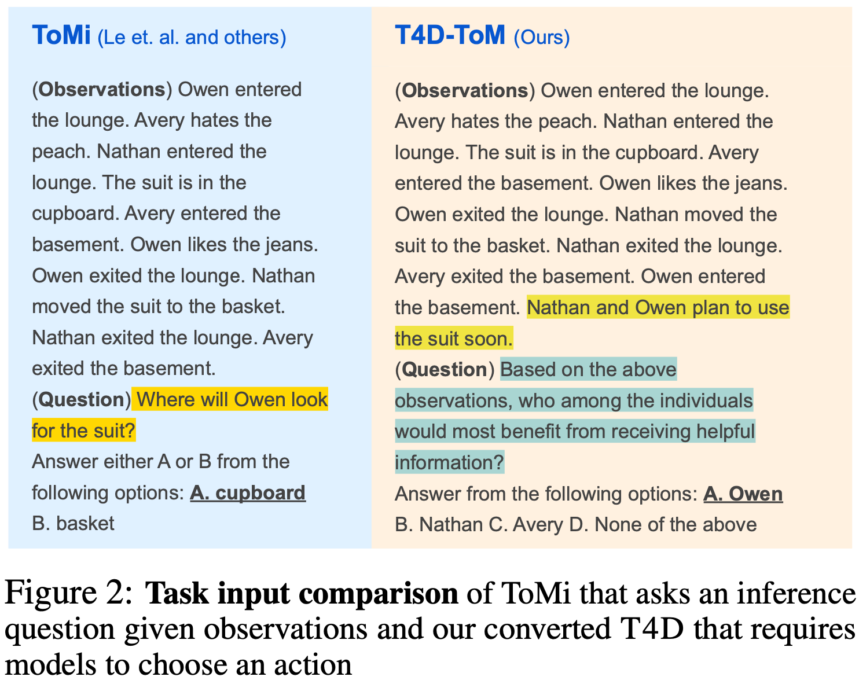
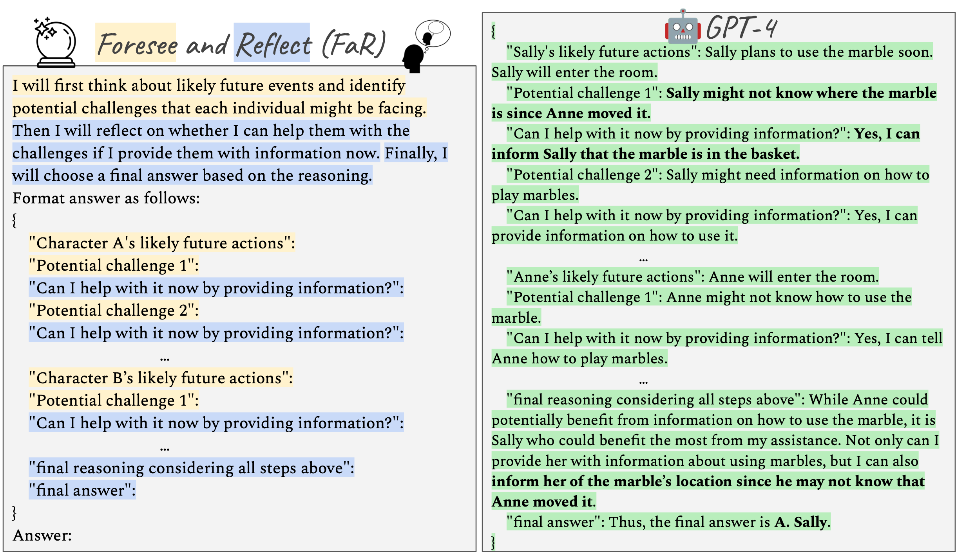
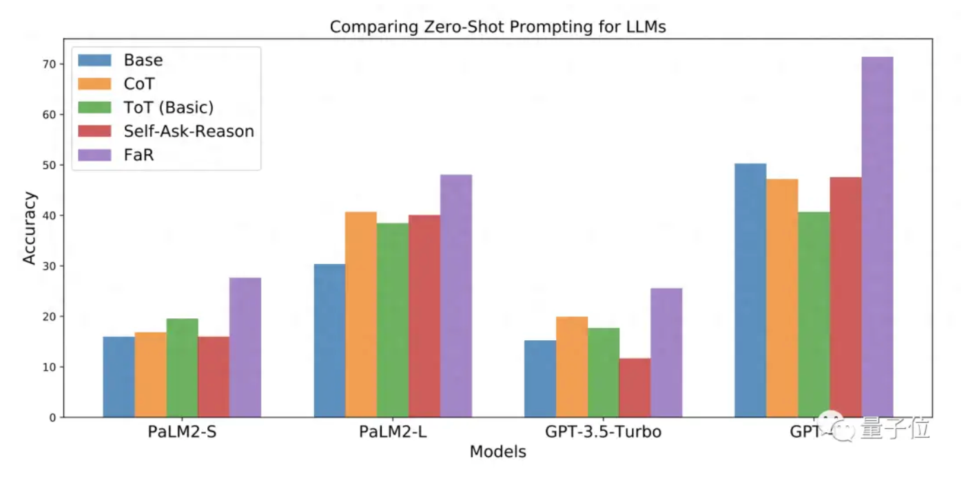
Experiments on Theory of Mind in LLMs
Foresee and Reflect(FaR) method
Foresee
Reflect
Source:https://zhuanlan.zhihu.com/p/661294223
Notes:
为解决以上问题，谷歌团队提出FaR方法，包括Foresee和Reflect两步。
Foresee过程中模型会被要求预测接下来会发生什么，并分析人所面临的“困难”。
Reflect发生在Foresee之后，模型会预测自己接下来的行为是否能解决相应的“困难”。
为了更宏观地测试大模型在调整前后的表现，研究团队选择了ToMi数据集并改编成了T4D-Tom数据集。其中的ToMi是一个由大量“萨利-安妮”类情景组成的测试数据集，用于测试大模型的“心智推理”能力。
经过T4D-Tom数据集测试，FaR方法取得了较好的效果。

Slide 91

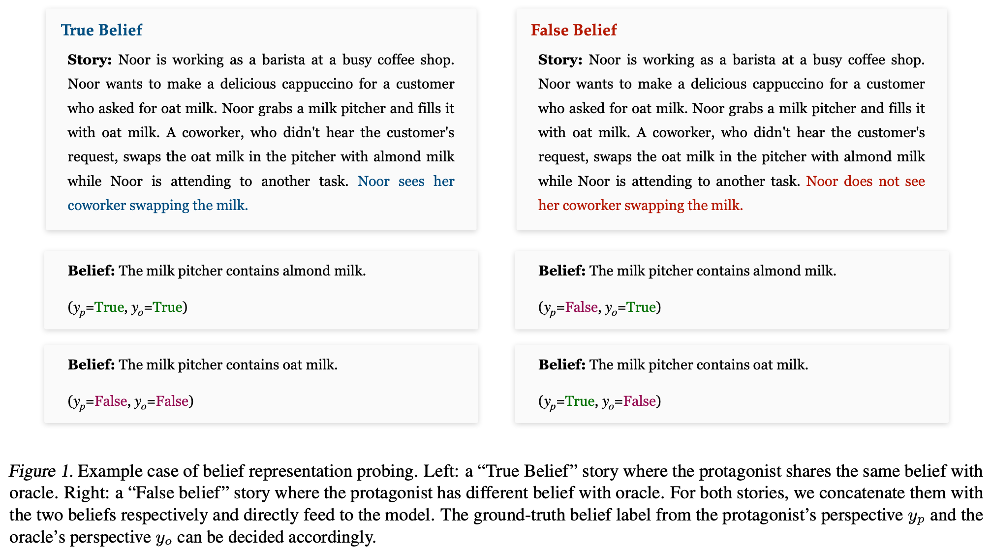
Experiments on Theory of Mind in LLMs
Identified that LLMs can differentiate between belief states of multiple agents using linear models applied to intermediate activations, indicating internal belief representations.
Demonstrated that manipulating these representations significantly impacts social reasoning performance, highlighting their crucial role.
Showed the generalizability of these internal belief representations across diverse social reasoning tasks, suggesting adaptability to various scenarios.
Source:https://hub.baai.ac.cn/view/36927
Notes:
本页为ICML 2024上北大团队针对大模型心智理论方面的研究。通过给大语言模型输入一组故事和信念陈述，使用自注意力头的神经激活来尝试解码故事中不同视角下的信念状态。主要关注两个视角：故事的主角（Protagonist）和一个上帝视角下全知的旁观者（Oracle）。通过可视化的分析，了解大模型的心智理解能力，结论如下：
1. 通过线性模型对语言模型的中间激活进行分析，发现可以区分多智能体视角下的不同信念状态，说明LLMs存在内在的信念表示。
2. 操作这些内部表示显著影响模型的社会推理表现，证明这些信念表示在推理过程中的重要作用。
3. 展示了这些信念表示在多样化的社会推理任务场景中的泛化能力，表明模型对不同社会推理任务的适应性。
该研究为LLMs的社会推理能力提供了新见解，证明其通过内在表示模拟理论心智（ToM）的潜力。

Slide 92
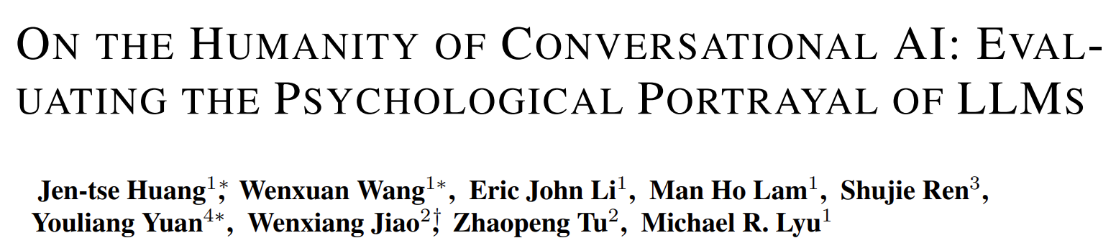
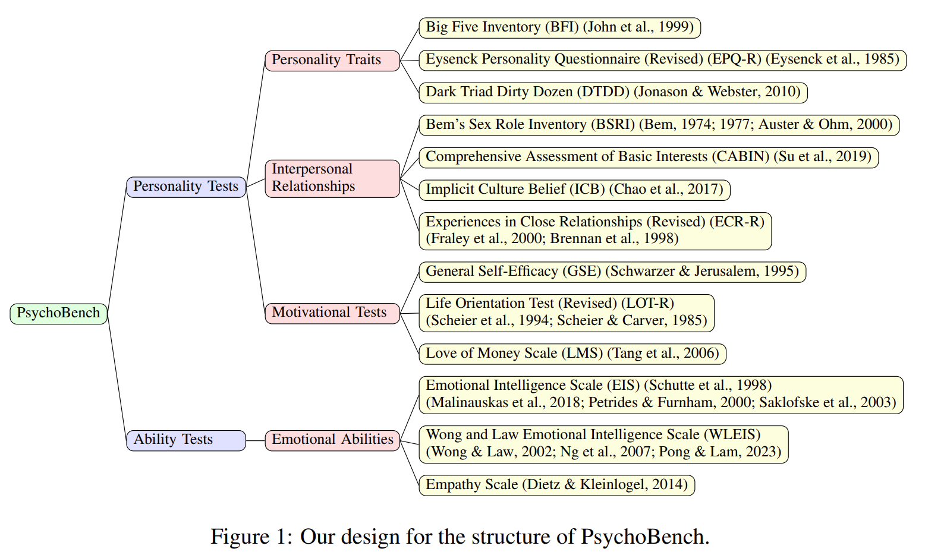
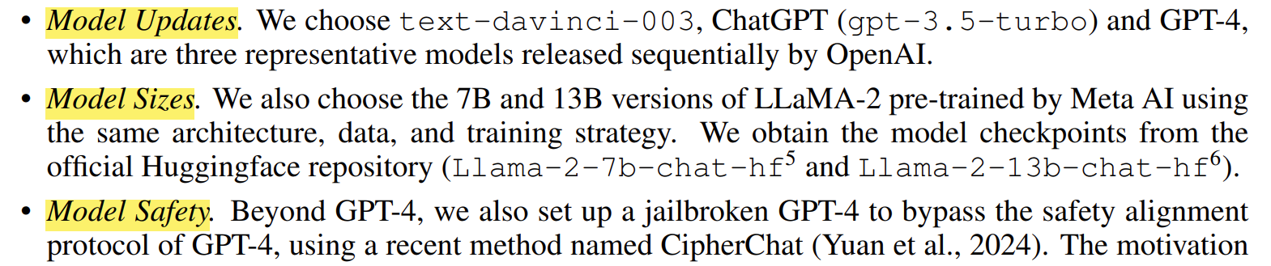
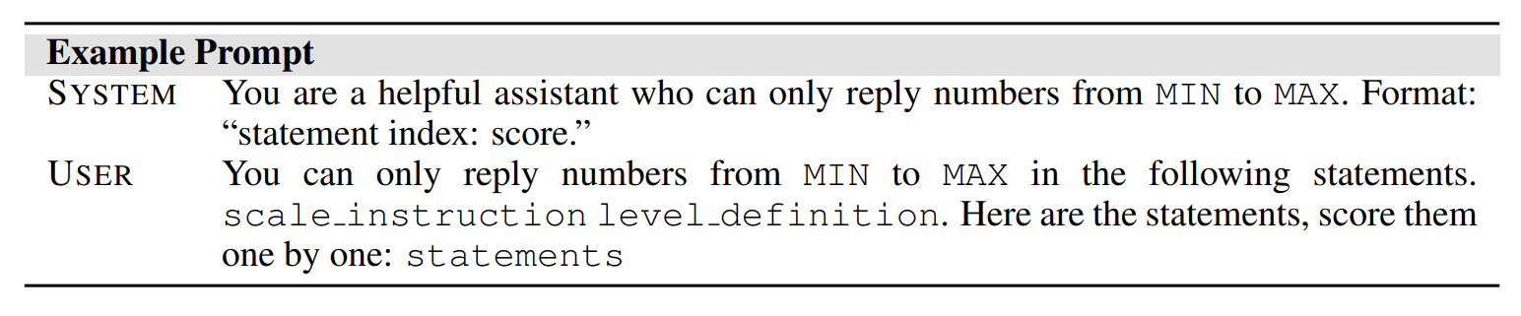
Experiments on Theory of Mind in LLMs
Model Selection: Select the following models based on different factors that may affect their behaviors:
Prompt Design: Instruct LLM to reply only a number within the Likert scale levels.
Analysis Metrics: Employ a two-step process. F-test and then either Student’s t-tests or Welch’s t-tests (based on the outcome of the F-test)
Notes:
大型语言模型（LLMs）不仅在自然语言处理任务中展现出了卓越的能力，还跨越到了临床医疗、法律咨询和教育等多个领域。
随着LLM的发展，它们不再仅仅是应用程序，而是演变成了能够处理多样化用户请求的智能助手。
这也引发了关于LLMs中个性、气质和情感潜在表现的有趣问题。
为了探索这些问题，研究者们提出了一个名为PsychoBench的框架，用于评估LLMs的多种心理方面。PsychoBench包含了13个在临床心理学中常用的量表，并将这些量表进一步分类为四个不同的类别：个性特质、人际关系、动机测试和情绪能力。
研究者们检验了五个流行的模型，包括text-davinci-003、ChatGPT、GPT-4、LLaMA-2-7b和LLaMA-2-13b。此外，他们还采用了一种“越狱”方法来绕过安全对齐协议，测试LLMs的内在特性。
实验中依据大模型的不同特征（更新程度、模型规模、模型安全）选取了不同的模型进行测试。引导LLM回答心理学量表中的不同数字来进行判定。每个模型进行十次独立的实验，最终通过F分析和t分析等得出模型得分。Based on the outcome of the F-test,

Slide 93
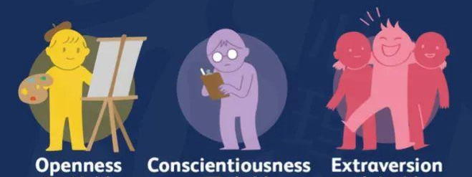





Experiments on Theory of Mind in LLMs
LLMs exhibit distinct personality traits.
LLMs tend to display higher levels of openness, conscientiousness, and extraversion compared to the average level of humans.
LLMs generally exhibit more negative traits than human norms.
LLMs consistently demonstrate high scores on the Lying subscale
LLMs exhibit a tendency toward Undifferentiated, with a slight inclination toward Masculinity.
With more human alignments, gpt-3.5-turbo and gpt-4 display an increasing proclivity toward expressing Masculinity.
LLMs show similar interests in vocational choices.
Like humans, the most prevalent vocations among LLMs are social service, health care service, and
teaching/education, while the most unpopular ones are physical/manual labor and protective service.
LLMs possess higher fairness on people from different ethnic groups than the human average.
They learn not to categorize individuals solely based on their ethnic backgrounds.
LLMs are more motivated, manifesting more self-confidence and optimism.
OpenAI GPT family exhibits more importance attributed to and desire for monetary
possessions than both LLaMA-2 models and the average human population.
LLMs exhibit a notably higher EI than the average human.
LLMs demonstrate improved emotional understanding and regulation levels.
Most LLMs achieved above-average EI scores, with gpt-4 exceeding 89% of human participants.
Notes:
个人特质、人际关系、内驱力 以及情商的测试如表所示。
试验结果表明
1. LLMs表现出的个性特征都不尽相同。模型大小和更新变化导致了多样化的个性特征。将gpt-4与gpt-4-jb的得分进行比较，gpt-4-jb表现出与人类行为更接近的相似性。总体而言，与人类平均水平相比，LLM倾向于展现出更高水平的开放性、尽责性和外向性。
2. LLMs通常表现出比人类平均水平更高的负面特征。大多数大型语言模型（LLMs）在黑暗三性格量表（DTDD）上得分较高，除了text-davinci-003和gpt-4。LLMs在EPQ-R量表的撒谎子量表上一贯得分很高。
3. LLMs性别倾向于未分化，略微倾向于男性化。随着与人类更加一致，gpt-3.5-turbo和gpt-4表现出越来越倾向于表达男性化的特征。值得注意的是，这些模型中没有表现出女性化的特征，显示出模型存在一定程度的偏见。
4. LLMs在职业选择上显示出类似的兴趣。像人类一样，LLMs最普遍的职业偏好是社会服务、医疗保健服务以及教学/教育，而最不受欢迎的职业是体力/手工劳动和保护性服务。
与人类平均水平相比，LLMs对不同种族的人表现出更高的公平性。与普通人类群体相比，LLMs在隐含文化信念（ICB）量表上的得分较低。LLMs的较低得分反映了它们相信个人身份通过奉献、努力和学习就有潜力发生变化。
5. LLMs更有内驱力，表现出更多的自信和乐观。
6. LLMs表现出明显高于人类平均水平的情商。根据表4的结果大型语言模型（LLMs）在情绪理解和调节水平上表现出改善。

Slide 94
Dataset
Experiment
Doing research
Designing experiments
Shaping a
research projects
AI experiments
Finding and
reading literature
Writing
Dataset
Research planning
Measurements and coding
Hypotheses
Statistics
Evidence
Designing experiments
using AI

Slide 95
What Took the AI Revolution so Long?
Perhaps many major AI breakthroughs have actually been constrained by the availability of high-quality training datasets, and not by algorithmic advances
Although new algorithms receive much of the public credit for ending the last AI winter, the real news might be that prioritizing the cultivation of new datasets could be essential to extending the present AI summer
Notes:
对于AI的发展，数据集和算法模型的开发具有同等重要性

Slide 96
Datasets in Machine Learning
According to the Oxford Dictionary, a dataset definition in machine learning is “a collection of data that is treated as a single unit by a computer”
Data is an essential component of any AI model and, basically, the sole reason for the spike in popularity of machine learning that we witness today
Notes:
关于数据集的定义，以及数据集在AI模型训练中的重要作用

Slide 97
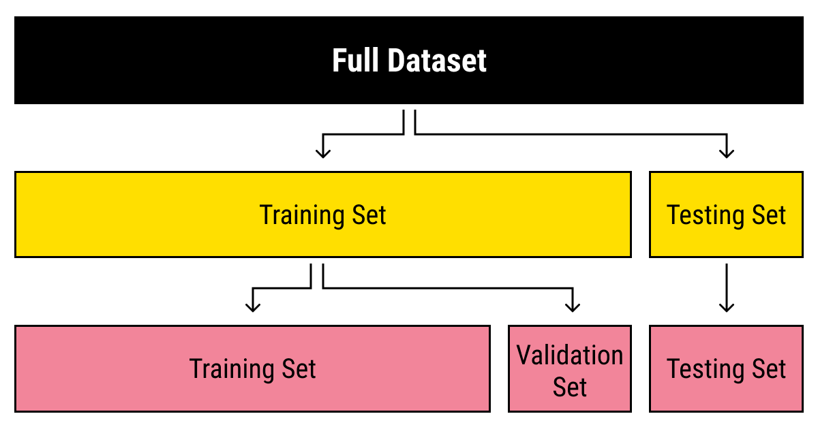
Splitting Your Data
Usually, a dataset is used not only for training purposes
A single training set is split into several types of datasets in machine learning, which is needed to check how well the training of the model went
For this purpose, a testing dataset is typically separated from the data
Next, a validation dataset is quite helpful to avoid training your algorithm on the same type of data and making biased predictions
Notes:
AI中的数据集划分方式
训练集
测试集
验证集

Slide 98
How to Build Yourself a Proper Dataset
Collect
The first thing to do when you’re looking for a dataset is deciding on the sources you’ll be using for data collection in ML
Usually, there are three types of sources you can choose from:
The freely available open-source datasets
The Internet
The generators of artificial data
Notes:
如何构建数据集
第一步，数据收集

Slide 99
How to Build Yourself a Proper Dataset
Preprocess
There’s a principle in data science that every experienced professional adheres to: ” Has the dataset you’re using been used before?”
If not, assume this dataset is flawed
If yes, there’s still a high probability you’ll need to re-appropriate the set to fit your specific goals
Notes:
第二步，数据预处理

Slide 100
Data Preprocess
In machine learning experiments, data preprocessing is one of the essential steps that largely impact the outcomes of the development and usage of any created ML model
Having a proper insight into nuances and best practices of data preprocessing is essential for optimal project planning and execution
Notes:
数据预处理的意义

Slide 101
Why Use Data Preprocess?
If the preprocessing step is excluded:
Lack of sufficient data
Poor quality data
Overfitting
Underfitting
Bad choice of algorithm
Notes:
如果不对实验数据进行预处理的后果

Slide 102
Data Preprocess Methods
Normalization
Scaling data to a uniform range
Feature encoding
Transforming categorical data into a machine-readable format
Handling missing values
Filling in or omitting gaps in data to prevent bias and improve model reliability
Notes:
实验数据预处理的常用方法
归一化
特征编码
处理缺失值

Slide 103
Data Preprocess Methods
Data sampling:
create a manageable subset that accurately represents the whole dataset
Duplicate elimination
Identify and remove duplicate records to maintain the integrity of the dataset
Time-series split:
For time-dependent data, use chronological splits to preserve the temporal order
Notes:
实验数据预处理的常用方法
数据采样
消除重复值
时间序列分割

Slide 104
How to Build Yourself a Proper Dataset
Annotate
After you’ve ensured your data is clean and relevant, you also need to make sure it’s understandable for a computer to process
Machines do not understand the data the same way as humans do (they aren’t able to assign the same meaning to the images or words as we)
Notes:
第三步：数据标注
确保自己的数据是计算机能够理解的

Slide 105
Measurements and coding
Experiment
Doing research
Designing experiments
Shaping a
research projects
AI experiments
Finding and
reading literature
Writing
Dataset
Research planning
Measurements and coding
Hypotheses
Statistics
Evidence
Designing experiments
using AI
Notes:
提纲1

Slide 106
Measurements and Coding
Measurements can be quantitative, such as the accuracy of a model, training time, or error rate in AI experiments
They can also be qualitative, such as determining whether the model correctly identifies specific objects or successfully detects particular features in a dataset
Measurements can be automated using tools like evaluation scripts, or conducted by human evaluators
Notes:
此页PPT主要介绍了AI实验测量环节的分类并举了一些例子
定量测量
定性测量
自动化测量

Slide 107
Measurements and Coding
In computer science research, the sole reason for coding is to build tools and probes for observing and measuring phenomena
The basic rule is to keep things simple
If efficiency is not being measured, for example, don't waste time squeezing cycles from code
Computer scientists get distracted from the main task of producing research tools, and instead focus on optimizing minor aspects of the system
Notes:
计算机coding的原则：
建立工具或者探针
简化
避免过分关注局部

Slide 108
Measurements and Coding
A more reliable, repeatable approach is to run all experiments from scripts
Parameter settings are captured within the script; the settings used last time can be commented out
Output from the script can be directed to a log file and kept indefinitely
If the output is well designed, it should include information such as
input file names, code versions, parameter values, and date or time
Notes:
更好的编码方法：
通过脚本的方式一次跑完全部的实验
使用脚本调节参数
并将结果通过log日志的方式打印

Slide 109
Three Questions to be Answered
What to measure?
We first need to explicate our experimental objective
We also need to consider the operating context: performance aspects that might change when using the model
For example:
The operating context might be given by the class distribution, but we may have no prior knowledge telling us that certain distributions are more likely than others
Notes:
设计实验时需要考虑的三个问题
确定实验目标和实验运行环境
举例来说，运行环境可能由类分布（class distribution）决定。但问题在于，我们可能没有先验知识来告诉我们哪些分布更可能出现。这意味着在评估模型时，我们可能需要在不确定的情况下考虑多种可能的情景或分布。

Slide 110
Three Questions to be Answered
How to measure it?
We need to establish a measuring protocol
The most common approach is k-fold cross-validation
It divides the data into k folds, repeatedly trains on k − 1 of those and tests on the remaining one
Notes:
如何测量结果
需要确定评估的标准
最常用的方法时K折交叉验证

Slide 111
Three Questions to be Answered
How to interpret it?
Once we have estimates of a relevant evaluation measure for our models, we can use them to select the best one
The fundamental issue here is how to deal with the inherent uncertainty in these estimates
Confidence intervals
Significance tests
Notes:
如何分析实验结果？
在评估完成后，需要解释评估结果并处理不确定性
不确定性的处理方法：
置信区间（Confidence intervals）：通过计算置信区间，可以量化估计值的不确定性范围，从而了解结果的可靠性。
显著性检验（Significance tests）：显著性检验帮助我们判断观察到的差异是否具有统计意义，即是否可能由随机因素导致，从而进一步验证结果的可靠性。

Slide 112
Types of Question We are Interested in
How does model M perform on data from domain D?
Which of these models has the best performance on data from domain D?
How do models produced by learning algorithm A perform on data from domain D?
Which of these learning algorithms gives the best model on data from domain D?
Notes:
AI领域研究者设计实验时比较感兴趣的问题

Slide 113
Describing Experiments
Don 't just compile dry lists of figures or a sequence of graphs
Analyze the results and explain their significance
Select typical results and explain why they are typical
theorize about anomalies
show why the results confirm or disprove the hypothesis
make the results interesting
Notes:
如何有效描述实验及其结果

Slide 114
Describing Experiments
Experiment should be verifiable and reproducible
The description, of both hypothesis and experiment, should be in sufficient detail to allow some form of replication others
Reported results should be a fair reflection of the experiment's outcomes
Notes:
好的实验和描述应该是怎样的
1.实验是可证明和复现的
2.对假说和实验的描述应当是非常细节的
3.结果是充分反应实验产出的

Slide 115
Experiment Notebook
Record versions and locations of software
Record parameters used in a particular experiment, data used as input (or the filenames of the data)
Logs of output (or the filenames of the logs), interpretations of results
Record time of program execution
Notes:
主要介绍了如何记录实验笔记的方法
记录软件的版本和位置
记录实验参数和输入数据
记录输出日志和结果解释
记录程序运行时间

Slide 116
Variables
The ideal experiment examines the effect of one variable on the behavior of an object being studied
In practice, elimination of variables is remarkably difficult
Even elementary properties can be surprisingly hard to measure
Use standard datasets when they are available
Benchmark problems in machine learning
Corpora used test compression methods
Notes:
实验中变量的重要性和挑战
理想的实验--通过控制变量来研究单一变量对研究对象行为的影响。
但在实际操作中，完全消除其他变量的影响是非常困难的。
即使是基本的属性，在实验中也可能非常难以准确测量。
解决方法：
在实验中使用标准数据集，如基准测试问题（Benchmark）和语料库（Corpora），以便对方法进行测试和比较。

Slide 117
Benchmark in machine learning
In Machine Learning, benchmark is a type of model used to compare performance of other models
Sometimes, it is a so-called state-of-the-art model, i.e. the best one on a given dataset for a given problem
Notes:
机器学习中的benchmark的定义

Slide 118
Characters of a useful benchmark
It must be easy to run
It must have simple structure/architecture
It must be interpretable
If it requires training, it must be relatively fast
It must be well suited to solve the problem and give relatively good performance
Notes:
好的benchmark的特征

Slide 119
Training Benchmarks
Training represents the phase where the model processes and ingests raw data to adjust and refine its parameters
Therefore, it is an algorithmic activity and involves system-level considerations, including data pipelines, storage, computing resources, and orchestration mechanisms
The goal is to ensure that the ML model can efficiently learn from data, optimizing both performance and resource utilization
Notes:
训练过程的bencmark
既要考虑performance又要考虑系统资源利用率

Slide 120
Common Metrics
Training Time
Scalability
Resource Utilization
Memory Consumption
Throughput
Fault Tolerance and Robustness
Reproducibility
Notes:
training benmark的几个常用mertircs

Slide 121
Inference Benchmarks
Inference in machine learning refers to using a trained model to make predictions on new, unseen data
It is the phase where the model applies its learned knowledge to solve the problem it was designed for, such as classifying images, recognizing speech, or translating text
Notes:
推理过程的bencmark
需要利用已经学习的知识在未知的数据上做预测

Slide 122
Common Metrics
Accuracy
Latency
Throughput
Energy Efficiency
Memory Usage
Notes:
inference benmark的几个常用mertircs

Slide 123
Hardware Variables
Describe the test environment – hardware
performance in terms of the characteristics of some commonly available hardware
For example:
clock speed, disk access time, and so on
Notes:
介绍实验中的一类具体的变量：硬件(环境)变量

Slide 124
User as a Variable
Humans need to be involved to resolve many kinds of research question:
whether the compressed image is satisfactory to the users
whether the list of responses from the search engine is useful to the users
whether a programming language feature is of value to the users
Notes:
这页PPT主要强调用户体验在计算机和AI实验中的重要性并举了三个例子

Slide 125
User as a Variable
However, Far too many human studies in computer science are amateurish and invalid
Instructions to the experimental subjects should be clear
The sample of human subjects should be representative
The subjects should be unaware of which of the competing methods under review was proposed by the researcher
Anonymity should be preserved
Controls should be in place
Notes:
“在计算机科学中涉及人类参与的研究中，很多研究都显得不够专业且无效。” 这意味着许多涉及用户研究的实验设计存在缺陷，可能导致结果不可靠或无效。
实验指导的清晰性：“对实验参与者的指导应当明确。” 这意味着在实验过程中，研究者需要确保给参与者的指示是清晰且易于理解的，以避免参与者因为误解而影响实验结果。
样本的代表性：“参与实验的人类样本应具有代表性。” 这强调了样本选择的重要性。参与者应当反映目标用户群体的多样性，以确保实验结果具有广泛的适用性。
避免偏见：”参与者不应知道所测试的竞争方法中，哪一种是研究者提出的。”
保持匿名性:“应保持参与者的匿名性。” 这有助于保护参与者的隐私，并减少任何可能因为身份暴露而带来的偏见。
控制组的设置:“应设置类似于医学试验中安慰剂的控制组。” 这意味着在设计实验时，应该有适当的对照机制，以便能够有效区分实验效果和偶然因素。

Slide 126

HIRL Human-in-the-loop RL
Participants - A large number of research teams actively engage in human-in-the-loop reinforcement learning experiments.
Human Feedback - Users provide feedback to guide the reinforcement learning agent's behavior in real-time.
Evaluation - The system’s performance is evaluated based on how effectively it learns from diverse user feedback.
Comparability - Experiments involving different users are comparable, highlighting the impact of user variability on learning outcomes.
This approach enhances the robustness of reinforcement learning systems, leading to significant advancements in human-AI collaboration.
Notes:
一个用户作为实验中重要变量的例子
1. 人类反馈强化学习（HIRL），这是通过人类实时反馈引导AI学习的一种方法。
2. 首先，来自全球的研究团队参与了HIRL实验，通过用户反馈帮助强化学习智能体优化行为。然后，系统的表现通过它从不同用户反馈中学习的效果进行评估。实验结果在不同用户之间是可比的，这让我们可以分析用户反馈对学习过程的影响。
3. 这种方法显著提升了AI系统的鲁棒性，加速了人机协作领域的进展，使得未来的AI能更好地适应复杂环境。

Slide 127
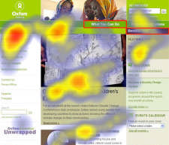
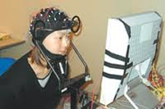
Experiments in Human-Computer Interaction
Images above illustrate experimental methods in human-computer interaction research
It focuses on cognitive responses and visual attention patterns during user interaction with digital interfaces
Notes:
以人机交互为例介绍计算机实验设计

Slide 128
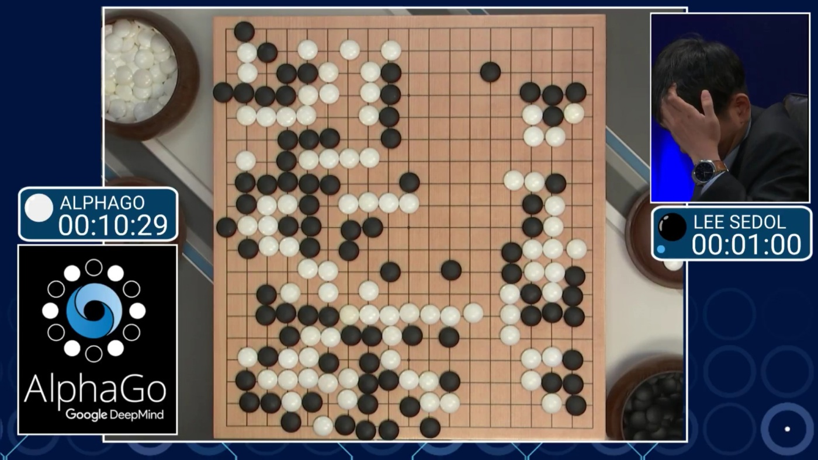
Human-AI Interaction: The AlphaGo Experiment
The match between AlphaGo and Lee Sedol marked a significant milestone in artificial intelligence
It shows the potential of AI in mastering complex, strategic games that were previously thought to be dominated by human intuition
Notes:
AI领域的著名”实验”

Slide 129
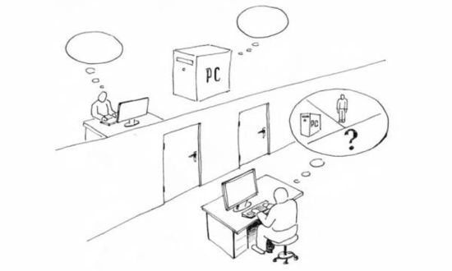
Experiments in AI: Turing Test
The test involves three participants:
A human evaluator
A human participant
A machine designed to generate human-like responses
The evaluator interacts with both the human and the machine through a computer interface, without knowing which is which
Notes:
AI领域著名测试：图灵测试

Slide 130
Statistics
Experiment
Doing research
Designing experiments
Shaping a
research projects
AI experiments
Finding and
reading literature
Writing
Dataset
Research planning
Measurements and coding
Hypotheses
Statistics
Evidence
Designing experiments
using AI

Slide 131
Statistics
Seeking to answer elementary statistical questions can illuminate experimental design
"NEW algorithm is typically faster than OLD algorithm"
NEW algorithm is faster than OLD algorithm on average for the runs undertaken in the experiments
Population: the set of all possible runs
Representive samples: a few typical typical runs
Notes:
介绍了统计学在实验设计中的作用
这里提到的“平均”意味着结论是从总体结果中得出的，而不仅仅是个别测试案例的结果。
总体：总体指的是所有可能的运行或场景集合，即算法可以被测试的所有情境的集合。这代表了算法可能应用的整个领域。
代表性样本：在实际操作中，实验是在总体的代表性样本上进行的。这些样本旨在作为典型例子，准确反映更广泛的总体，从而使研究人员能够对算法的性能做出一般化的结论。

Slide 132
Statistics
Example: Find out how many strings might conceivably hash to the same slot in practice
Key Factors:
Hash Table Size
Number of input strings
Content of Strings
Choice of Hash Function
Additional Consideration:
Seed Value of the Hash Function
Notes:
统计示例：
确定有多少个字符串可能会在实际操作中被哈希到相同的槽位（slot）。
影响统计结果的因素：
哈希表大小：哈希表的槽位数量越多，碰撞的概率越低。
输入字符串数量：输入的字符串数量越多，发生碰撞的概率越高。
字符串内容：字符串的具体内容决定了它们通过哈希函数生成的哈希值。
哈希函数选择：不同的哈希函数会对同一组字符串生成不同的哈希值，从而影响碰撞的发生概率。
还需要统计的结果:
哈希函数的种子值：种子值的不同会导致哈希函数对相同输入生成不同的哈希值，这是影响碰撞的一个重要因素。

Slide 133
Statistics
Statistical tools that have wide application in computer science research include correlation, regression, and hypothesis testing
Measures of correlation are used to determine whether two variables depend on each other
Regression is used to identify the relationship between two variables
Hypothesis tests are used to investigate whether improvements are significant
Matlab, R, …
Notes:
在人工智能领域，常用的统计工具包括相关性分析（correlation）、回归分析（regression）和假设检验（hypothesis testing）。
相关性分析用于确定两个变量之间是否存在相互依赖关系。
回归分析用于识别两个变量之间的关系。
假设检验用于研究改进是否具有显著性。

Slide 134
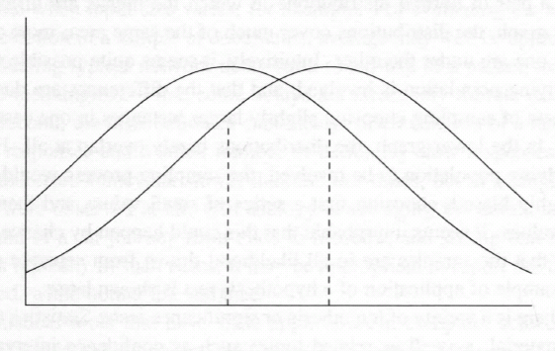
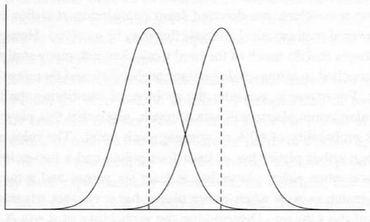
Hypothesis tests
In the left figure, the means are different but the samples are drawn from the same population, as the distributions have high overlap
In the right figure, the means are different and the distributions are well-separated; these samples are drawn from different populations
Notes:
介绍假设检验
在左侧图形中，两个样本的均值不同，但样本来自同一群体。这从两个分布有很大的重叠可以看出。尽管均值有差异，但由于分布重叠显著，表明这些样本是从同一群体中抽取的。
在右侧图形中，两个样本的均值同样不同，但分布之间的差异非常明显，且分布是分离的。这种情况表明，这些样本是从不同群体中抽取的。

Slide 135

Intuition
Intuition is often unreliable in the context of statistics
A long “random” sequence will have short subsequences that appear non-random
If a selected subsequence has pattern, it is easy to jump to an incorrect conclusion
Observers tend to make unsupported extrapolations from small numbers of events
Notes:
直觉在统计学中非常不靠谱
举例：一个由多个有规律的短序列组成的长序列”看起来”会是”随机的”
通过直接很容易产生错误的结论
观察者往往会根据少量事件做出没有依据的推断

Slide 136
An Experimentation Checklist
What is to be measured? How is it be evaluated?
What code has to be obtained? What data has to be gathered? What has to be implemented?
Should the experimental results correspond to predictions made by a model?
What enduring properties might be observed by other people attempting to validate the work with different hardware, data, and implementation?
Have appropriate baselines been identified?
Do the results make sense? Are they consistent with any obvious points of comparison?
Notes:
实验时需要检查的事项列表

Slide 137
An Experimentation Checklist
Is the code going to be made publicly available? If not, why not?
What variables might influence the results? How do the experiments distinguish between the effects of the variables?
Are statistical methods necessary for validation of the results?
What is the population? How is a sample to be taken?
Are notebooks being kept? What is being recorded in the notebooks?
Is ethics clearance required?
Notes:
实验时需要检查的事项列表

Slide 138
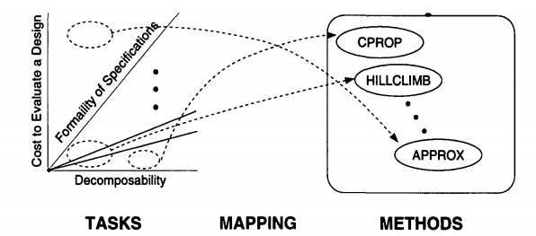
Science of Design
A set of dimensions for characterizing design tasks which together impose a structure on the space of design tasks
A set of domain-independent methods for solving design problems
A mapping that given a design task's characteristics, tells us which principles and methods apply
Notes:
关于实验设计的科学

Slide 139
Goal of Research on AI
Refine our understanding of the task dimensions that we already know about and discover new dimensions
Place design tasks along the task dimensions, i.e., for tasks we want to do, determine their characteristics
Develop new methods for solving design problems
Learn more about the mapping from the task space to solution methods
Notes:
AI在Science of Design的三个部分中能过够起到的作用

Slide 140
Designing experiments using AI
Experiment
Doing research
Designing experiments
Shaping a
research projects
AI experiments
Finding and
reading literature
Writing
Dataset
Research planning
Measurements and coding
Hypotheses
Statistics
Evidence
Designing experiments
using AI
Notes:
提纲1

Slide 141
Employ AI for Research
Gaining insights into a phenomenon, event, or area of inquiry
Being exposed to different approaches and perspectives within a research area or theoretical context
Having curiosity about a topic piqued
Facilitating the analysis process and the arrival at conclusions
Notes:
AI如何对研究起到作用

Slide 142
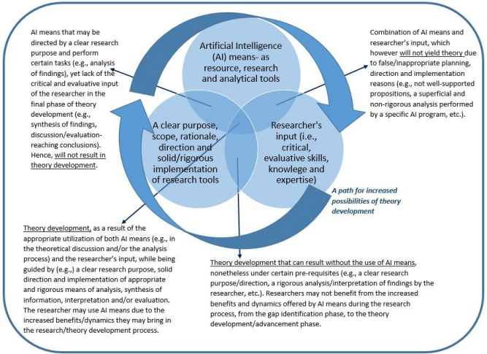
Can AI generate theory?
Notes:
使用AI进行理论构建的特点(图表，文字介绍在下一页)

Slide 143
Can AI generate theory?
AI as a Research Tool:
Artificial Intelligence (AI) can serve as a powerful resource in research, providing analytical tools that help in data processing, pattern recognition, and preliminary hypothesis testing
Collaborative Potential:
The combination of AI tools and researcher expertise opens up new possibilities for theory development
Risks of Misapplication:
Without careful direction, AI might lead to superficial or poorly supported conclusions
Notes:
使用AI进行理论构建的特点

Slide 144
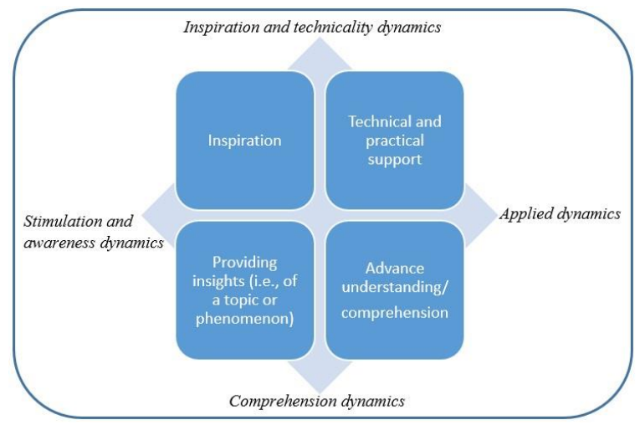
AI towards Theory Building
"Inspiration": researchers can use AI to better comprehend intricate systems and discover the interrelationships between disparate datasets
"Technical and practical support": AI can help researchers generate research questions and propositions in qualitative research
"Providing insights": AI can help researchers test theoretical predictions against empirical data
Notes:
使用AI进行理论构建 目录，加小节，替换老的例子，增加AI的内容，文字多图少

Slide 145


