Slide 1
科技写作和报告 Writing and Presenting for Computer Science Class1 Introduction
wwj09315@buaa.edu.cn
http://sccse.nlsde.buaa.edu.cn
Notes:
课程代号： 061307

Slide 2
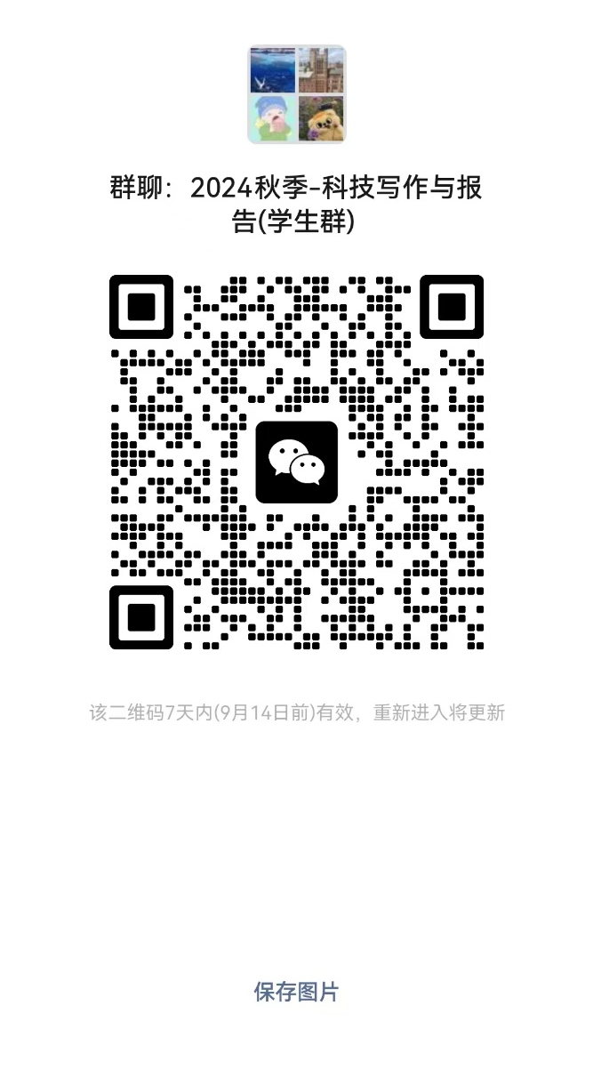
Outline
Why publish?
Publication Venues
Cycles of Publication
Publication Layout
Ethnics
Referee
课程考核

Slide 3

http://en.wikipedia.org/wiki/Publish_or_perish
"Publish or perish" refers to the pressure to publish work constantly to further or sustain a career in academia.
Publish or perish
Publish and flourish
Notes:
发表或灭亡”指的是不断发表作品以促进或维持学术生涯的压力
也就是要么发表文章，要么灭亡
你发表得好了，那么就可以蓬勃发展

Slide 4
The importance of publications
Academic career depends on publication list
Young PhD graduate: a few publications may convince potential employer of research potential
Something is better than nothing
Yet, avoid publishing crap
Strategic plan is useful: publish what, where, at what pace, with whom?
Notes:
因此，发表文章由非常多的重要性
学术生涯取决于你文章列表的水平
年轻的博士毕业生：一些出版物可能会让潜在雇主相信研究潜力
然而，避免发表垃圾的文章，
发表文章的策略也是很重要的：发布什么内容、在哪里发表、发表的速度、以及和谁发表，都非常的重要

Slide 5
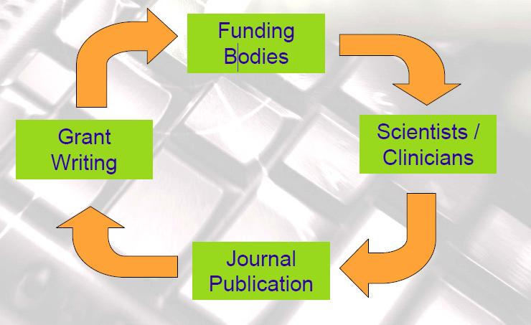
Publish or perish
Notes:
我们发表文章和延续科研是有内在的循环关系的

Slide 6
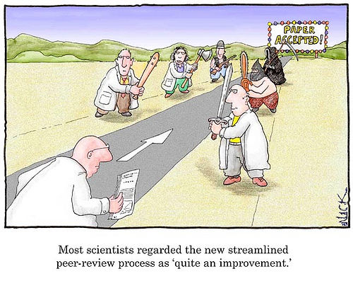
Writing, science, and skepticism
Writing defines what we consider to be knowledge.
Scientific results are only accepted as correct once they are refereed and published
A unifying principle for the scientific culture is skepticism
Within science, skepticism is an open-minded approach to knowledge
Notes:
New ideas must be explained
clearly to give them the best possible chance of being understood, believed,
remembered, and used. This
A unifying principle for the scientific culture that determines the value of research is that of skepticism.
我们发表文章，做科学研究，还需要具有一些善于怀疑和质疑的精神和特性
写文章定义了我们所认为的可以作为知识的东西
科学结果只有在经过评审并发表后才被视为正确
在科学文化中，怀疑精神和主义是一种统一的普世的原则
在科学中，怀疑主义是一种对知识的开放接受批评的态度

Slide 7
Writing, science, and skepticism
Science is a system for accumulating reliable knowledge.
The process of science:
speculation, observation, and a growing understanding of some idea or phenomenon.
Writing underpins the research cycle.
the discipline of stating ideas as organized text forces you to formulate and clarify your thoughts
Notes:
A key aspect of writing is that the discipline of stating ideas as organized text forces you to formulate and clarify your thoughts
科学本身是一种积累可靠知识的庞大的系统
那么科学是一种怎样的过程呢？
它包括推测、观察以及对某些想法或现象的不断加深的理解和认识
因此写作是科学研究周期中的非常基础和重要的一环
以有组织的文本形式陈述想法的过程，会迫使你阐明和澄清你的观点

Slide 8

Kinds of Publication
Scientific results can be presented in
A book
A thesis
A journal article
A complete paper or extended abstract in a conference or workshop proceedings
A technical report or a manuscript
A poster in a conference or workshop
Notes:
那么，我们有哪些类型的发表论文的方式呢？
会议或研讨会的论文
和展报的一种形式，如90cmx70cm的板报的大小

Slide 9

Books vs Papers
Books
tend not to contain new results or prove the correctness of the information they present
can represent an author's opinions as well as established scientific knowledge
Papers
must be defended and justified
Notes:
Books are usually texts that tend not to contain new results or prove the correctness of the information they present.
In contrast to books-which can represent an author's opinions as well as established scientific know ledge
the content of a paper must be defended and justified.
写书时，一般不包含新结果或证明其所提供信息的正确性，可以代表作者的观点以及陈述既定的科学知识
而我们写的论文则要求每个细节都是可论证的，可辩护的

Slide 10
Journal vs Conference
Theoretical research
a long tradition of completing, revising, and extending conference papers for submission and publication in archival journals
Experimental research
conference publication is preferred to journal publication
the premier conferences are generally more selective than the premier journals
Notes:
http://www.cra.org/resources/bp-view/evaluating_computer_scientists_and_engineers_for_promotion_and_tenure/
When one discovers a fact about nature, it is a contribution per se, no matter how small. Since anyone can create something new [in a synthetic field], that alone does not establish a contribution. Rather, one must show that the creation is better.
Accordingly, research in computer science and engineering is largely devoted to establishing the "better" property.
http://www.cs.washington.edu/homes/mernst/advice/conferences-vs-journals.htm
而期刊和会议也是有区别的，
首先对于理论方面的工作，我们经常有一个长期的传统，也就是在会议论文的基础上，（）我们可以转投期刊
但是对于实验性的结果和研究，我们一般先投会议，因为比较快。

Slide 11
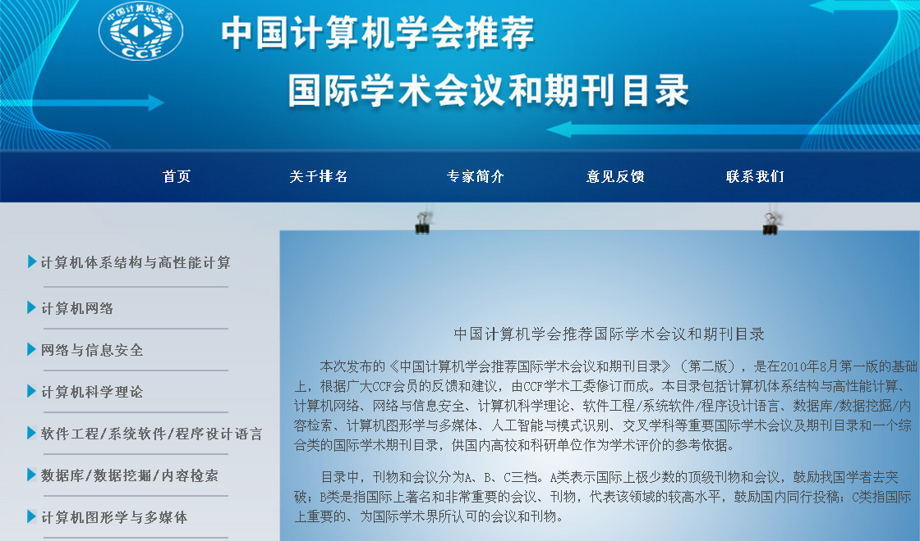
http://history.ccf.org.cn/sites/ccf/paiming.jsp

Slide 12
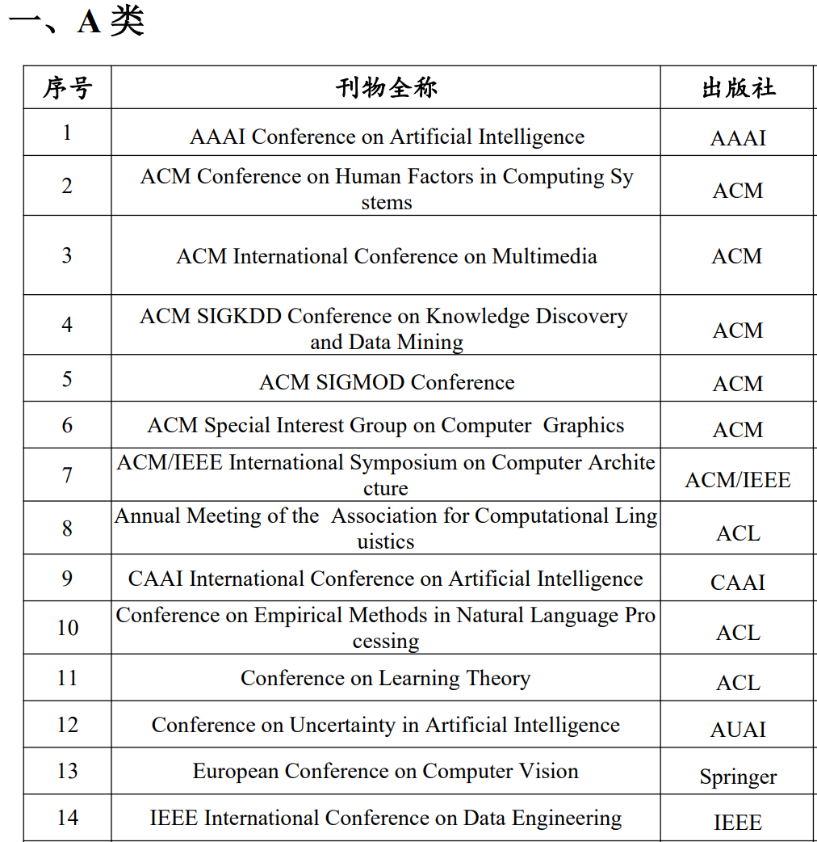
中国人工智能学会推荐国际学术会议和 国际/国内期刊目录
智能科学与技术基础理论
智能科学与技术交叉
脑认知与类脑智能
机器学习
机器感知与模式识别
自然语言处理
知识工程与数据挖掘
跨媒体智能与人机交互
智能机器人与系统
智能芯片与计算系统以及人工智能伦理
安全与治理
https://www.caai.cn/index.php?s=/home/article/detail/id/3445.html

Slide 13
Journal
Aim for balance: some quick “low” level: conference proceedings, web-based journals. Invest time & energy in at least one/ a few prestigious publication/s
“if you can do one, you can do more!”
Get your best work in the best journals (check them out: impact factor?)
Avoid non-refereed journals (unless it’s reviews or opinion pieces for general public)
Avoid editors that work slowly (you can’t wait 3-4 yrs for your first publication to come out)
Notes:
我们需要平衡自己的目标：一些快速的“低”级别：会议记录、网络期刊。投入时间和精力在至少一本/几本著名出版物上
如果你能做好一件事，你就能做更多，这是我们学术圈内默认的规律
不要发表没有同行评议的期刊，除非你在做一些大众科普服务的事情
尽量避免速度太慢的期刊，特别是一些效率很慢的编辑。不可能在博士阶段过了3-4年才发表第一篇文章。

Slide 14
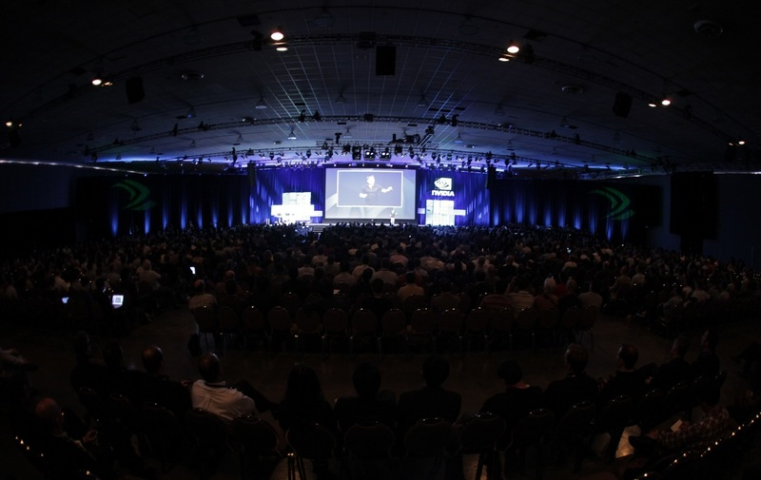
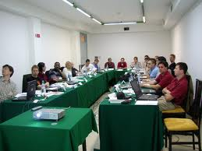
Conference and Workshop
Conference
A large academic meeting
Wide scope
More attendance
Longer paper ( 8-12 pages )
Workshop
A smaller meeting
Narrow scope
Less attendance
Shorter paper ( 6 pages )
Can be held together with a conference
Proceeding of Conference or Workshop
Notes:
那么我们的会议和研讨会有什么区别呢？
Conference会议
1是一个大规模的学术的meeting，2有非常广泛的受众面，3有更多的听众，4其要求的论文的长度也更长
而研讨会
1一般是小规模的meeting，2其包括的领域范围也更窄，3听众更少，4

Slide 15
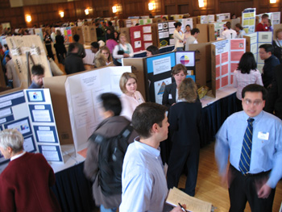
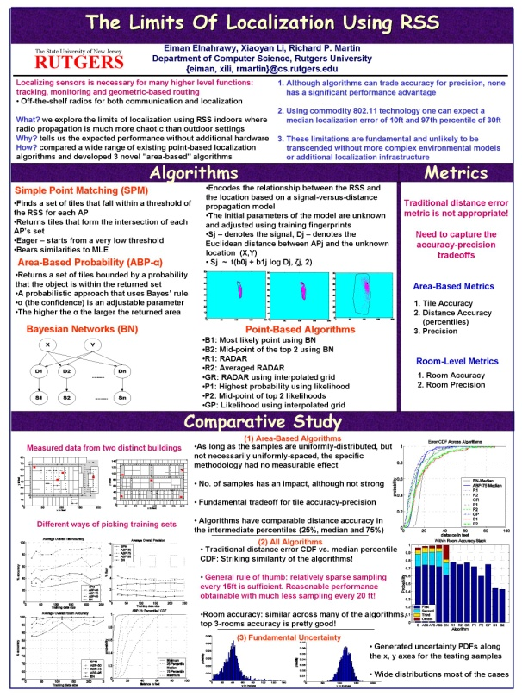
Poster
Poster session
separate room or area of a tradeshow floor
researchers accompany a paper poster
illustrating their research methods and outcomes
Poster Size: from 2x3 feet to 4x8 feet in dimensions
Notes:
Poster
展报的session部分
通常有一个独立的房间
战报

Slide 16
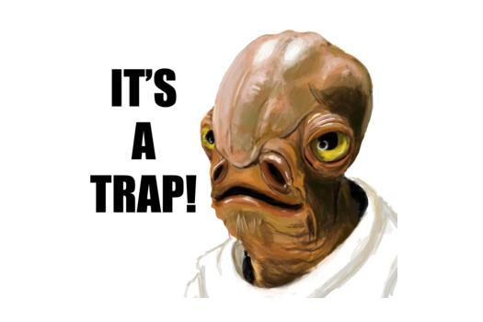
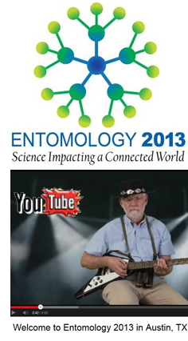
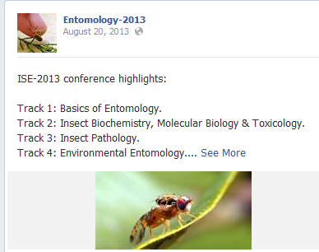
Don’t choose bogus conferences
Entomology-2013 vs Entomology 2013
Notes:
The scientists who were recruited to appear at a conference called Entomology-2013 thought they had been selected to make a presentation to the leading professional association of scientists who study insects.
一定要小心，不要选择虚假的会议
像有一些虚假的会，会通过各种方式让你以为这是该领域的权威回应。通常是在权威会议的logo等基础上，做一些手脚，或极小的修改，让你看不出来。

Slide 17
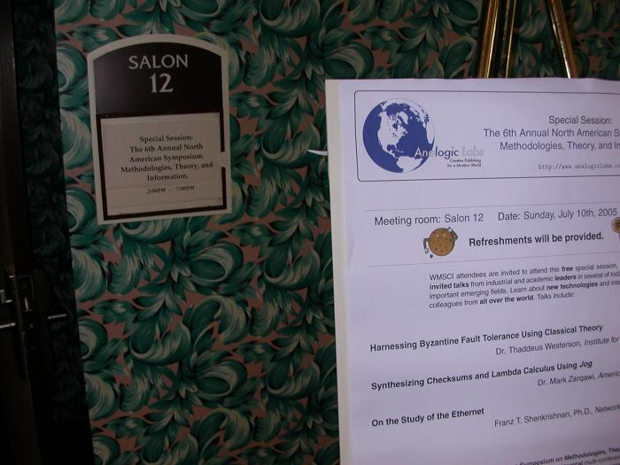
Don’t choose bogus conferences
SCIgen: http://pdos.csail.mit.edu/scigen/
WMSCI 2005
World Multiconference
on Systemics,
Cybernetics
and Informatics
Notes:
http://pdos.csail.mit.edu/scigen/
Scigen是 一种论文自动生成器，

Slide 18
Don’t choose bogus conferences
http://scigendetection.imag.fr/index.php
Cyril Labbé of Joseph Fourier University in Grenoble, France, has catalogued computer-generated papers that made it into more than 30 published conference proceedings between 2008 and 2013.
Labbé developed a way to automatically detect manuscripts composed SCIgen
Labbé does not know why the papers were submitted — or even if the authors were aware of them.
Most of the conferences took place in China, and most of the fake papers have authors with Chinese affiliations.
Notes:
http://scigendetection.imag.fr/index.php
Over the past two years, computer scientist Cyril Labbé of Joseph Fourier University in Grenoble, France, has catalogued computer-generated papers that made it into more than 30 published conference proceedings between 2008 and 2013.
Sixteen appeared in publications by Springer, which is headquartered in Heidelberg, Germany, and more than 100 were published by the Institute of Electrical and Electronic Engineers (IEEE), based in New York. Both publishers, which were privately informed by Labbé, say that they are now removing the papers.
Among the works were, for example, a paper published as a proceeding from the 2013 International Conference on Quality, Reliability, Risk, Maintenance, and Safety Engineering, held in Chengdu, China. (The conference website says that all manuscripts are “reviewed for merits and contents”.) The authors of the paper, entitled ‘TIC: a methodology for the construction of e-commerce’, write in the abstract that they “concentrate our efforts on disproving that spreadsheets can be made knowledge-based, empathic, and compact”.
http://www.nature.com/news/publishers-withdraw-more-than-120-gibberish-papers-1.14763
Labbé is no stranger to fake studies. In April 2010, he used SCIgen to generate 102 fake papers by a fictional author called Ike Antkare [see pdf]. Labbé showed how easy it was to add these fake papers to the Google Scholar database, boosting Ike Antkare’s h-index, a measure of published output, to 94 — at the time, making Antkare the world's 21st most highly cited scientist. Last year, researchers at the University of Granada, Spain, added to Labbé’s work, boosting their own citation scores in Google Scholar by uploading six fake papers with long lists to their own previous work2.
拉贝博士 开发一种能够检测自动生成器生成的文章的软件，经过统计发现，其中，2008到2013年直接，有30多篇已发表的文章是来自于这种生成器的，都发表在spinger和IEEE的会议上面。其中，绝大多事，是来着中国的作者和中国研究单位，这是一件非常不光彩的事情

Slide 19
How to get published
Is the research topic hot?
Do you belong to a network of people interested in the topic?
go to conferences
talk to major researchers in the field, contact authors if paper is not easily accessible (a little flattery can help)
Keep an eye on call for papers of conferences or special issues or edited books
Notes:
请密切关注会议论文或特刊或编辑书籍的 征稿信息

Slide 20
Cycles in writing and publication
Doing research
Shaping a research projects
Finding and reading literature
Research planning
Hypotheses
Evidence
Experiment
Writing
Notes:
我们的写作和发表是有其的写作周期规律的
首先做科研，
-需要构思你的研究项目
-不断做背景调研
-设计你的研究计划
-做适当的科研假设
-并搜集足够的证据去证明你的假设
然后是实验，
最后是通过写论文，把你的成果和方法展现出来

Slide 21
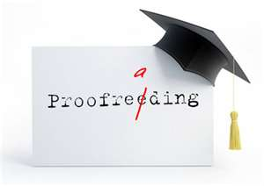
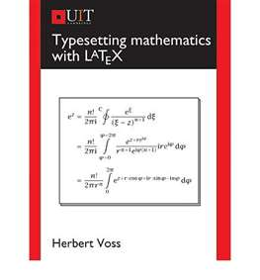
Cycles in writing and publication
Drafting
Revising
Proofreading
Typesetting
Submitting
Notes:
Writing
起草 修改 校对 排版 提交
那么这是整一套的前期的流程

Slide 22
Cycles in writing and publication
Publication
Notification
Revising again based on the comments
Copyright form
Prepare your presentation for a conference paper
Cosmetic work for a journal paper
Notes:
在这个循环过程当中，
你出版之前，需要等待通知，例如返修的通知
然后，根据审稿意见进行修改，
填写版权表格
会议接收之后，需要准备会议的presentation
同时也要进一步做修饰的工作，例如文章的polish，文笔的打磨

Slide 23
Paper Structure (1)
Need to be accurate and informative for
effective indexing
and searching
Title
Author(s)
Affiliation(s) and address(es)
Abstract
Keywords
Notes:
论文的题目需要精确和拥有较大的信息量，这是方便我们后期能够在查找和索引方面更加高效

Slide 24
Paper Structure (2)
Introduction
Content
Related Work
Conclusion
Acknowledgement
References
Notes:
介绍 实质内容 相关工作调研 结论 致谢 参考

Slide 25
Paper Structure (3) Introduction
Provide the necessary background
information to put your work into context
It should be clear from the introduction:
Why the current work was performed
–aims
–significance
What has been done before
What was done (in brief terms)
What was achieved (in brief terms)
Notes:
提供必要的背景
将您的工作和信息适当地融入上下文当中
在简介的部分，你需要呈现如下的信息：
为什么进行当前的工作 –目标 -意义
之前其他人的工作已经做过什么
你的文章做了什么（简单来说）
最终取得了什么成果（简而言之）

Slide 26
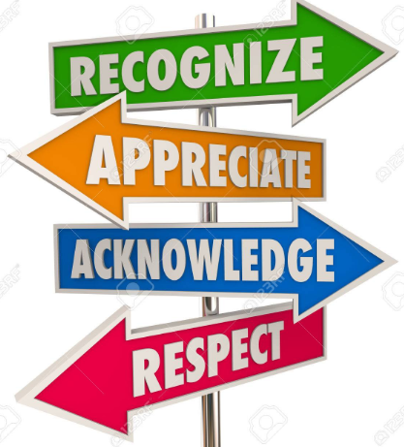
Paper Structure (4) Acknowledgement
Acknowledge anyone who has helped you with the
study, including:
Researchers who supplied materials or software,
Anyone who helped with the writing or English, or offered critical comments about the content
Anyone who provided technical help
State why people have been acknowledged and ask their permission
Acknowledge sources of funding, including any
grant or reference numbers
Notes:
在致谢的部分也需要 注意许多细节，
你需要对任何给予这篇文章帮助的人表示感谢
同时在表示感谢的时候，需要说明原因，以及获得对方的允许
确认资金来源，包括任何 授权号或参考号

Slide 27
Paper Structure (4) References
the style and format as required – it is not the editor’s job to do so for you
Harvard System (alphabetical by author/date)
APA (American Psychological Association) System (alphabetical)
Vancouver System (numbered in order or citation)
Note: there are a number of other systems in use and variations for all systems
Notes:
所需的风格和格式 - 编辑的工作不是为您这样做
注意，不同的期刊，和会议的投稿的参考文献风格是不一样的，你需要在投稿之前，对所需要投稿的会议的文献风格作相应的了解，有前期的调研。不要出现乌龙的情况

Slide 28
Supplementary material
Information related to and supportive of the main text,
but of secondary importance
Data
Code
Video data
Will be made available online when the manuscript is published
Notes:
与正文相关并支持正文的任何信息，都可以包含在这个部分
当我们的
补充材料的信息会在我们论文发表后 在网上同时提供出来。

Slide 29
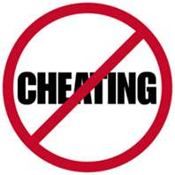
Ethics
Science is built on trust
Researchers are expected to be honest
Research is assumed to have been undertaken ethically
No Plagiarism
Notes:
Plagiarism is re-use in one paper of material 由at has ap严缸ed in another,
without appropriate acknowledgement
Misrepresentation is when a paper does not accurately reflect the outcomes that
were observed or the contribution of previous research.
Deciding who has merited authorship of a paper can be a difficult and emotional
issue. A broadly accepted view is that each author must have made some
significant contribution to the intellectual content of the paper.
科学的伦理道德
科学建立在信任之上
研究人员都应给是诚实的
研究被认为是在道德上进行的
严禁抄袭
本质上是不要做任何的欺诈和舞弊的行为

Slide 30
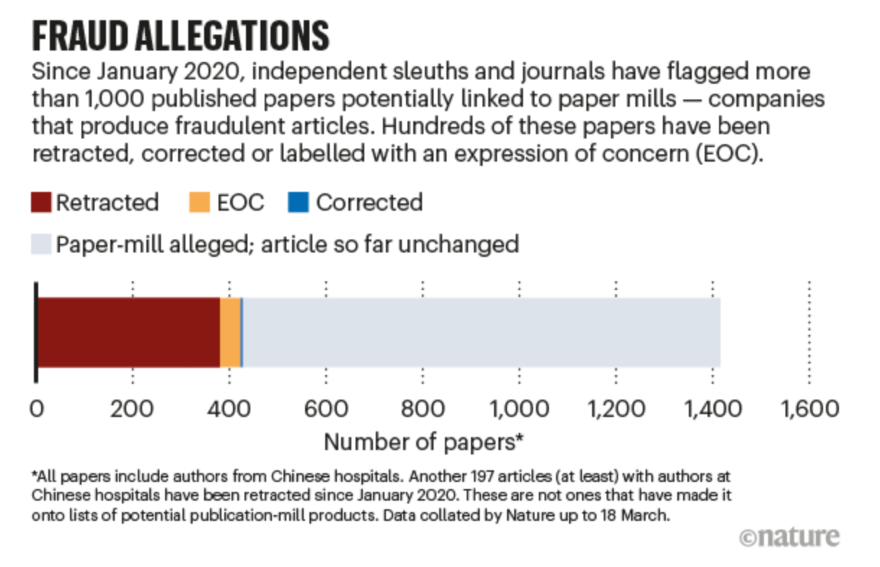
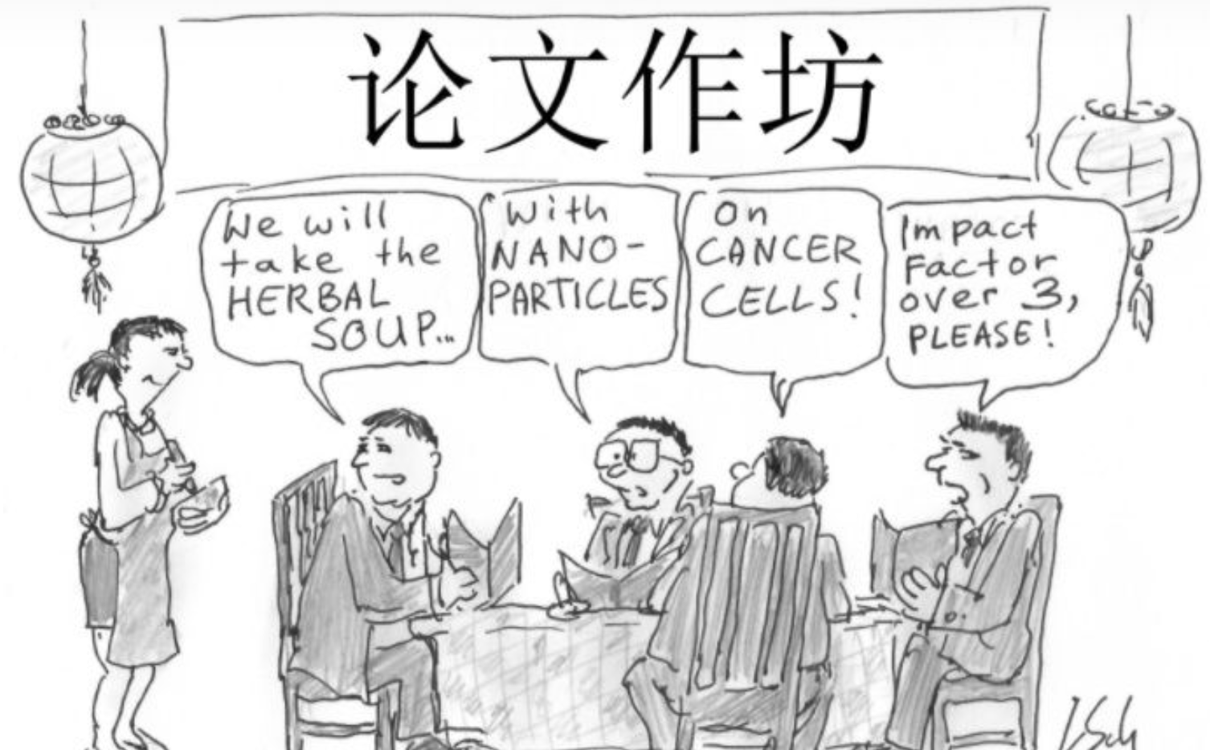
Fake-paper factories – Paper Mill
In 2017, China’s Ministry of Science and Technology (MOST) said it would crack down on misconduct after a scandal in which 107 papers were retracted at the journal Tumor Biology
<<科学技术活动违规行为处理暂行规定>>
“从事学术论文买卖、代写代投以及伪造、虚构、篡改研究数据等”
Notes:
这里介绍一个假论文工厂的非常不好的例子
这些假论文的工厂都已经形成了一种产业了
2017 年，《肿瘤生物学》杂志发生 107 篇论文被撤回丑闻后，中国科学技术部 (MOST) 表示将严厉打击不当行为

Slide 31
Ethics Check list (1)-- Authorship
Is all the text yours?
Are you the copyright holder for all figures and illustrations?
Have any authors been listed without their knowledge?
Have other potential authors been omitted? Do they know that publication is proceeding without them?
Notes:
Is any of the material confidential?
Was clearance obtained for any human studies?
那么学术道德是由很多方面组成的，首先是你的作者版权和作者列表
-首先这篇文章是你写的吗？一个最基本的问题
-你对所有图片和插图是否享有你的版权
-是否有作者在不知情的情况下被列出
-其他潜在作者是否被遗漏了？他们是否知道出版工作在没有他们的情况下进行

Slide 32
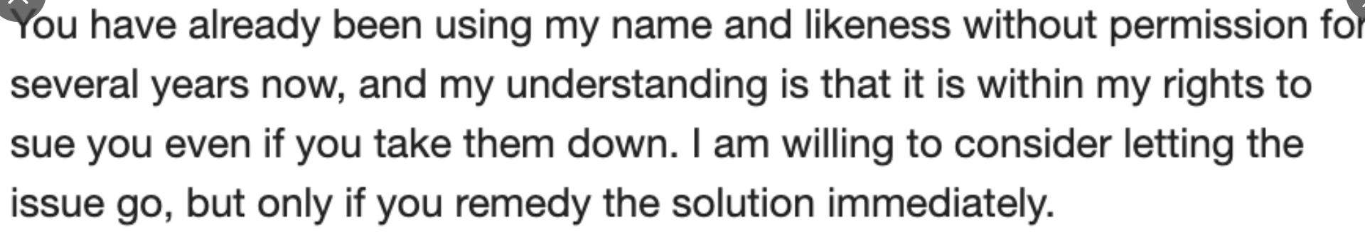
Journal pulls two-studies that listed an author without his permission
Springer Nature has removed two studies that were published in its journal Cluster Computing
A FCM cluster: cloud networking model for intelligent transportation in the city of Macau
Mobile network intrusion detection for IoT system based on transfer learning algorithm
David Cox, the IBM Director of the MIT-IBM Watson AI Lab
Notes:
https://retractionwatch.com/2021/02/01/journal-pulls-two-studies-that-listed-an-author-without-his-permission/
Springer Nature has removed two studies that were published in its journal Cluster Computing and included a co-author who didn’t know that the papers existed until December 2020, years after they were published.
澳门城市大学研究员 将造假归咎于另外一位作者 Xiang Yao。Xiang Yao 隶属于珠海大横琴科技发展有限公司。Daming Li 向出版商表示，Xiang Yao 在听取了 Cox 的 idea 后，将其姓名加在论文作者列表之中，目前 Xiang Yao 已被解雇。
这个作者列表的问题在近期是由具体案例的，
也就是Springger Nature旗下的期刊Cluster computing对两篇滥用作者列表的论文进行了撤稿，
这两篇均来自澳门城市大学的研究人员，

Slide 33
Ethics Check list (2)
Is the scope of citation and attribution clear? Is there a clear distinction between new work and previous knowledge?
Has other work with similar results been appropriately cited and discussed?
If any material is shared with another paper, has the sharing been explained to the reader? Has it been explained to the editor?
Does the paper include material recycled from your earlier work?
Are other papers accurately described?
Notes:
引用范围和归属是否明确？新工作和以前的知识之间有明显的区别吗？
具有类似结果的其他工作是否被适当引用和讨论
如果任何材料与另一篇论文共享，是否向读者解释了共享情况？有没有给编辑解释一下
论文中是否包含从您早期作品中的材料，并且重复使用了
其他论文是否准确描述？

Slide 34
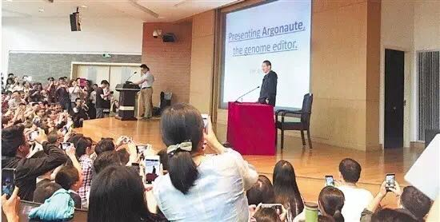
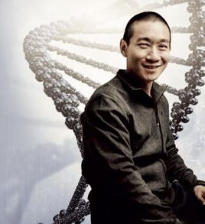
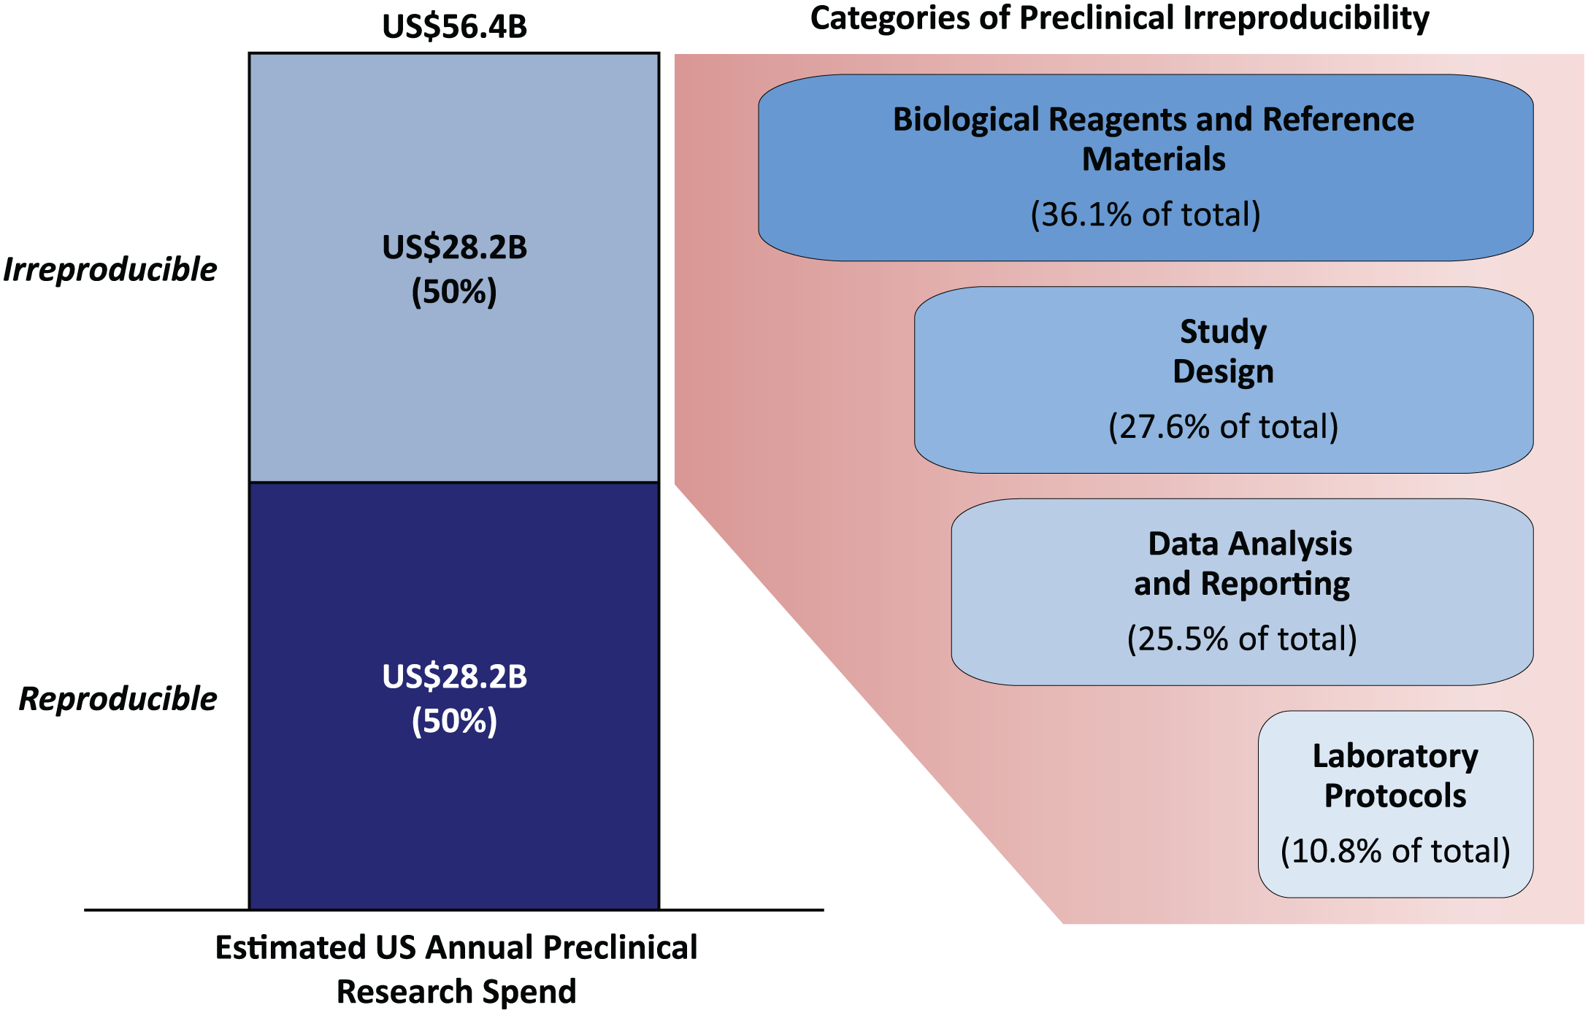
Ethics
Reproducibility in Science
“non-reproducible single occurrences are of no significance to science”
-- Karl Popper
<The Logic of Scientific Discovery>
Reproducible research: research paper along with the laboratory notebooks and full computational environment used to produce the results in the paper such as the code, data, etc.
around $28 billion worth of research per year in medical fields is non-reproducible
Notes:
文章结果的可复现性也是科学伦理道德的很重要的一个方面
不可重复的单一事件对科学没有意义！！
河北科技大学 生命科学系 副教授 韩春雨于2016年，在国际顶级期刊《自然·生物技术》（Nature Biotechnology）杂志上发表了一篇研究成果，即发明了一种新的基因编辑技术。论文发表后，在国内外引发强烈关注，甚至被部分媒体誉为“诺奖级”实验成果。但此后不久，该论文内容就陷入争论：有人提出韩春雨的试验无法重复，有人说可以重复。在2017时候，就进行了撤稿处理。
医学领域每年价值约 280 亿美元的研究是不可重复的，这是对我们原本就非常稀缺科技资源的极大浪费

Slide 35
Ethics Check list (3)
Reproducibility: Could you run the experiments again and get the same outcome?
Do you know which version of the code was used to run the experiments?
Are there any weaknesses or limitations in the experiments that need to be described? Would you be prepared to show other researchers the raw experimental materials?
Are any claims overstated?
Notes:
再现性：你能再次进行实验并得到相同的结果吗？
您知道使用哪个版本的代码来运行实验吗？
实验中是否存在需要描述的弱点或限制？您愿意向其他研究人员展示原始实验材料吗？
是否有任何说法被夸大了？

Slide 36
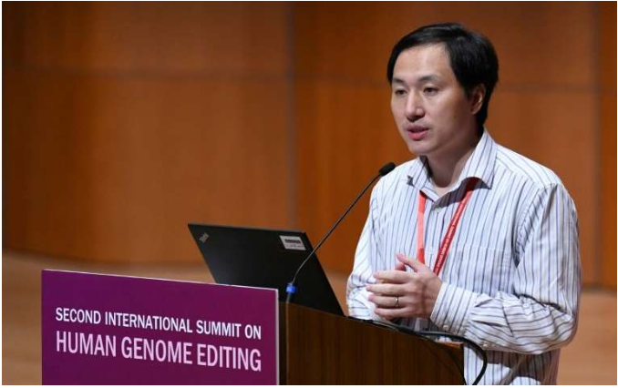
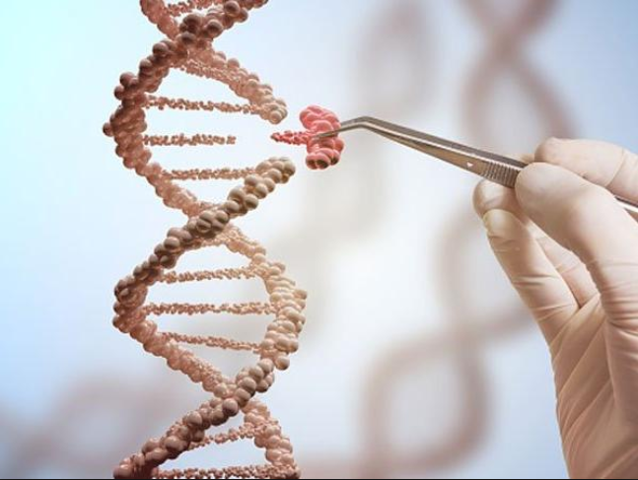
Ethics
The Southern University of Science and Technology severed ties with the scientist who rattled researchers last year after he claimed to have engineered the world’s first gene-edited babies
Regulations in the U.S., U.K., China, and elsewhere require genetically-modified human embryos to be destroyed after a few days.
Notes:
A university in China has severed ties with the scientist who rattled researchers last year after he claimed to have engineered the world’s first gene-edited babies.
He claims to have used CRISP-Case 9, a precise gene-editing technique, to alter a pair of embryos to make them impervious to HIV.
还有一种更加严重的违反学术道德的问题，就是违反人伦道德，
这里有一个非常恶劣 一个事件，就是2018通过基因编辑技术，对婴儿胚胎进行基因编辑的时间，并且这个孩子好像已经出生了。
贺建奎在自己的实验室内录制视频解释自己对胚胎进行基因编辑的过程

Slide 37
Ethical Issues for AI
Privacy & Security: AI systems should be secure and respect privacy
Reliability & Safety: AI systems should perform reliably and safely
Transparency: AI systems should be understandable
Accountability: AI systems should have algorithmic accountability
Fairness: AI systems should treat all people fairly

Slide 38
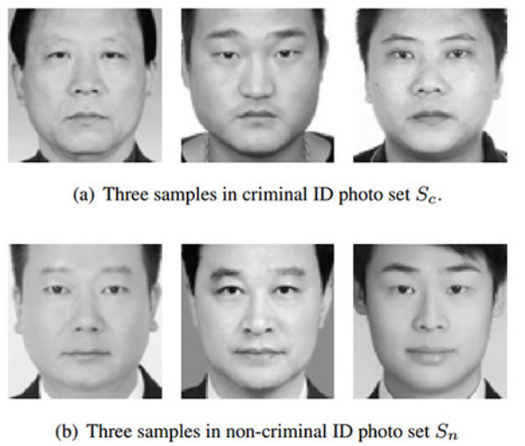
Ethical Issues for AI
Privacy Protection
Data collected for ‘Big Data’ originates from many aspects of human activities and may involve collection of personal data
Avoid Bias and Discrimination
Data Balance
Facial Recognition Examples
Two scientists from China's Shanghai Jiao Tong University produced a study that claims to be able to tell a criminal from a law-abiding citizen solely based on a facial recognition algorithm.
IEEE found that police surveillance cameras using facial recognition to identify suspected criminals are five to 10 percent less accurate when identifying African Americans .
Notes:
下一个伦理道德的问题涉及我们的AI和大数据
首先是隐私保护的问题，“大数据”收集的数据源自人类活动的许多方面，可能涉及个人数据的收集。这方面的数据是需要保护的
我们需要避免歧视和偏见。包括数据平衡和面部识别示例
2017年的时候，上海交通大学的两名科学家进行了一项研究，声称能够仅根据面部识别算法来区分 罪犯和 守法公民。就是通过看别人的脸来判断是不是罪犯，或者有犯罪倾向，然后 准确率达到了近90%。这篇文章发表后，也引起了轩然大波，也被美国google公司的相关研究人员，活力全开进行痛批。因为这种行为会引发严重的社会问题，促进种族主义。这是极端思想的延续，远远超出了科学伦理的范畴。
Privacy protection
Data collected for ‘Big Data’ originates from many aspects of human activities and may involve collection of personal data, interests, credit card information and even health records of individuals.
(2) https://www.rt.com/news/368307-facial-recognition-criminal-china/
“I‘d call this paper literal phrenology, it’s just using modern tools of supervised machine learning instead of calipers. It’s dangerous pseudoscience,” Kate Crawford, an AI researcher with Microsoft Research New York, MIT, and NYU told The Intercept.
We suggest that the concept of responsible research and innovation (RRI) can provide the framing required to act with a view to ensuring that the technologies are socially acceptable, desirable, and sustainable.
What this means is that, unintentionally, products often perform better for this particular group. Today, that could just mean something relatively trivial like Siri recognising an American male voice with greater accuracy
https://ieeexplore.ieee.org/document/6327355
Face Recognition Performance: Role of Demographic Information

Slide 39
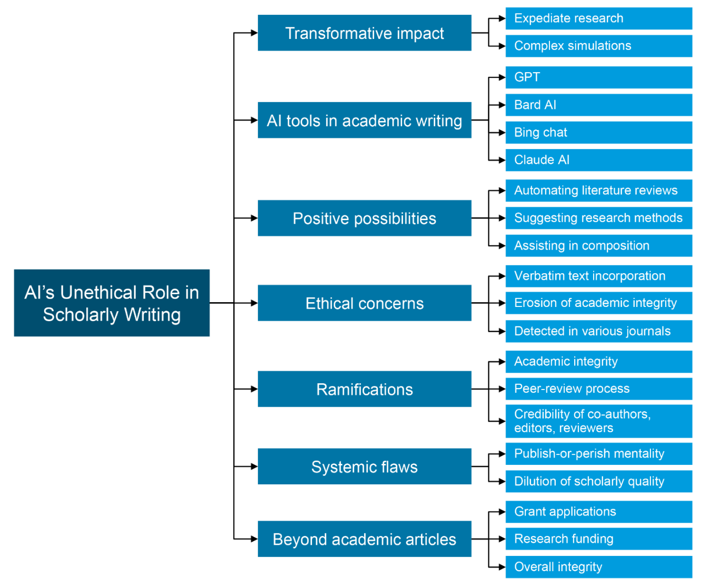
AI’s Unethical Role in Scholarly Writing

Slide 40
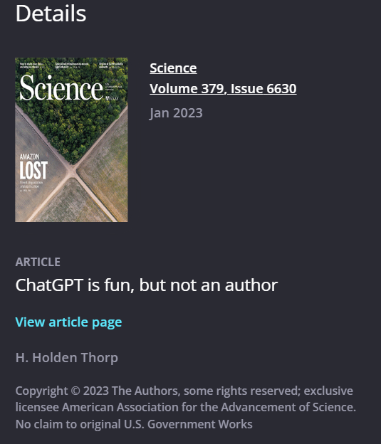
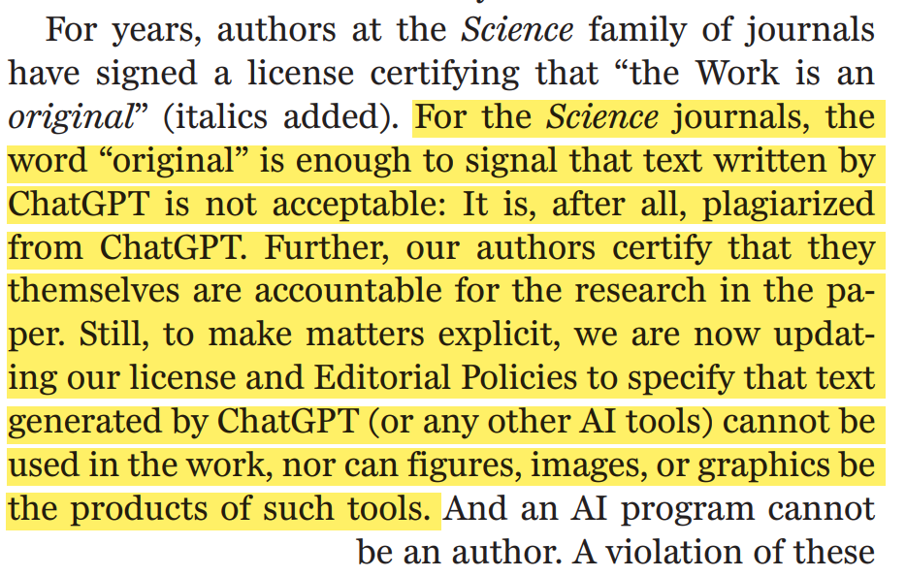
AI tools for Academic Writing
Ethic Problems in Writing with GPT
Controversy over originality
References generated by the AI are fictious
Science announced AI cannot be an author.
Notes:
下一个伦理道德的问题涉及AI生成论文的问题
AI作为一个写作工具，但是其生成的学术文章的原创性和真实性难以保证
Science杂志发布规定 AI不能成为science的作者

Slide 41
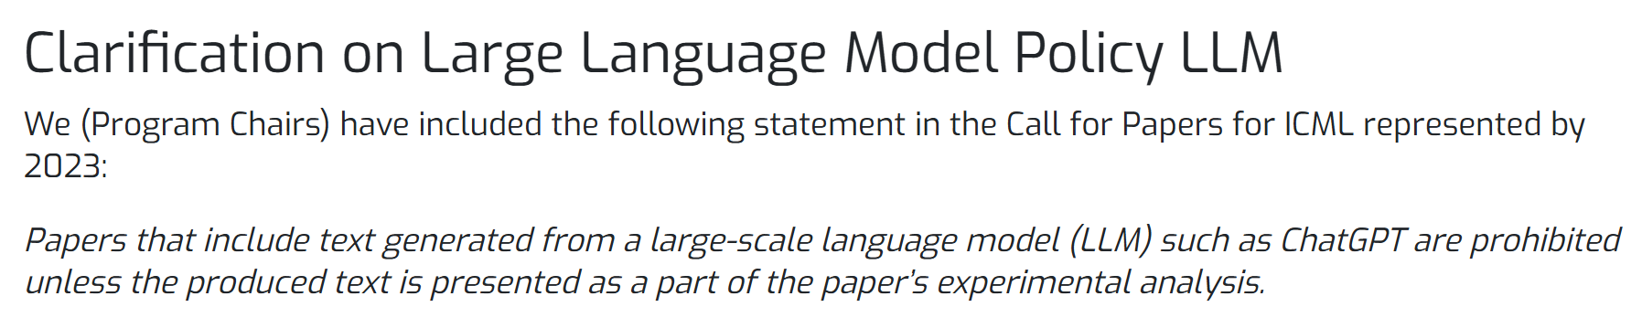
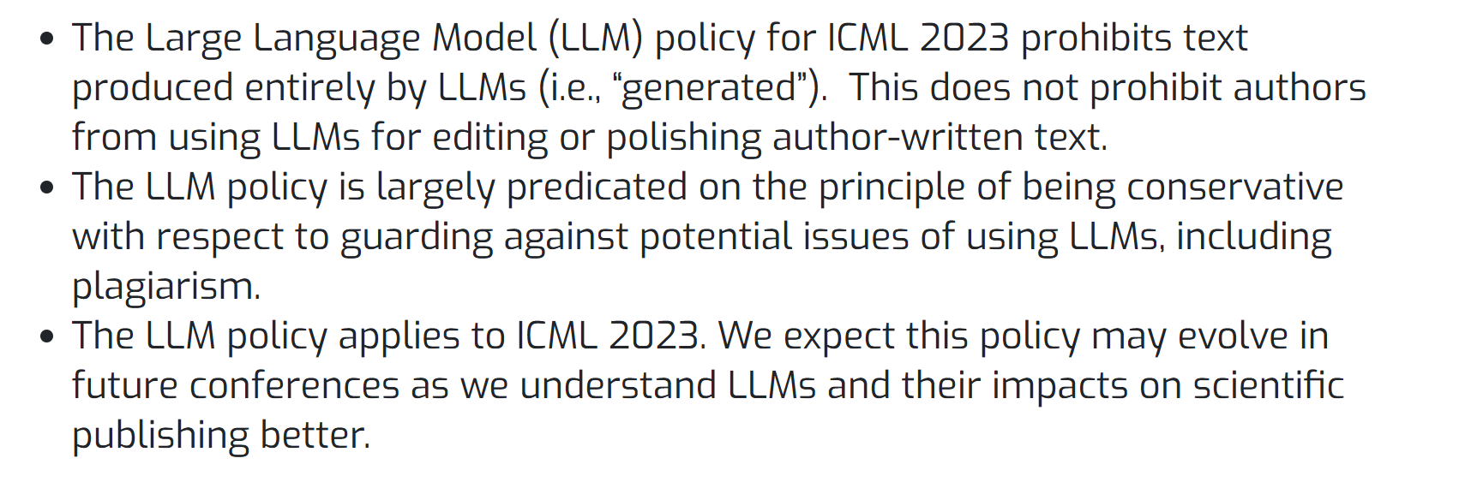
AI tools for Academic Writing
Top AI conference bans use of ChatGPT and AI language tools to write academic papers
Clarification on Large Language Model Policy 2023 (icml.cc)
Notes:
除此之外， AI顶会ICML也在去年发布规定，禁止投稿AI生成的文章

Slide 42
AI tools for Reviewing
Ethic Problems Reviewing with AI tools
Lack of Transparency:undermine trust in the review process
Confidentiality: confidential information could be leaked
Accountability: who is responsible for decisions made?
Ethical Use of AI: AI tools are used to automate decisions
Informed Consent: affect author’s trust in the review process
Quality Control: unreliable assessments and compromise the review process.
Notes:
除此之外 AI审稿也带来了全新的伦理问题
例如评审工具不透明、信息私密性保证、责任分配等问题
当使用AI审稿时，审稿责任的落实难以把握
部分审稿人利用ai审稿可能将导致作者们对期刊/会议审稿过程的质疑
并且AI无法判断稿件是否是一篇高质量论文，因此AI审稿无法控制稿件质量

Slide 43
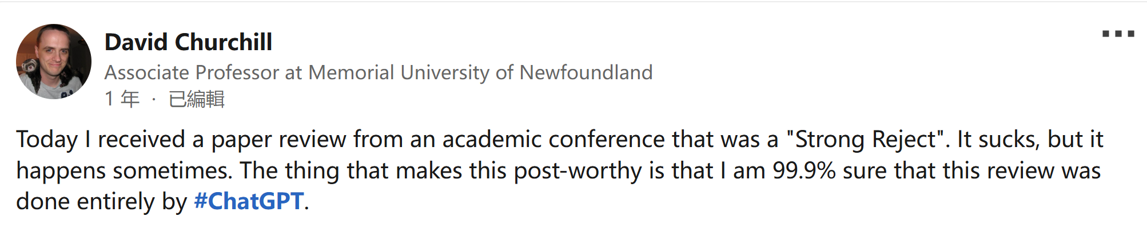
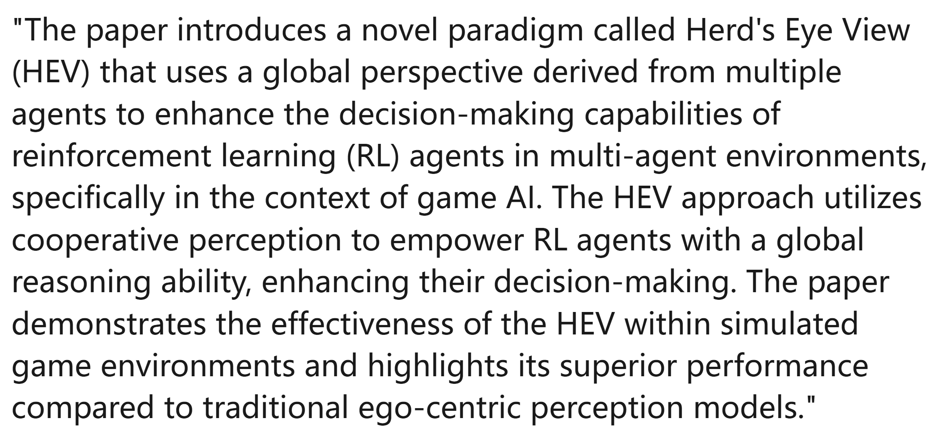
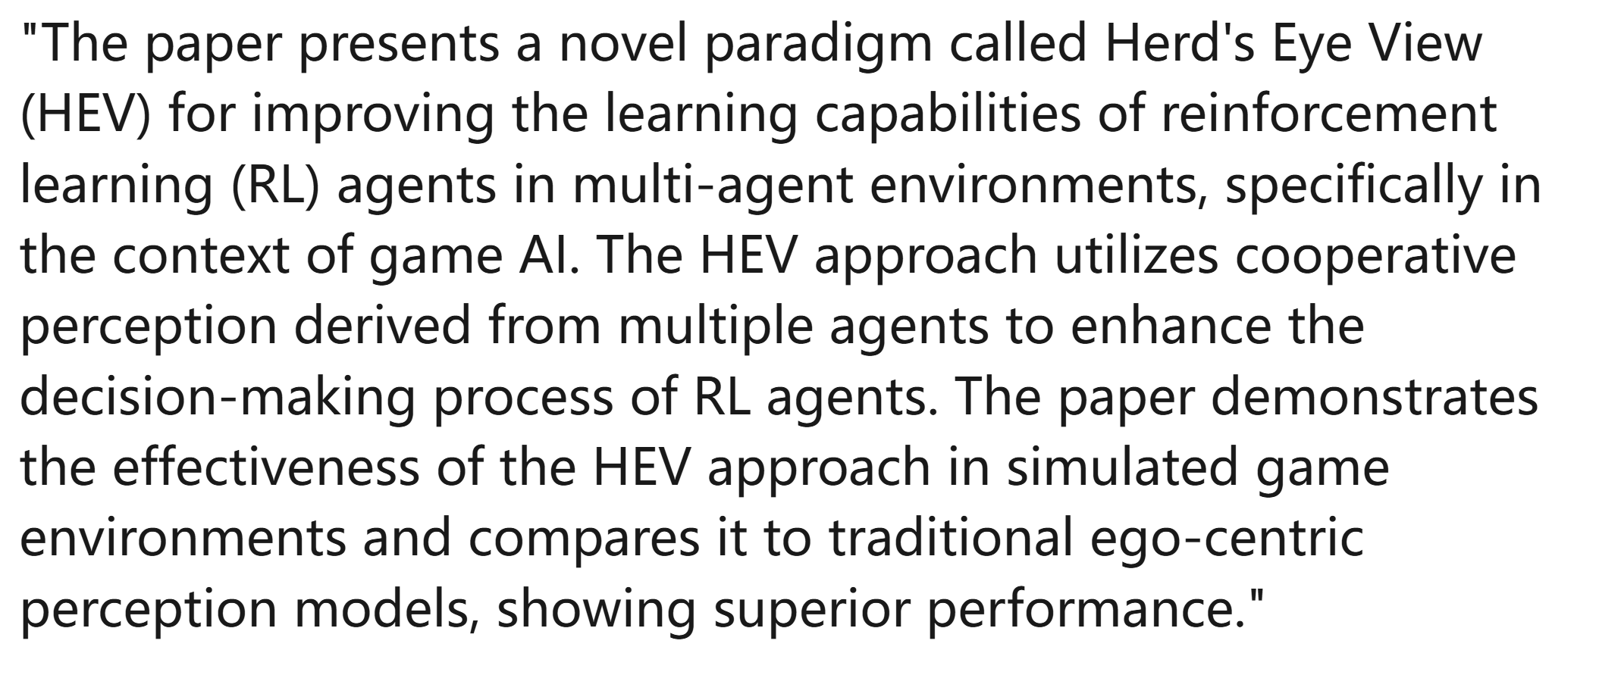
AI tools for Reviewing
Reviewing with AI tools
'paper contributions' section of the review submitted by the reviewer:
get straight out of ChatGPT:
IDENTICAL
https://www.linkedin.com/posts/david-churchill-41171730_chatgpt-activity-7079567258854785025-mlwJ?utm_source=share&utm_medium=member_desktop
Notes:
一年前有一位纽芬兰的学者遭遇拒稿
他将论文传给GPT发现，审稿人给出的意见与GPT生成的完全一致
这对审稿可信度造成打击

Slide 44
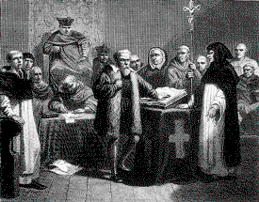
Introduction to Peer-Review
“Peer review is the assessment by an expert of material submitted for publication.”
Publication process
Awarding of funding for research
Patents
Standards
Galileo
Notes:
我们讲完了伦理道德的部分，我们接下来看看同行评议的部分。
同行评审是专家对提交出版的材料进行的评估
它包含了我们科研过程的方方面面，例如 审稿发表的过程
基金项目对你的本子的评审的过程
专利的实质性审查过程
以及标准的评议过程
他有点像伽利略当年接受宗教审批的过程

Slide 45
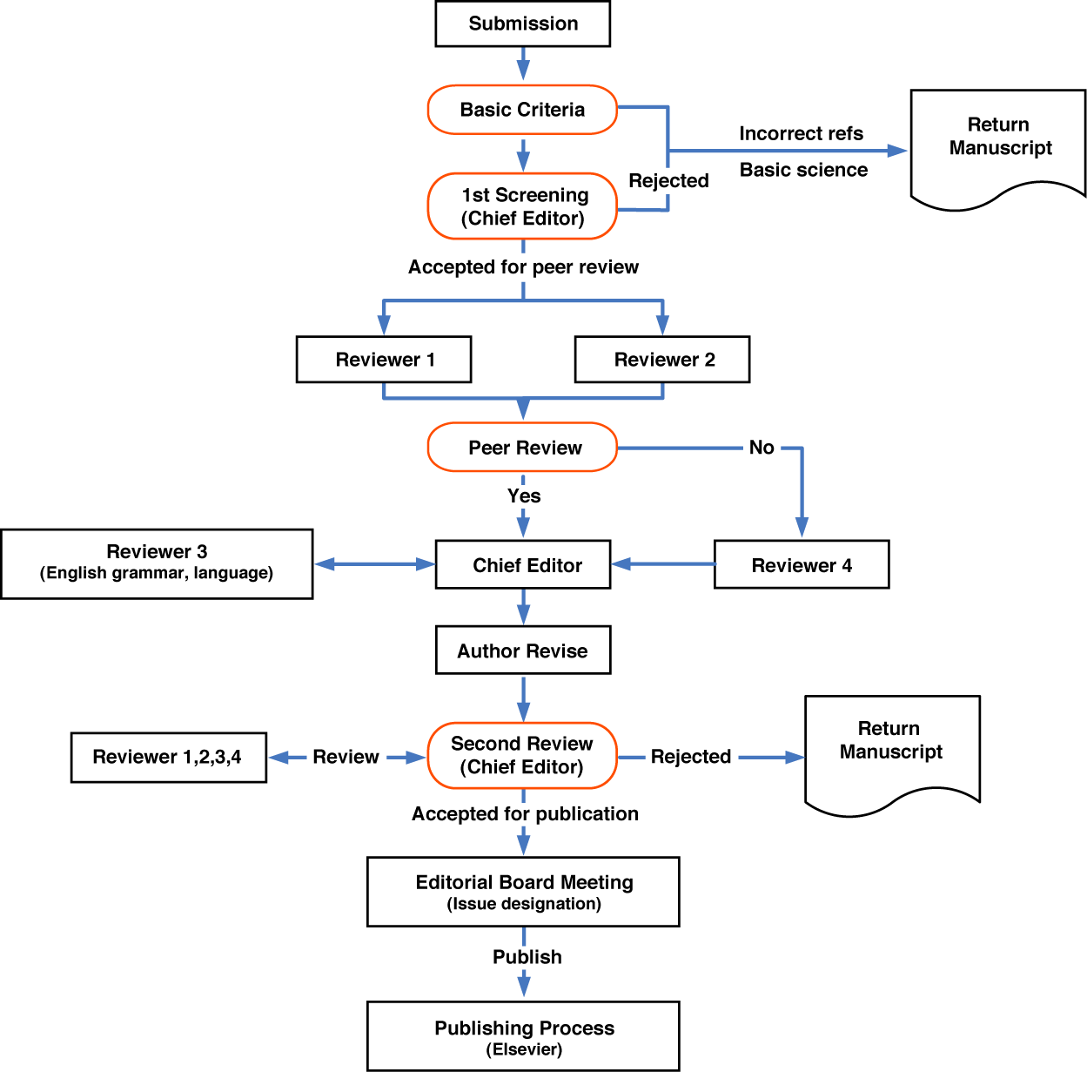

Slide 46
Peer Review: Refereeing (1)
Refereeing can be a chore, but deserves the same effort, care, and ethical standards as any other research activity
Resonsibilities
Author
Referee: fair, objective, avoid conflict of interest
Editor: choose referees, arbitrate based on referees’ evaluation
Notes:
评审可能是一件苦差事，但值得像任何其他研究活动一样付出同样的努力、并且要有同样严格的道德标准
审稿过程是一种责任感的体现
首先，作者要对自己的科研成果负责
然后审稿人，需要公平，客观，并且避免利益冲突。
最后，编辑人：需要选择合适的审稿人，并且根据审稿人的意见进行决定
Responsibilities
When an author completes a paper, it is submitted to the editor of a journal (or
the program chair of a conference) for publication. The editor sends the paper
to referees, who evaluate the paper and return assessments. The editor then
uses these ωsessments to decide whether the paper should be accepted, or, in
the case of a joumal paper, whether further refereeing or revision is required.
Referees should be fair, objective, maintain confidentiality, and avoid conflict
of interest.
The editor's responsibilities are to choose referees appropriately, ensure
that the refereeing is completed promptly and to an adequate standard arbitrate
when the referees' evaluations differ or when the authors argue that a referee'
evaluation is incorrect, and use the reports to decide whether the paper should
be accepted.

Slide 47
Peer Review: Refereeing (2)
Contribution
originality and validity
Evaluation of papers
Is there a contribution? Is it significant?
Is the contribution of interest?
Is the contribution timely or only of historical interest?
Is the topic relevant to the likely readership?
Are the results correct?
Are the proposals and results critically analyzed?
Notes:
那么我们审稿的时候，具体有哪些标准呢？
贡献点的大小：也就是他的原创性和有效性是否是足够
然后，我们的评估就有一下一些关键点
-有贡献吗？重要吗？
-然后是这些贡献是否是有趣的，也就是是否是领域所关注的？
-贡献是否及时还是说，只是在历史上被关注？也就是过时了的
-该主题与可能的读者相关吗？
-结果正确吗？
-技术方法的提出以及实验结果是否经过严格分析？

Slide 48
Refereeing Checklist
Are appropriate conclusions drawn from the results, or are there other possible interpretations?
Are all the technical details correct? Are they sensible?
Could the results be verified?
Are there any serious ambiguities or inconsistencies?
What is missing? What would complete the presentation? Is any of the material unnecessary?
How broad is the likely readership?
Can the paper be understood? Is it clearly written? Is the presentation at an adequate standard?
Notes:
接下来还有其他标准
-从结果中是否得出适当的结论，或者是否有其他可能的解释
-所有技术细节都正确吗？是否是可以被看懂的？
-结果能否得到验证？
-是否存在严重的歧义或不一致之处
-文章是否还缺了什么？怎样才能弥补这些缺失的信息？是否有任何材料是不必要的
-读者的受众面有多广？
-论文能看得懂吗？写得清楚吗？演示是否达到足够的标准？

Slide 49
Referee report (1)
10: Award quality: Technically flawless paper with groundbreaking impact on one or more areas of AI, with exceptionally strong evaluation, reproducibility, and resources, and no unaddressed ethical considerations.
9: Very Strong Accept: Technically flawless paper with groundbreaking impact on at least one area of AI and excellent impact on multiple areas of AI, with flawless evaluation, resources, and reproducibility, and no unaddressed ethical considerations.
8: Strong Accept: Technically strong paper with, with novel ideas, excellent impact on at least one area of AI or high-to-excellent impact on multiple areas of AI, with excellent evaluation, resources, and reproducibility, and no unaddressed ethical considerations.
7: Accept: Technically solid paper, with high impact on at least one sub-area of AI or moderate-to-high impact on more than one area of AI, with good-to-excellent evaluation, resources, reproducibility, and no unaddressed ethical considerations.
6: Weak Accept: Technically solid, moderate-to-high impact paper, with no major concerns with respect to evaluation, resources, reproducibility, ethical considerations.
Notes:
这里，在审稿结束之后，我们通常能拿到一个审稿的报告，对这篇文章的不同维度进行打分。
The explicit purpose is that it is the mechanism used by editors to decide whether papers should be accepted for
publication. The implicit purpose-equa1ly important, and often overlooked is that it is a means of sharing expertise between scientists, via comments for the authors.
Is the case for or against the paper convincing?
Is there adequate guidance for the authors?

Slide 50
Referee report (1)
5: Borderline accept: Technically solid paper where reasons to accept outweigh reasons to reject, e.g., limited evaluation. Please use sparingly.
4: Borderline reject: Technically solid paper where reasons to reject, e.g., limited evaluation, outweigh reasons to accept, e.g., good evaluation. Please use sparingly.
3: Reject: For instance, a paper with technical flaws, weak evaluation, inadequate reproducibility and incompletely addressed ethical considerations.
2: Strong Reject: For instance, a paper with major technical flaws, and/or poor evaluation, limited impact, poor reproducibility and mostly unaddressed ethical considerations.
1: Very Strong Reject: For instance, a paper with trivial results or unaddressed ethical considerations.
Notes:
这里，在审稿结束之后，我们通常能拿到一个审稿的报告，对这篇文章的不同维度进行打分。
The explicit purpose is that it is the mechanism used by editors to decide whether papers should be accepted for
publication. The implicit purpose-equa1ly important, and often overlooked is that it is a means of sharing expertise between scientists, via comments for the authors.
Is the case for or against the paper convincing?
Is there adequate guidance for the authors?

Slide 51
Referee report (1)
Summary of paper
Good things about the paper (one paragraph)
Comments and Recommendations
Notes:
除了定量的打分部分，审稿人的重点，是提供审稿意见。

Slide 52
Referee report (2)
Strong points
This is an excellent analysis of theory and practice in relation to [. . .]. This material shows how practical experience can provide directions for transcending sterile theoretical debates. The article is very well written, logically structured and a pleasure to read. Use of sources is appropriate.
Notes:
This is an excellent analysis of theory and practice in relation to [. . .]. The critique of formulaic positions is well done, as is the discussion of [. . .]. The four responses to the question of [. . .] are astute and serve very well to highlight creative ways of thinking. The second half, on [. . .], is even more stimulating. The role of [. . .] is explained vividly, with informative commentary on issues such as [. . .]. This material shows how practical experience can provide directions for transcending sterile theoretical debates. The article is very well written, logically structured and a pleasure to read. Use of sources is appropriate.
Instead of the last two paragraphs of the article, it would be more helpful to have a separate conclusion section with a summary of the key points made in the article, an assessment of [. . .], and possibly some comments on how insights from this assessment might be used in other parts of the world.

Slide 53
Referee report (3)
Weak points
Instead of the last two paragraphs of the article, it would be more helpful to have a separate conclusion section with a summary of the key points made in the article, an assessment of [. . .], and possibly some comments on how insights from this assessment might be used in other parts of the world.
Notes:
不好的部分是说，。。。对文章中的要点进行总结。然后审稿人会建议如何做来提升整体文章的质量

Slide 54
A refereeing checklist
Convince yourself that it has no serious defects
Convince the editor that it is of an acceptable standard, by explaining why it is original, valid, and clear.
List the changes, major and minor, that should be made before it appears in print, and where possible help the author by indicating not just what to
Notes:
你为了应对严格的审稿人，
首先-说服自己它没有严重的缺陷
-通过解释为什么它是原创的、有效的和清晰的，让编辑相信它符合可接受的标准
-在修改后，明确罗列主要和次要更改，并在可能的情况下通过指示而不仅仅是指出要进行的更改来帮助作者
• Convince yourself that it hωno serious defects.
• Convince the editor that it is of an acceptable standard, by explaining why
it is original, valid, and clear.
• List the changes, major and minor, that should be made before it appears
in print, and where possible help the author by indicating not just what to
change but what to change it to (but if there are excessive numbers of errors
of some kind, you may instead want to give a few examples and recommend
that the paper be proofread).
• Take reasonable care in checking details such as mathematics, formulas，
and the bibliography

Slide 55
Making recommendations
(1) Major results; very significant (fewer than 1 percent of all papers).
(2) Good, solid, interesting work; a definite contribution (fewer than 10 percent).
(3) Minor, but positive, contribution to knowledge (perhaps 10-30 percent).
(4) Elegant and technically correct but useless. This category includes sophisticated analyses of flying pigs.
(5) Neither elegant nor useful, but not actually wrong.
(6) Wrong and misleading.
(7) So badly written that technical evaluation is impossible.
Notes:
那么审稿人是如何做出接收意见的推荐的呢？
这里有7个层次
-一个是非常重要的杰出的贡献，一般有1%左右的文章达到这个水平
-好的、扎实的、有趣的工作；有一定的贡献（低于10%）
-对知识的微小但积极的贡献（大约 10-30%）
-优雅且技术上正确但无用。此类别包括对飞猪的复杂分析。
-既不优雅也不实用，但实际上并没有错
-错误且具有误导性
-写得太差，无法进行技术评估
Referees are usually asked to make a recommendation, for example, 'accept without revision,' 'accept with minor revisions,' 'revise and resubmit,' or 'reject.'

Slide 56
课程考核
3个同学组成一个小组
每组需提交一篇学术论文，论文的选题不限，只要是自己的论文，可以是发表过的，或者是待发表的论文
投稿两阶段：Abstract + Full Paper
每名同学要评审其他小组的论文,并给出评审意见
会议投稿： http://sccse.nlsde.buaa.edu.cn

Slide 57
课程考核
课程的最后，我们将安排一次模拟的学术会议,包括two sessions
Regular paper session
Poster session
每个小组要做一个15-20分钟的论文报告
每个小组需要准备一个Poster
最后的成绩由课程考勤和模拟的会议的表现决定

Slide 58
Assignment 1
Divide into groups (?)
Choose a paper from your research area and write a brief answer to each of the following questions.
(a) What are the researchers trying to find out?
(b) Why is the research important?
(c) What things were measured?
(d) What were the results?
(e) What do the authors conclude and to what factors do they attribute
their findings?
(f) Can you accept the findings as true? Discuss any failings or shortcomings of the method used to support the findings.

Slide 59
Assignment 1
Read papers by asking questions of them, such as:
What is the main result?
How precise are the claims?
How could the outcomes be used?
What’s the evidence?
How was the evidence gathered?
How were measurements taken?
How carefully are the algorithms and experiments described?
Why is the paper trustworthy?
Has the right background literature been discussed?
What would reproduction of the results involve?

